Slide 1



——— pipeline system

Slide 2

1
The importance of a fresh air pipeline system.
2
Introduction to BlauFast pipeline systems
目录
CONTENTS
The Blaufast pipeline systems provide systematic solutions
3
CONTENTS
A comparative summary of BlauFast pipeline systems
4

Slide 3
The Importance of the
BlauFast Pipeline System
Part One

Slide 4
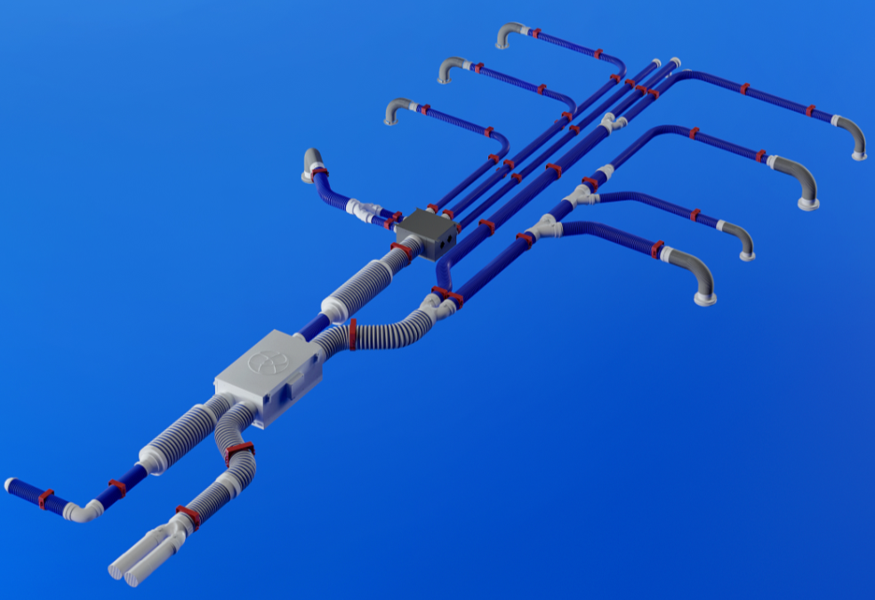
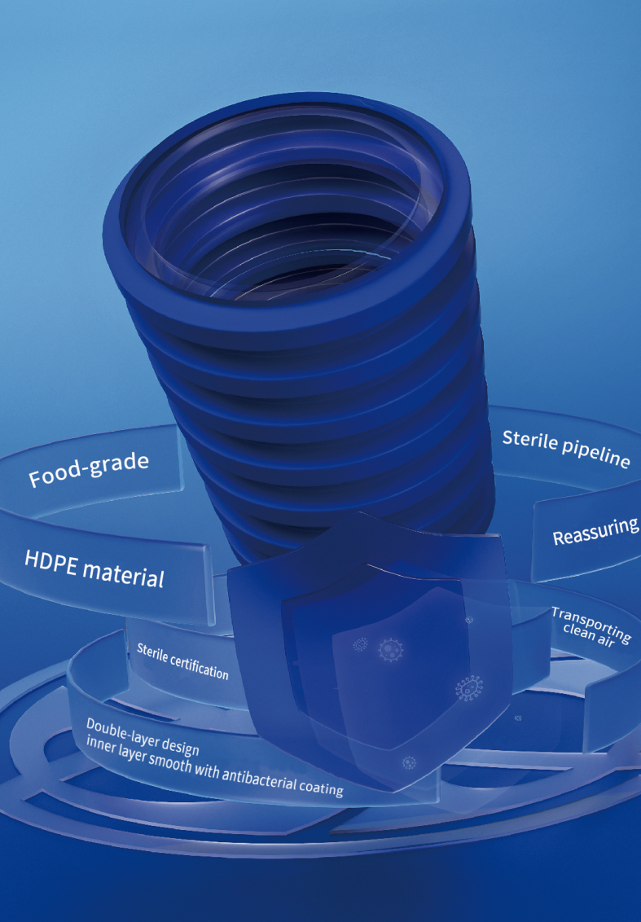
1
The all-new BlauFast pipeline system

Slide 5
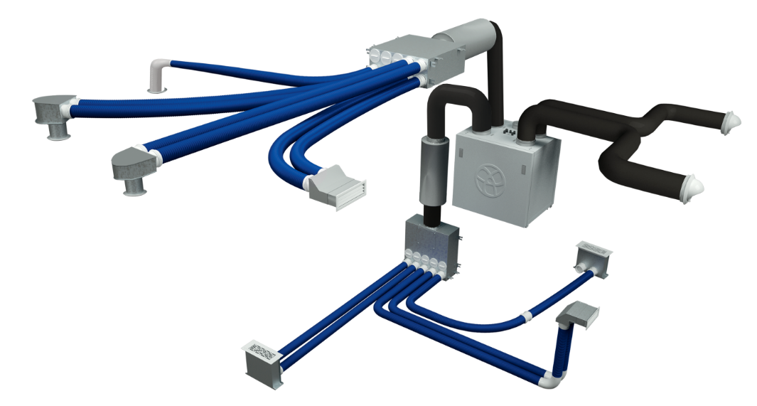
1.1
The importance of pipeline systems for ventilation systems
Unlike traditional PVC pipeline systems in China, Blauberg introduced the Blaufast pipeline (made from food-grade HDPE material) to the Chinese market in 2016. This initiative has driven the advancement of the entire industry, bringing Europe's most advanced BlauFast pipeline system into Chinese homes.
Due to significant differences between European and domestic Chinese architecture, the installation of ventilation systems has encountered challenges. In response, Blauberg from Germany has focused extensively on the overall upgrade of the BlauFast pipeline system. They not only ensure excellence in individual components within the pipeline system but also strive to provide customers with comprehensive solutions for ventilation systems as a whole.

Slide 6
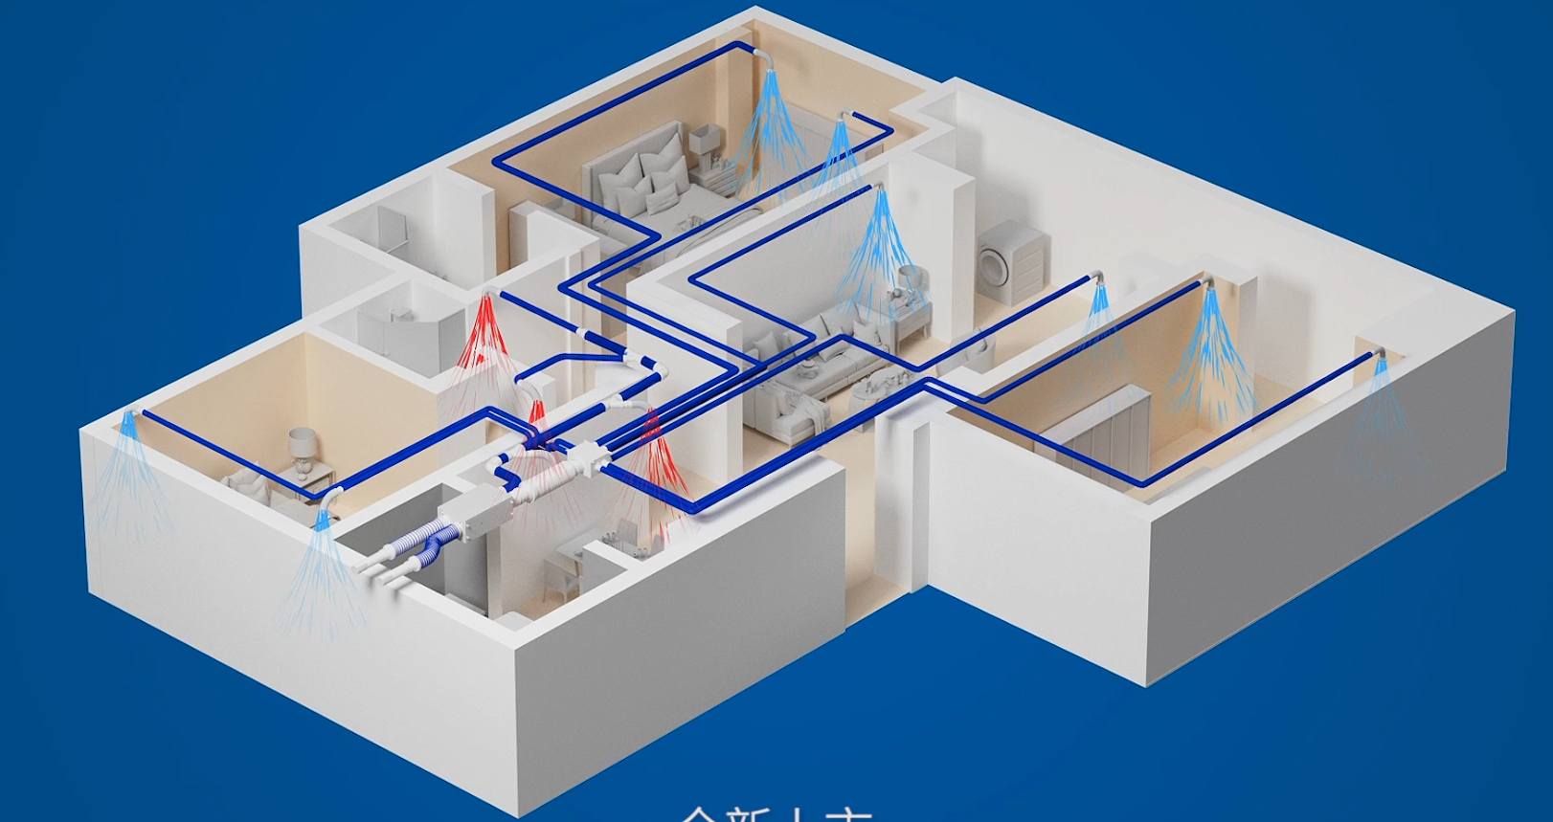
1.1
The importance of pipeline systems for ventilation systems
The fresh air system, heating system, and water-cooled air conditioning system have certain similarities:
These systems are all comprised of two essential components: equipment and pipeline systems. In the HVAC profession, there is a discipline called Fluid Distribution Networks, which studies how pipeline systems are used to optimize the performance and stability of the entire HVAC system.
Therefore, for the fresh air system, the pipeline system is crucial. The importance of the pipeline system is not only reflected in the quality of materials but also in its compatibility with the main equipment. A well-designed pipeline system can fully leverage the performance of the equipment.
The fresh air unit determines the upper limit of performance, while the pipeline system determines the lower limit of performance for the fresh air system.

Slide 7
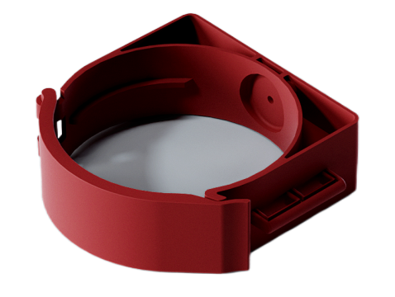
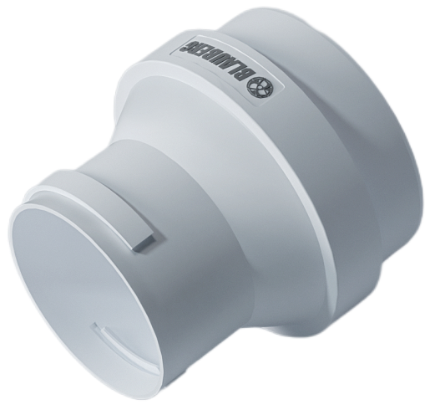
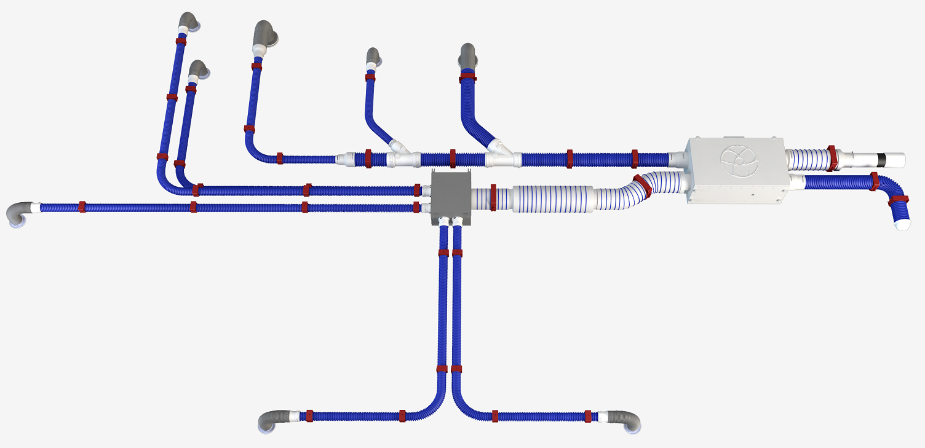
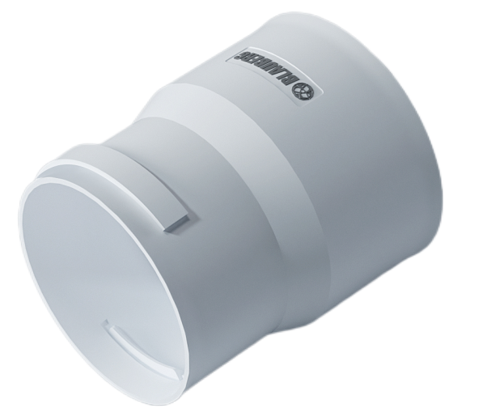
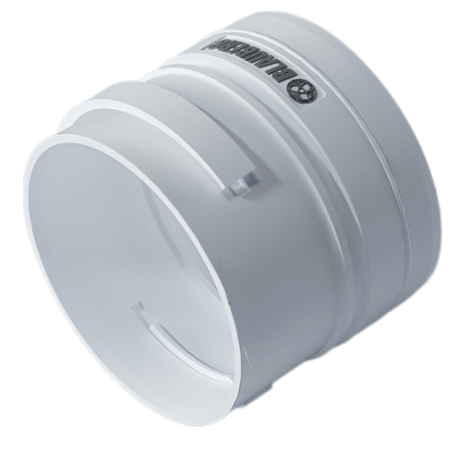
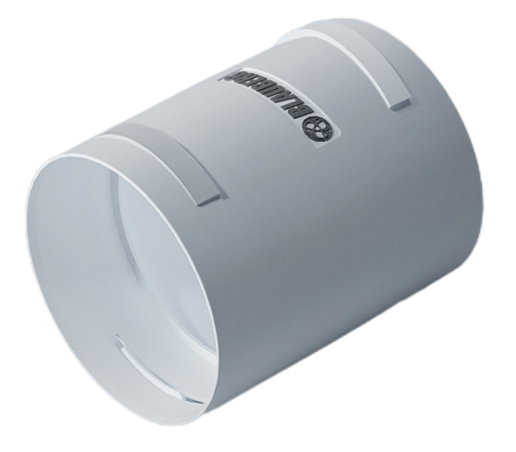
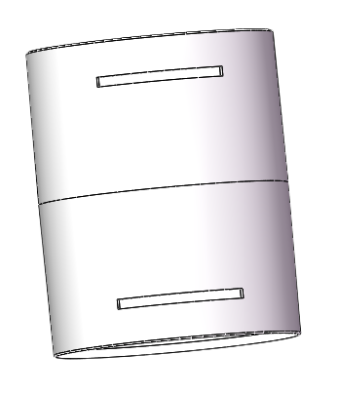
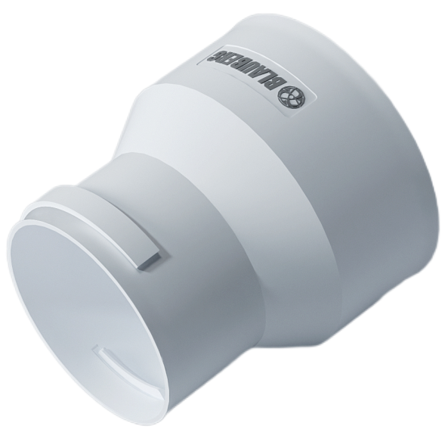
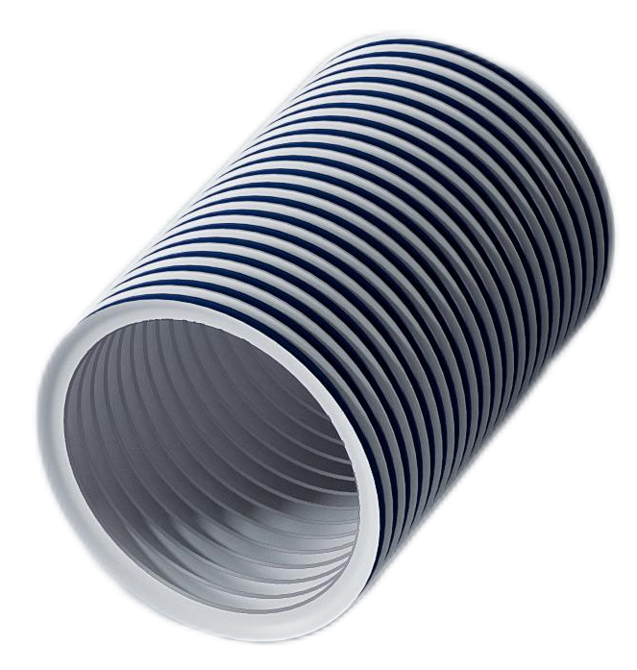
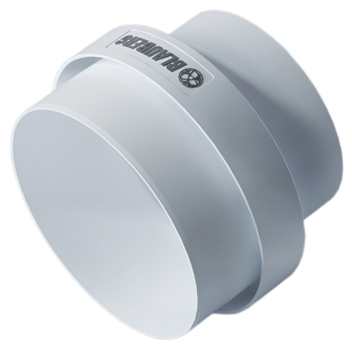
Demonstration of Ultra/ME units using the BlauFast pipeline system.
Round pipe clamp
BlauFast RPC 110 C
Round pipe flange diameter change
BlauFast RE 150-110 C
Flange diameter change
BlauFast RF 125-110 C
Round pipe flange diameter change
BlauFast RE 75-63 C
Round pipe connectors
BlauFast RM 110 C
Round pipe clamp
BlauFast RPC 75 C
Round pipe flange diameter change
BlauFast RE 110-75 C
Blaufast tube
BlauFast RBK 150/3 C
Round pipe clamp
BlauFast RPC 150 C
Flange diameter change
BlauFast RF 125-150 C

Slide 8
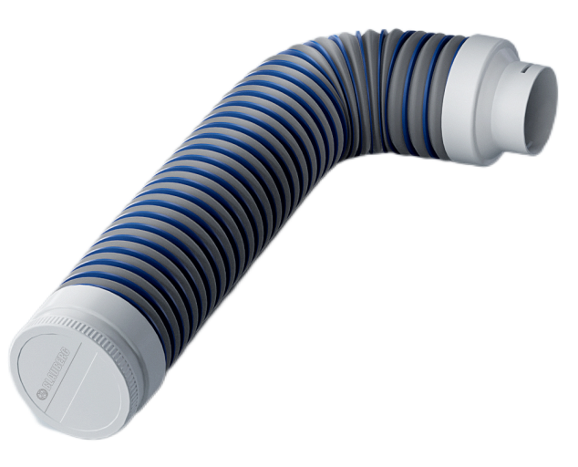
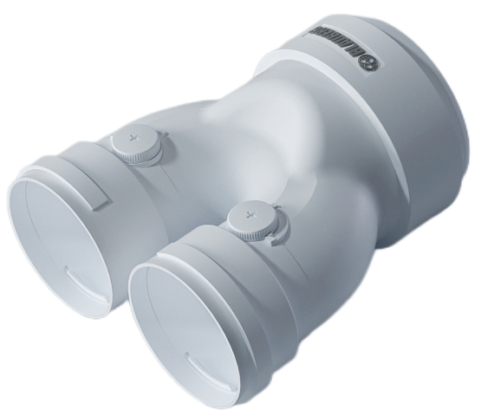
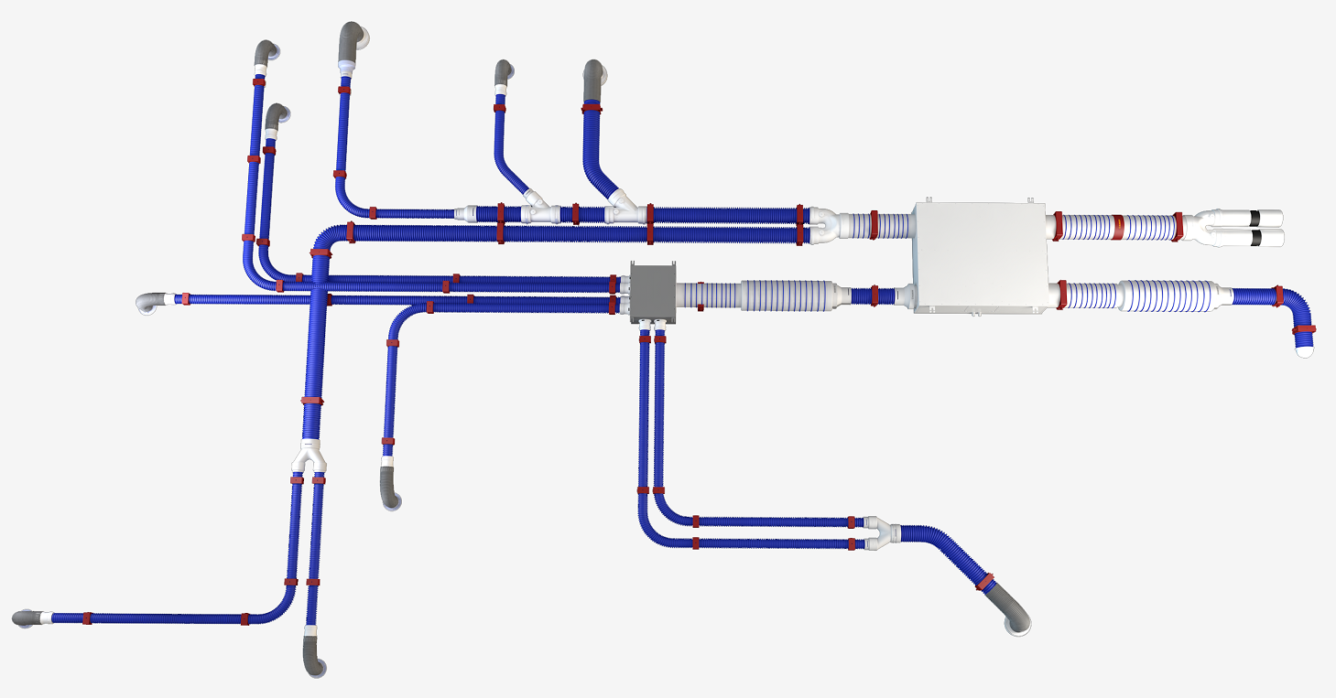
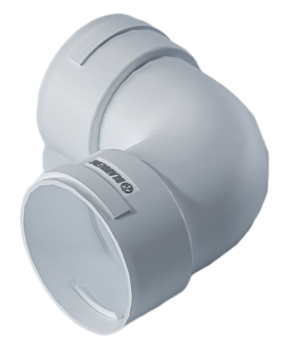
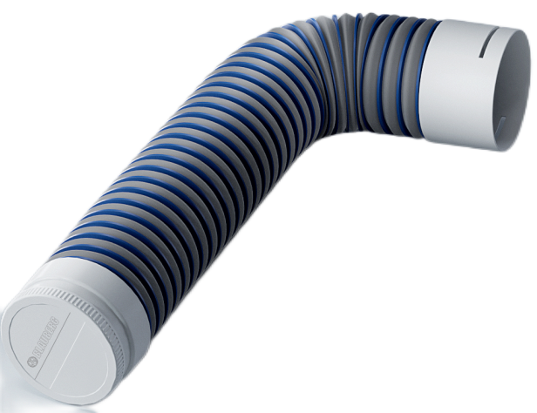
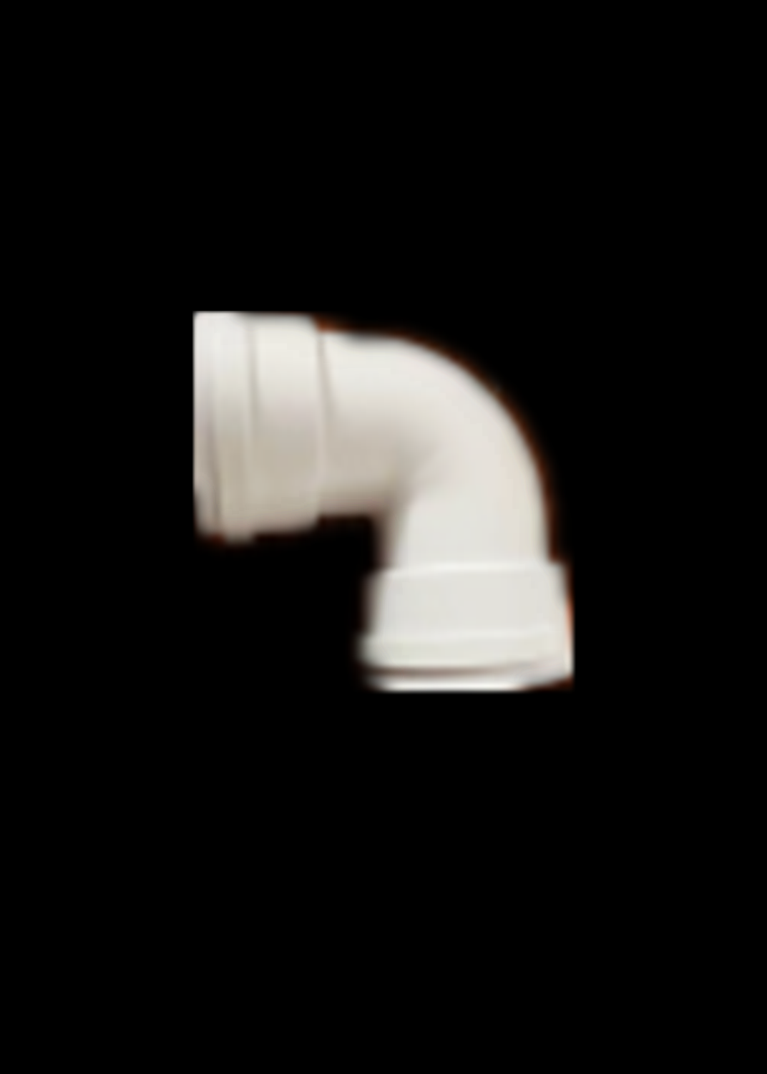
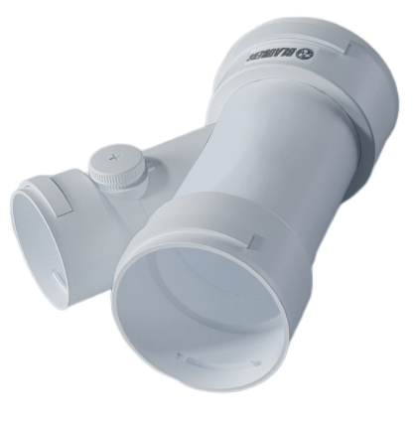
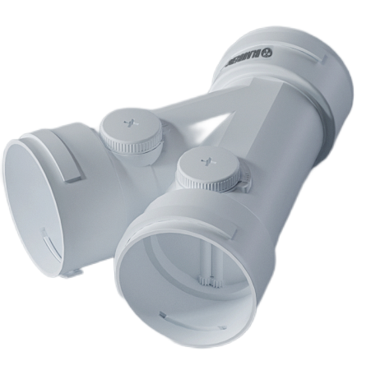
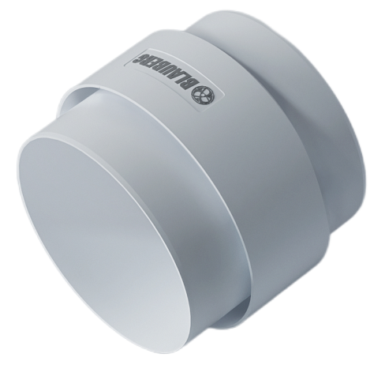
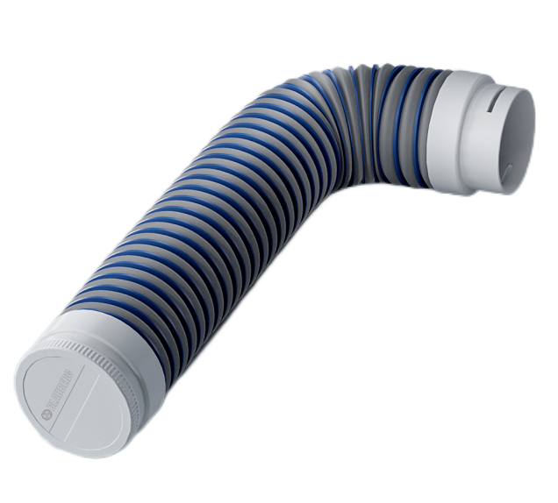
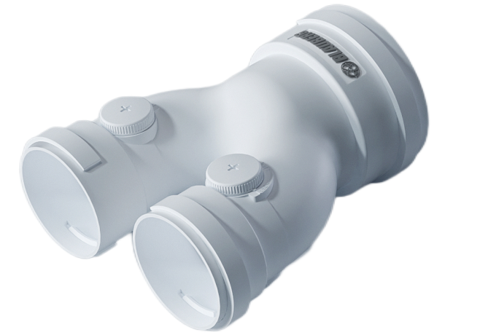
Demonstration of ERV/DOF/DTF units using the BlauFast pipeline system.
Air outlet connector
BlauFast RPZ 75/100 C
Y-shaped three-way (with valve)
BlauFast RYT 150/110*2 C
Round pipe connectors
BlauFast RB 110 C
Air outlet connector
BlauFast RPZ 110/100 C
Diagonal three-way (with valve)
BlauFast RXT 110/110/110 C
Diagonal three-way (with valve)
BlauFast RXT 110/110/75 C
Round pipe connectors
BlauFast RM 150 C
Flange diameter change
BlauFast RF 150-110 C
Air outlet connector
BlauFast RPZ 75/80 C
Y-shaped three-way (with valve)
BlauFast RYT 110/75*2 C

Slide 9
Part Two
The BlauFast pipeline
system accessories

Slide 10
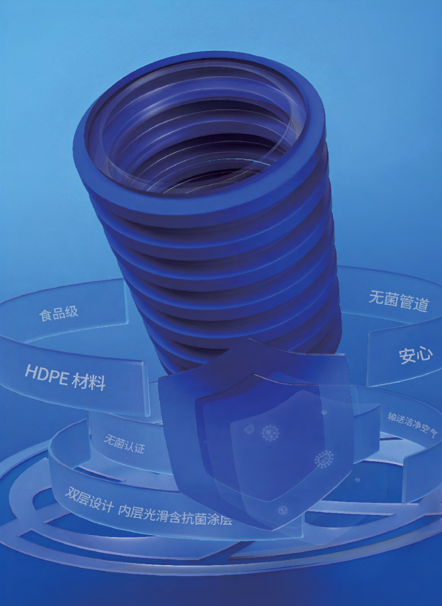
2.1
The BlauFast pipeline system
Imported Blaufast pipeline — double-layer flexible corrugated hose
Material：HDPE
Specifications and models：BlauFast RK 63/50
BlauFast RK 75/50
Color：Blauberg Classic Blue
Bending radius：The bending radius is φ63-130mm/φ75-150mm. During pipeline layout, it's possible to avoid using elbows, which are high-resistance fittings, effectively reducing system resistance；
Pressure resistance level：8 kN/m², effectively prevents unintended damage to the pipeline in complex installation environments
low friction resistance：When the airflow inside the pipeline is 40 m³/h, the pipeline resistance is 1.6 to 2.2 Pa, effectively extending the maximum length of the fresh air pipeline and reducing airflow noise within the pipeline.
Performance：RECH,HY,RoHS,Antimicrobial properties, antimicrobial durability, mold resistance, antistatic properties, weather resistance
Imported Blaufast pipeline

Slide 11
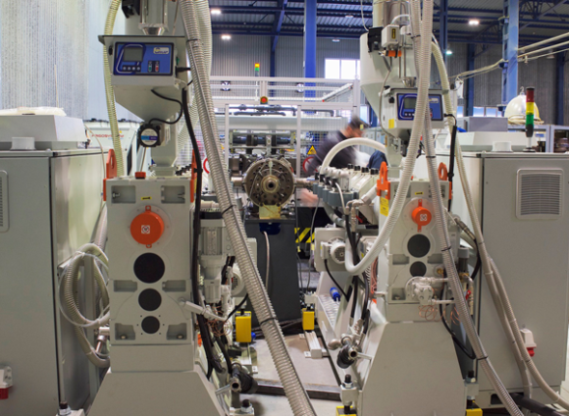
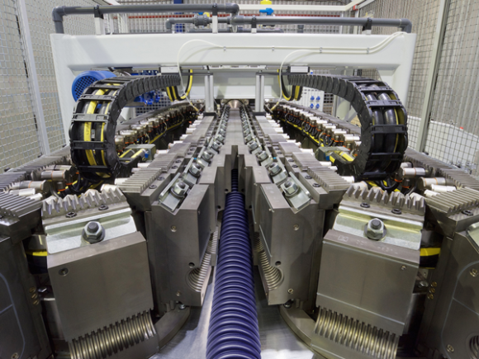
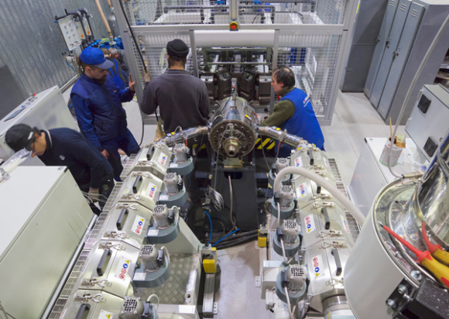
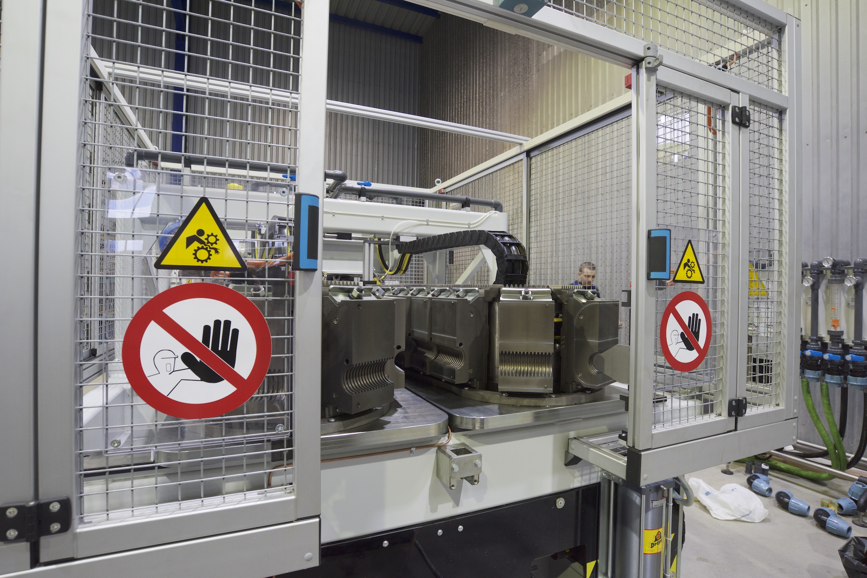
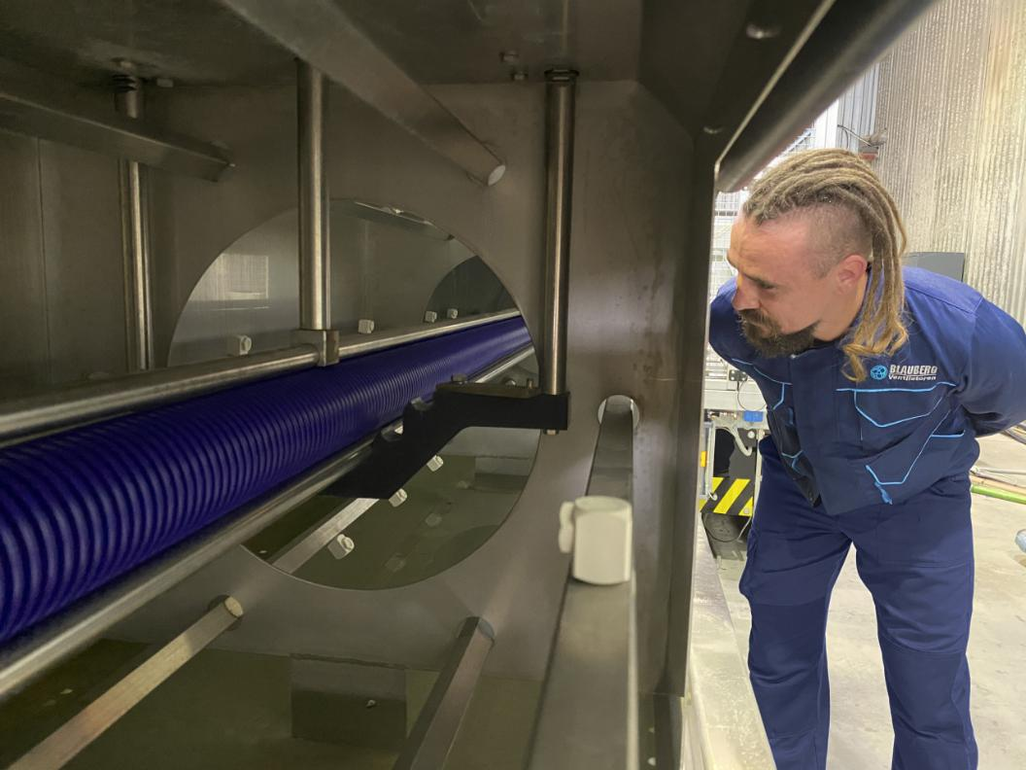
2.1
The BlauFast pipeline system
European production line
German Industry 4.0
Clean and orderly production line
fully mechanized production
Notes:
德国工业4.0 产线整洁有序 全机械化生产

Slide 12
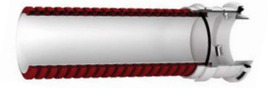
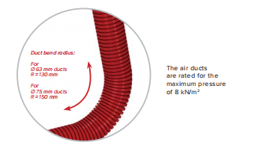
Blaufast made in China
2.1
The BlauFast pipeline system
Blaufast made in China——double-layer flexible corrugated hose
Material：HDPE
Specifications and models：
BlauFast RK 63/50 C Burgundy
BlauFast RK 75/50 C Burgundy
BlauFast RK 110/40 C Blauberg Classic Blue
BlauFast RK 110/40-1 C Burgundy
Bending radius：φ63-130mm/φ75-150mm/φ110-145mm allows for pipeline layout without the need for elbows, which are high-resistance fittings, effectively reducing system resistance；
Pressure resistance level：8 kN/m² withstands complex installation environments effectively preventing unintended damage to the pipeline.
Low friction resistance:
- For φ63/φ75 pipelines with an airflow of 40 m³/h, the pipeline resistance is 1.6~2.2 Pa.
- For φ110 pipelines with an airflow of 100 m³/h, the pipeline resistance is 2 Pa.
This effectively extends the maximum length of fresh air pipelines and reduces airflow noise within the pipeline.
performance：RoHS,Antimicrobial properties, antimicrobial durability, mold resistance, antistatic properties, weather resistance
Blaufast made in China
  Raw material suppliers：LG Chem (China)
LG Chem is a Fortune 500 company and one of the top ten global companies in the chemical industry. It has been operating in China for nearly 40 years, primarily focusing on petrochemicals, information electronic materials, and batteries. Bolle imports Blau pipeline materials from LG Chem, ensuring that domestic pipelines continue to rely on LG Chem as a supplier for reliable pipeline quality.

Slide 13
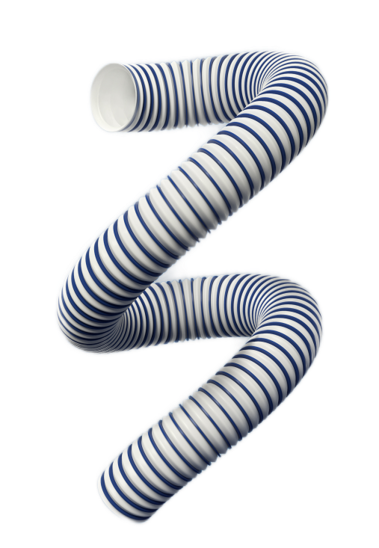
2.1
The BlauFast pipeline system
Bruck tube ——Flexible main pipeline
Introduction：The outer ring of the pipeline continues the classic Bolle Blue color, while the body utilizes an innovative material different from existing market options: thermoplastic elastomer TPV (commonly used in high-end automotive industry and road and bridge expansion joints). This choice results in a smooth inner surface, making the pipeline softer and more flexible with enhanced elasticity.
Specifications and models：BlauFast RBK 150/3 C, with an inner diameter of φ150mm and a length of 3 meters per piece
Bending radius：145mm
High and low temperature resistance：-40℃~70℃
Connection and fixing methods：Throat clamps
Applications：Used as the main duct in fresh air systems
Performance：RoHS, Antimicrobial properties, antimicrobial durability, mold resistance, antistatic properties, weather resistance
Booker tube

Slide 14
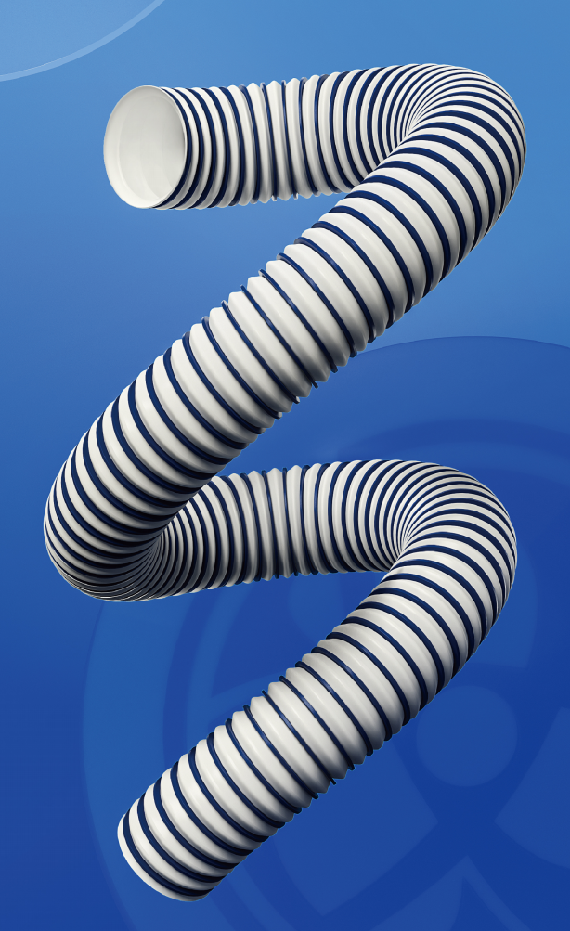
2.1
The BlauFast pipeline system
Advantages of Blaufast pipeline and Bruck tube include
Pipeline | Place of origin | Material | Certifications and performance
Imported Blaufast pipeline | European | HDPE | RECH, HY, RoHS, antimicrobial properties, antimicrobial durability, mold resistance, antistatic properties, weather resistance, extremely low leakage rate
Blaufast made in China | China | HDPE | RoHS,antimicrobial properties, antimicrobial durability, mold resistance, antistatic properties, weather resistance, extremely low leakage rate
Booker tube | China | TPV+PP | RoHS,antimicrobial properties, antimicrobial durability, mold resistance, antistatic properties, weather resistance, extremely low leakage rate
Pipeline performance
HY antimicrobial test strains：Aspergillus niger, Penicillium funiculosum, Penicillium chrysogenum, Trichoderma viride, and Fusarium solani
Antimicrobial test strains：Escherichia coli, Staphylococcus aureus
Mold resistance test strains：Aspergillus niger, Penicillium funiculosum, Trichoderma viride, Candida albicans, and Fusarium solani
Antimicrobial durability estimation：15 years
Weather resistance：-40℃~70℃
Leakage class：D ( BS EN 1507:2006 for strength and leakage requirements of rectangular thin metal ducts in buildings), leakage not exceeding 0.5%.

Slide 15
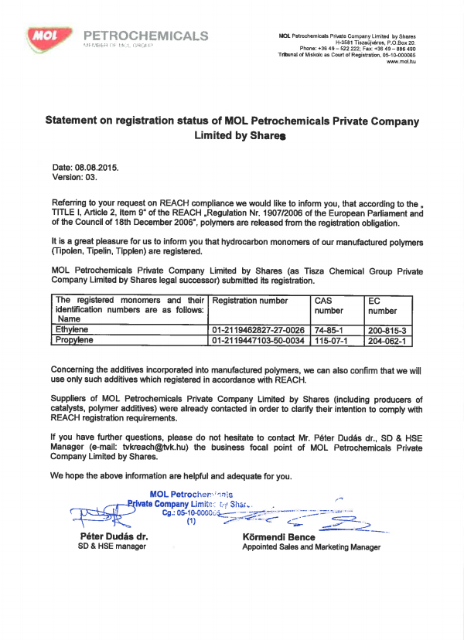


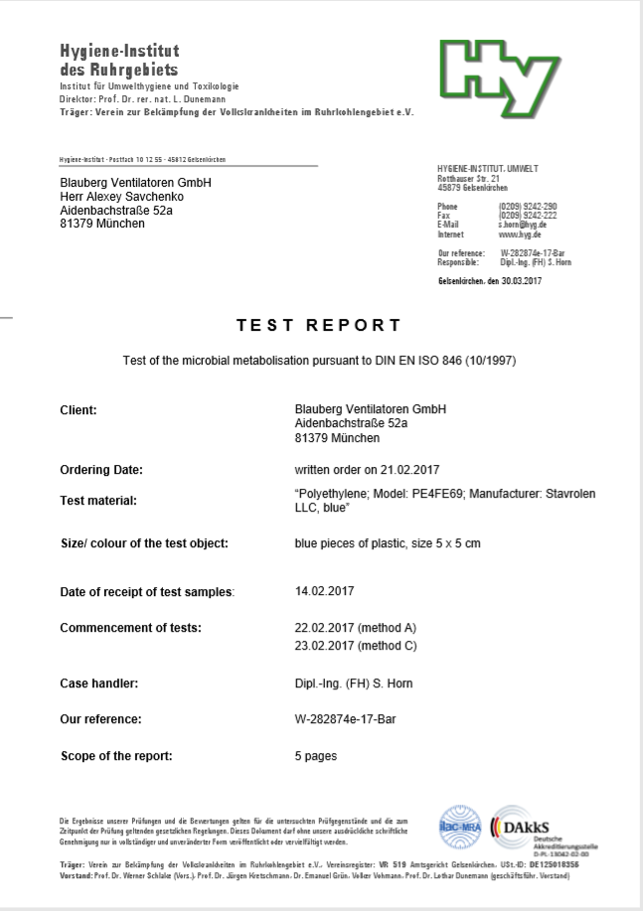

2.2
The BlauFast pipeline system has certifications according to regulations
REACH EU Regulation Certification
“Registration，Evaluation， Authorization and Restriction oF Chemicals，The European Union's Regulation concerning the Registration, Evaluation, Authorization and Restriction of Chemicals (REACH) is a comprehensive legislation aimed at the preventive management of all chemicals entering the EU market. In comparison to recent directives implemented by the EU, REACH has a broader scope of influence. It encompasses approximately 30,000 chemical substances and their downstream products in sectors such as textiles, light industry, and pharmaceuticals. These substances are subject to registration, evaluation, and authorization under three regulatory systems. Products not included in these management systems cannot be sold in the EU market.
LG Chem
Pipeline certification
HY German health standard certification
The HY hygiene standard certification from Germany is conducted by a specialized research institution dedicated to environmental hygiene and virology, and it is one of the largest and most modern institutions in its field in Europe.
Tested Material:HDPE (PE4FE69)
Tested Parameters:The material elements are cultured in Petri dishes to determine if there is any risk of infection from bacteria and fungi, and whether there is any risk of infection to humans.
Testing Standard:** DIN EN ISO 846
After the cultured testing, it was observed under a microscope that there was no significant growth of bacteria and fungi on the material, indicating that the material does not contain nutrients for microbial growth, and it complies with the requirements of DIN EN ISO 846 standard.
MOL Group from Hungary

Slide 16
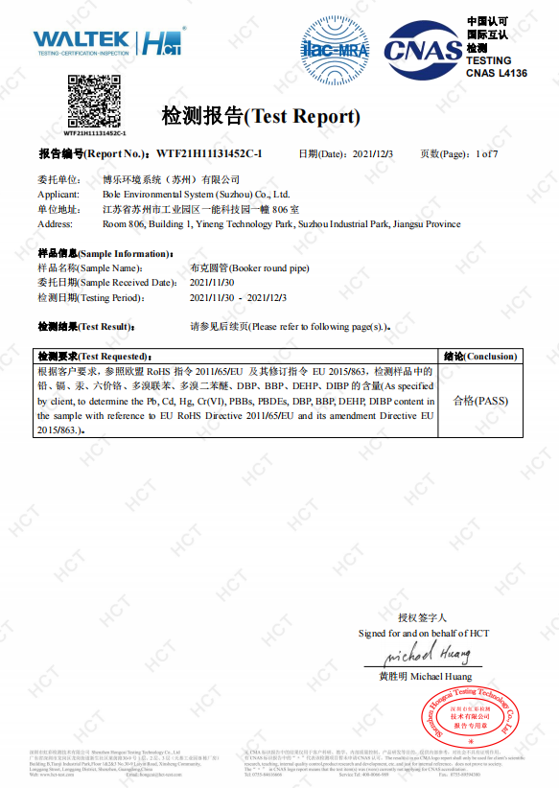
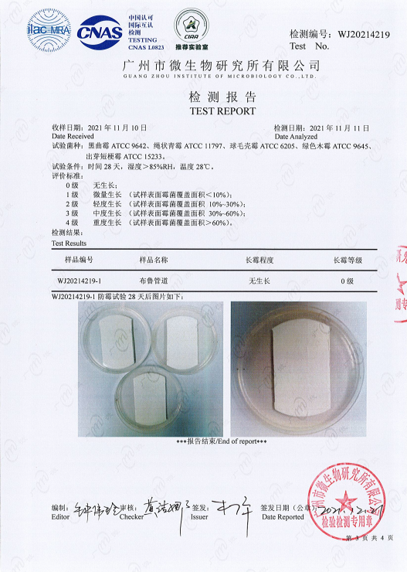
2.2
The BlauFast pipeline system has certifications according to regulations
RoHS certification
RoHS is a mandatory standard established by legislation in the European Union. Its full name is the "Directive on the Restriction of the Use of Certain Hazardous Substances in Electrical and Electronic Equipment". The standard was officially implemented on July 1, 2006, and it primarily regulates the material and process standards of electrical and electronic products to enhance human health and environmental protection.
The purpose of RoHS is to eliminate six hazardous substances from electrical and electronic products: lead, mercury, cadmium, hexavalent chromium, polybrominated biphenyls (PBB), and polybrominated diphenyl ethers (PBDE). The standard specifically limits the concentration of cadmium to not more than 0.01%.
Pipeline performance
Mold resistance certification
Testing standard: ASTM G 21-2015, Determining Resistance of Synthetic Polymeric Materials to Fungi
Mold resistance grade: Grade 0
There are five levels of mold resistance: Grade 0, Grade 1, Grade 2, Grade 3, and Grade 4. Grade 0 is the highest level, indicating that upon testing, the sample showed no growth (neither spore forming nor non-spore forming).

Slide 17
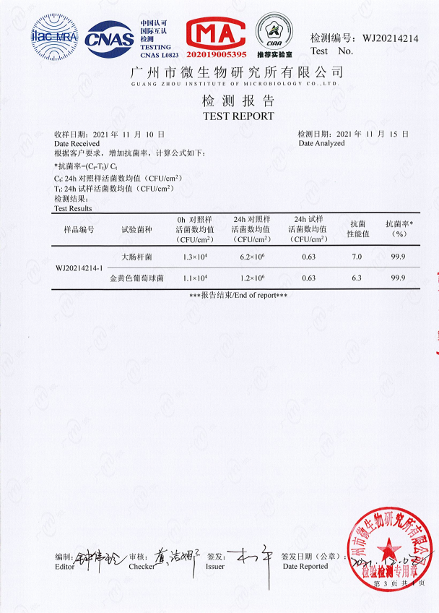
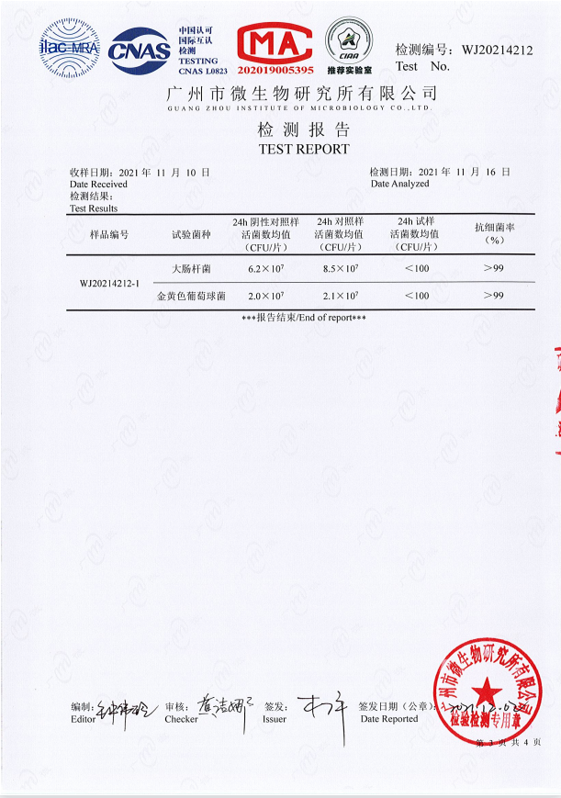
2.2
The BlauFast pipeline system has certifications according to regulations
Antimicrobial certification
Testing standard: GB/T 31402-2015, Test method for antimicrobial activity on plastics
Antimicrobial efficacy: 99.9%
According to the national standard, products with an antimicrobial efficacy exceeding 90% exhibit antimicrobial properties. Products with an antimicrobial efficacy exceeding 99% are considered to have strong antimicrobial effects.
Pipeline performance
Antimicrobial durability certification
Testing standard: JCT 939-2004, Antibacterial performance of antibacterial plastic pipes for construction
Antimicrobial efficacy: Greater than 99%
The antimicrobial efficacy of products diminishes over time, indicating a time-sensitive nature of antimicrobial properties. Antimicrobial durability certification evaluates the longevity of antimicrobial effectiveness.
Durability testing involves immersing the product in hot water for 24 hours to accelerate the dissipation of antimicrobial properties, followed by antimicrobial efficacy testing. This report can indirectly estimate that Bolle pipeline products maintain antimicrobial efficacy for up to 15 years.

Slide 18
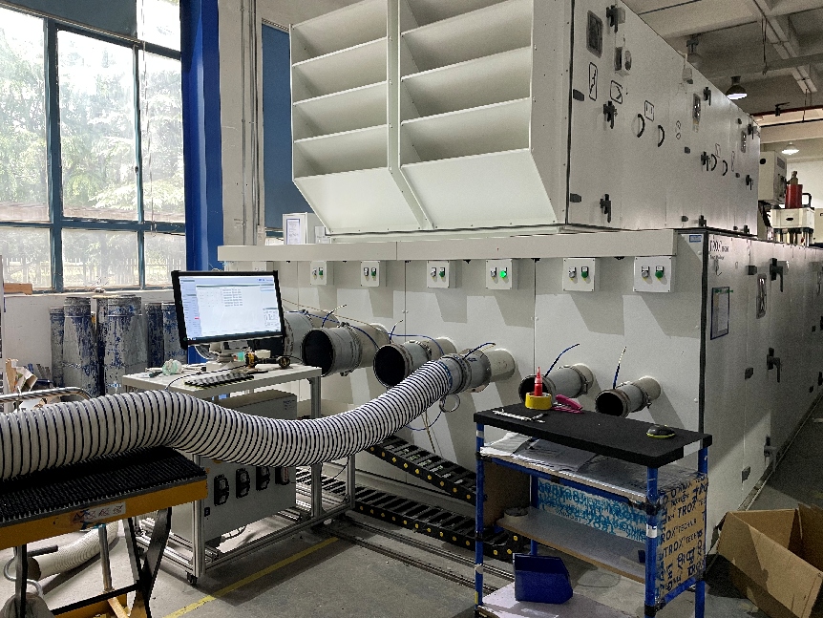
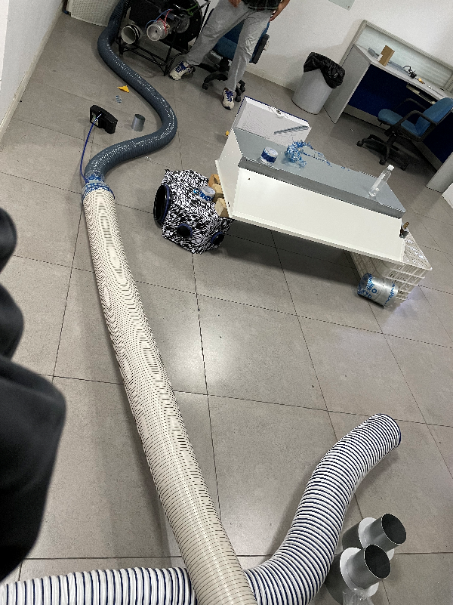
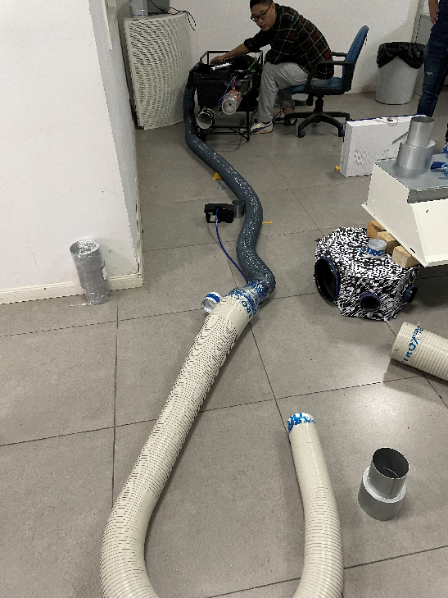
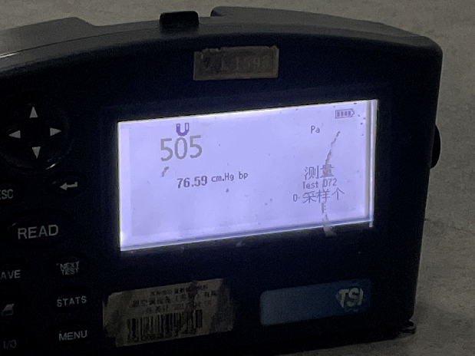
2.2
The BlauFast pipeline system has Significant sealing capability
Test site
Universal joint
bending test
Leakage rate
testing instrument
Bruck tube in the wind tunnel test stand
Universal joint
straightening test

Slide 19
2.2
The BlauFast pipeline system has Significant sealing capability
Main duct airflow leakage testing
 | φ110 universal joint leakage air volume (500Pa low pressure air duct standard) | φ180 universal joint leakage airflow (500Pa low pressure air duct standard) | Booker tube leakage airflow (500Pa low pressure air duct standard)
Pipeline straightening | 16m³/h | 12m³/h | 1m³/h
Pipeline bending | 31m³/h | 21m³/h | 1m³/h
Leakage rate (500 m³/h) | 6.2% | 4.2% | 0%
Test data
Testing standard: GB 50243-2016 "Code for acceptance of construction quality of ventilation and air conditioning engineering"
Observations during testing:
1. The larger the bend of the universal joint air duct, the more severe the air leakage.
2. Universal joint air ducts should not be compressed; even slight compression can lead to significant air leakage.

Slide 20
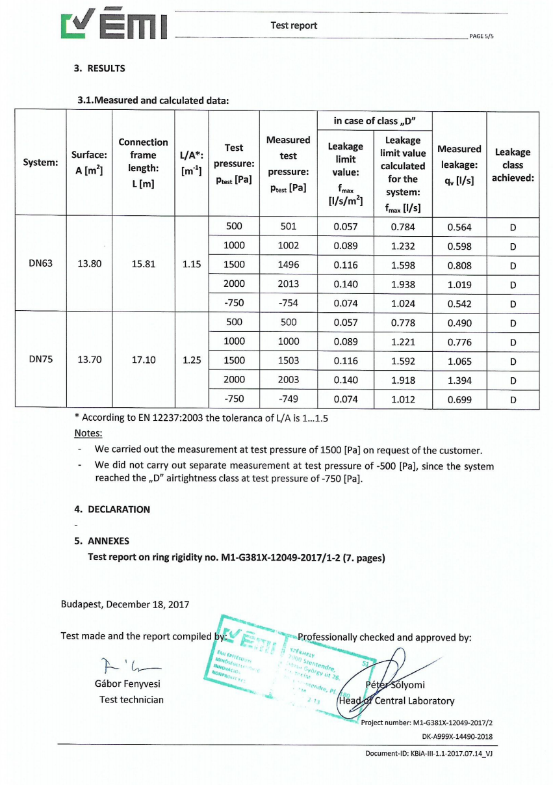
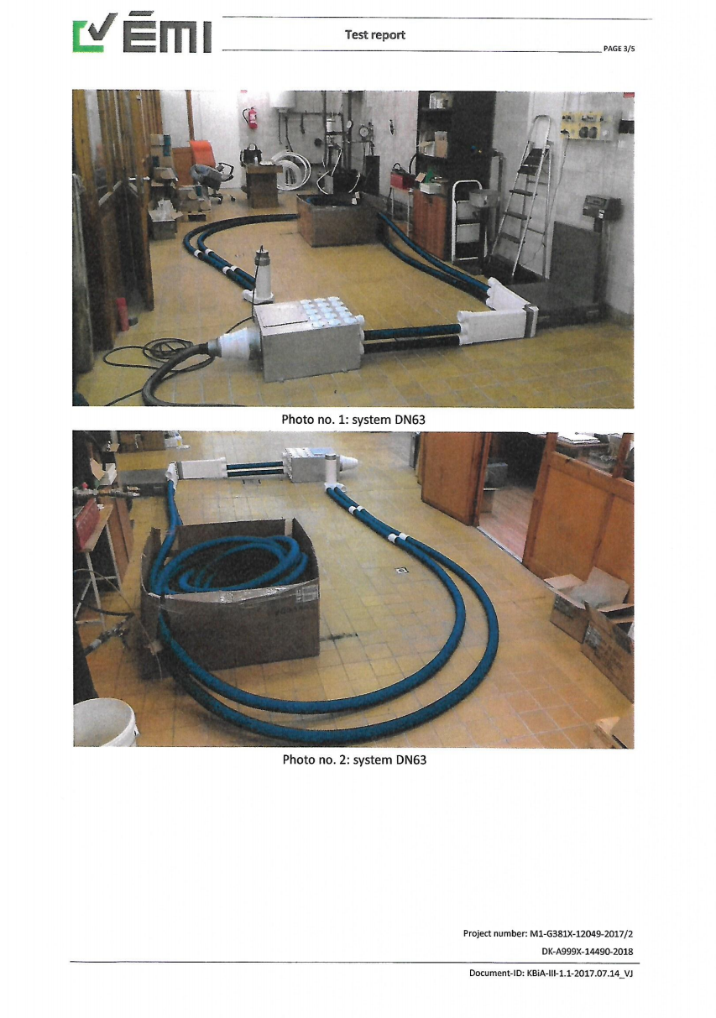
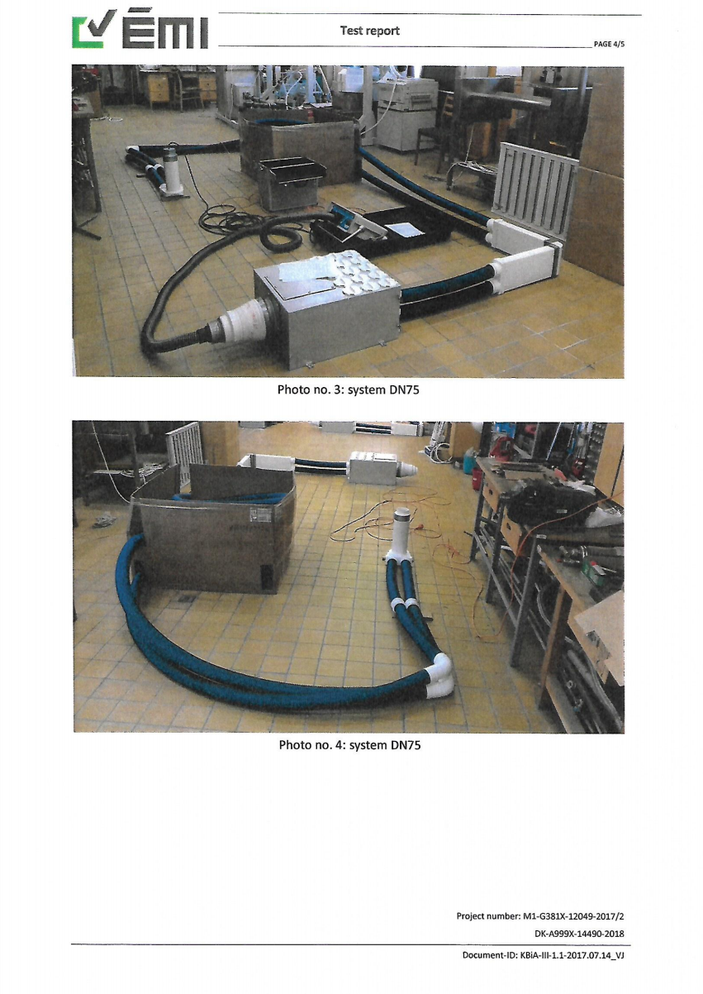
The BlauFast pipeline system has
Significant sealing capability
2.2
BlauFast pipeline system headquarters testing—duct leakage rate testing
Report number：M1-G381X-12049-2017/2
Testing basis：BS EN 12237：2003"Strength and Leakage Requirements for Circular Thin Metal Ducts in Buildings"
Headquarters test data
BS EN 1507:2006 "Ventilation for buildings - Sheet metal air ducts with rectangular section - Requirements for strength and leakage" standard specifies requirements for circular ducts, categorizing them into 4 grades A, B, C, and D based on tightness.Where D is the highest grade with a leakage rate not exceeding 0.5%.

Slide 21
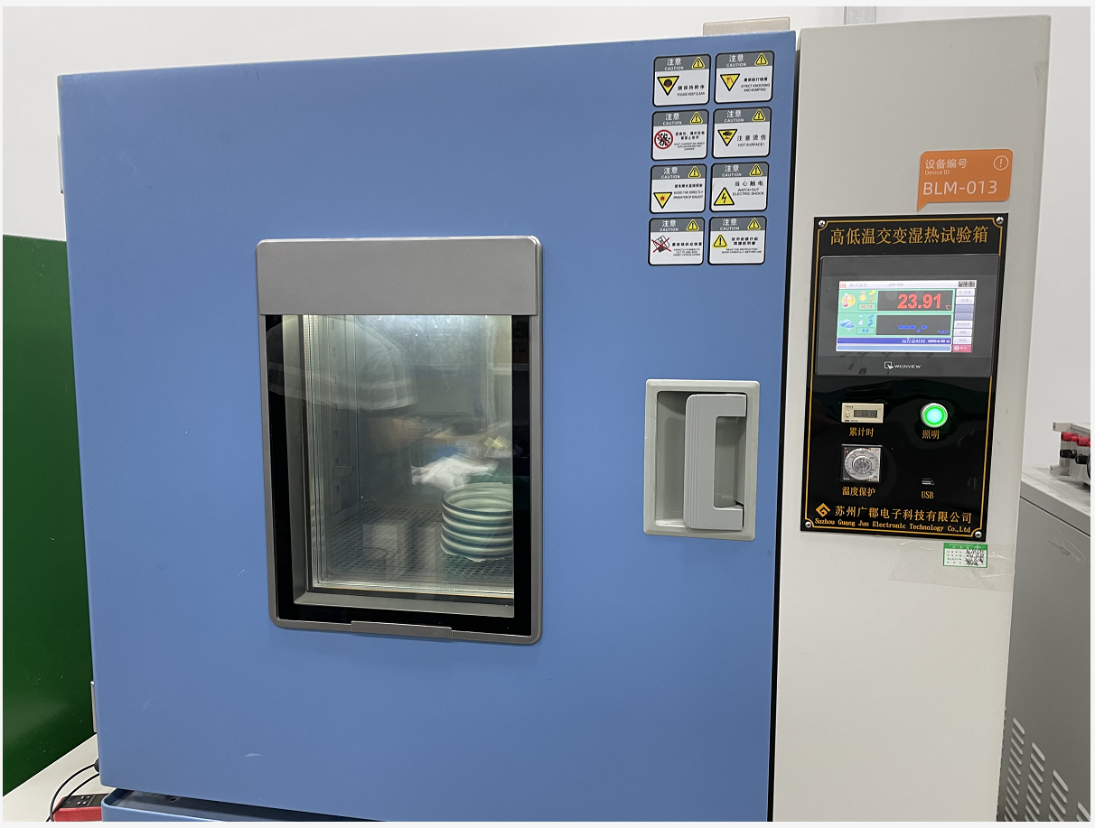
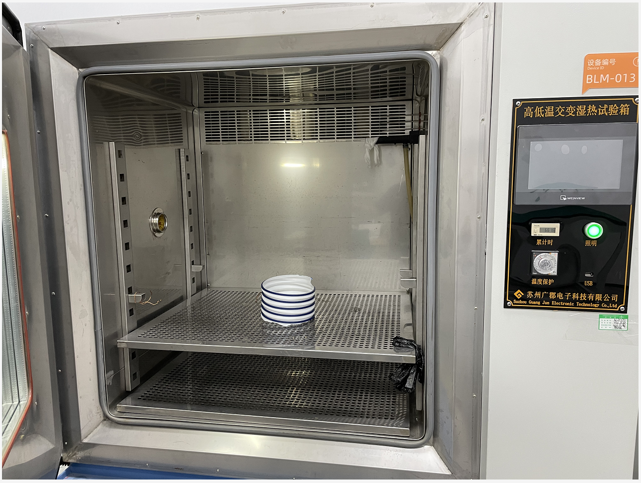
2.2
The BlauFast pipeline system has
Significant sealing capability
BlauFast pipeline testing—Weather resistance testing
Basis of testing：GB/T 2423.1, 2 "Environmental testing for electric and electronic products - Part 1: Low temperature testing methods, Part 2: High temperature testing methods"
Test description：
Temperature range H: -40℃ to 70℃
Humidity range: 40% RH
Temperature fluctuation/uniformity: ≤ ±0.5℃ / ±2%RH
Ramp-up time: Approximately 60 minutes from -40℃ to 70℃, hold at 70℃ for 60 minutes
Cool-down time: Approximately 80 minutes from 70℃ to -40℃, hold at -40℃ for 60 minutes; repeat this cycle 3 times
Test conclusion：No change, no odor emission, manual bending is identical to room temperature conditions.
Test data
High-low temperature cycling test
（-40℃~70℃）

Slide 22

2.3
The BlauFast pipeline system has
Significant airflow
Fresh air test data
Blauberg recommended installation method
Common installation methods in the market

Slide 23

2.3
The BlauFast pipeline system has
Significant airflow
Fresh air test data
Blauberg recommended installation method
Common installation methods in the market

Slide 24

2.3
The BlauFast pipeline system has
Significant airflow
Fresh air test data
Blauberg recommended installation method
Common installation methods in the market

Slide 25
Part Three
BlauFast pipeline system provides
comprehensive system solutions

Slide 26

3.1
BlauFast pipeline system provides comprehensive system solutions
·Accessories
All-new upgrade
pass easily over the beam
Pipeline fittings
Compatible with Blauberg
main unit models
  Compatible with all pipe sizes
Install the air valve

Slide 27

3.1
BlauFast pipeline system provides comprehensive system solutions
Serial number | Picture | Product model number | Serial number | Picture | Product model number | Serial number | Picture | Product model number | Serial number | Picture | Product model number
1 |  | Outdoor air vent VPU 80 C VPU 100 C | 6 |  | Round pipe flange diameter change BlauFast RE 150-110 C | 11 |  | Y-shaped three-way (with valve) BlauFast RYT 150/110*2 C | 16 |  | Diagonal three-way (with valve) BlauFast RXT 110/110/110 C
2 |  | Flange diameter change BlauFast RF 150-110 C | 7 |  | Round pipe flange diameter change BlauFast RE 110-75 C | 12 |  | Y-shaped three-way (with valve) BlauFast RYT 110/75*2 C | 17 |  | Diagonal three-way (with valve) BlauFast RXT 110/110/75 C
3 |  | Flange diameter change BlauFast RF 125-110 C | 8 |  | Round pipe flange diameter change BlauFast RE 75-63 C | 13 |  | Round pipe clamp BlauFast RPC 75 C | 18 |  | Air outlet connector BlauFast RPZ 75/80 C
4 |  | Flange diameter change BlauFast RF 125-150 C | 9 |  | Round pipe elbow BlauFast RB 110 C | 14 |  | Round pipe clamp BlauFast RPC 110 C | 19 |  | Air outlet connector BlauFast RPZ 75/100 C
5 |  | Round pipe connectors BlauFast RM 150 C | 10 |  | Round pipe connectors BlauFast RM 110 C | 15 |  | Round pipe clamp BlauFast RPC 150 C | 20 |  | Air outlet connector BlauFast RPZ 110/100 C

Slide 28



3.1
BlauFast pipeline system provides comprehensive system solutions
Advantages of pipeline system fittings
a) Continuing the glue-free installation principle, Blaufast pipes are connected to fittings using clamp rings, while Bruck pipes are connected to the main unit and fittings using throat clamps.
b) Fittings that coordinate with Blaufast pipes utilize a direct-insert clamp connection, allowing for easy installation without needing to remove the clamp rings. This eliminates concerns about losing clamp rings during installation, making the installation of Blaufast pipes more convenient.
Pipeline fittings

Slide 29




BlauFast pipeline system provides
comprehensive system solutions
3.1
Advantages of pipeline system fittings
c) Multiple forms of tees and reducers make design and installation more convenient. When access holes are restricted, tee fittings and reducers are used to efficiently manage return air routing.
d) Various combinations of fittings allow for easy passage over beams. The main duct carries the highest and most vulnerable airflow, so its proper installation is crucial. BlauFast offers multiple beam crossing solutions to minimize damage to the building and reduce loss of fresh air volume.
150mm to dual 110mm passing through beam
Pipeline fittings
150-110-150 passing through beam
The main 150mm duct uses a wall penetration cap.

Slide 30




3.1
BlauFast pipeline system provides
comprehensive system solutions
Advantages of pipeline system fittings
e) Tee fittings are equipped with air valves featuring dual butterfly valve design, offering precise airflow adjustment with multiple angles. The valve knob remains secure after thousands of rotations. When the blades are fully open, the airflow resistance is minimal, and when closed, it achieves excellent sealing with no whistling noise.
f) The transition fittings feature a sloped gradient connection at the junction with the pipes, designed for fluid distribution, reducing local resistance.
Pipeline fittings
Gradual transition design at pipe interfaces

Slide 31


BlauFast pipeline system provides
comprehensive system solutions
3.1
Installation case studies

Slide 32



BlauFast pipeline system provides
comprehensive system solutions
3.1
Installation case studies

Slide 33




3.2
BlauFast pipeline system components
Round pipe clamp
Material：PP
Specifications and models：RPC 63 C、RPC 75 C、RPC 110 C、RPC 150 C
Applicable pipe sizes：φ63/φ75/φ110 Blaufast pipeline，φ150 Booker tube
Installation method：Soundproofing nail gun，φ8mm Threaded rod
Purpose：In a top-supply air system, fixing the direction of the ducts enhances the overall aesthetic appearance of the ductwork. The use of a silenced nail gun significantly improves installation speed.
Round pipe clamp
Adaptable to various sizes of
silencing nail guns
It can be combined into a series of pipe clamps.
You can use a muffler nail gun to fix it on the ceiling.

Slide 34






3.2
BlauFast pipeline system components
Draught distributing box：
Introduction：The static pressure box, also known as a stabilizing chamber, is a crucial component in air supply systems. It reduces dynamic pressure, increases static pressure, stabilizes airflow, and minimizes air flow vibrations. In short, it enables air to be distributed over longer distances, ensures uniform airflow in various branches, reduces noise, and enhances the overall effectiveness of air supply.
Common specifications：One to four、One to eight、One to fourteen
Function：
1. It can convert part of the dynamic pressure into static pressure to extend the airflow distance.
2. It can reduce noise.
3. It distributes airflow evenly.
4. The plenum box can reduce noise and achieve uniform static pressure airflow, reducing dynamic pressure loss.
Draught distributing box
Why is Blauberg's air distribution box designed in a square shape?
  The windward cross-sectional area of the air distribution box is 0.07 square meters, which can reduce the air velocity from the outlet of the fresh air unit from 7-8 m/s to below 2 m/s. This significantly improves the conversion efficiency from dynamic pressure to static pressure, effectively reducing noise and converting dynamic pressure into static pressure.。
Maintenance cover plate
interface
To ensure smooth operation of maintenance and cleaning later on.
The holes are laser-cut to shape with nearly zero error, ensuring a tight fit and no air leakage with the fittings.
internal
corner
It features built-in 20mm thick sound-absorbing cotton, and its internal structure without partitions ensures effective static pressure.
Seamless sheet metal cornering process
Leakage rate: 0% under 500Pa pressurized ventilation conditions
It reduces noise by 3 to 5 dB.

Slide 35

3.2
BlauFast pipeline system components
Cloak of invisibility
Specifications：FM 110 C
Aperture size：φ120mm
Material：ABS
Overview：High-level installation, convenient and safe.
30° louver angle, compliant with aerodynamic louver spacing, enhances system airflow.
Lower-end perforation prevents backflow issues during extreme weather conditions.
Cloak of invisibility
 | Komfort EC Ultra L1 250 | Komfort EC Ultra L2 350 | Komfort ERV EC D450P
Airflow rate of a single stainless steel hood | 70.4% | 68% | 37.8%
The airflow rate of two stainless steel hoods | 88% | 93.4% | 53.3%
The airflow rate of a single through-wall hood | 92% | 100%* | 103%*
The airflow rate of two through-wall hoods | 96% | 104%* | 108%*
Note: *The airflow rate exceeding 100% in the data is due to the positive pressure from the fresh air unit.

Slide 36




3.2
BlauFast pipeline system components
Air outlet connector
Specifications：RPZ 63/80-1 C、RPZ 75/80 C、RPZ 75/100 C、RPZ 110/100 C
Appearance：The air duct connectors are paired with Bolu Blue and Advanced Gray, enhancing the aesthetics.
Material：The white connectors are made of PP material, while the pipes are made of TPV.
Product performance：The air duct connectors are lighter in weight, have superior mechanical properties, and are overall flexible. They ensure that after connecting, they do not push the air vents out of the suspended ceiling surface, ensuring a more seamless and aesthetically pleasing fit between the air vent and the ceiling. The dust cover has perforations for easy identification, facilitating future renovation coordination.
Antibacterial properties, antibacterial durability, mold resistance, antistatic properties, weather resistance
Air outlet connector
With dust cover
Regular aluminum foil duct
Common flexible joints mostly use aluminum foil ducts or nylon ducts, which are of poor quality. When unpacked, they emit a strong plastic odor.
The inner walls are often wrinkled, causing high air resistance and roughness, leading to poor sealing. Leakage of airflow may occur later on.
Install the air vent

Slide 37




3.2
BlauFast pipeline system components
Adjustable round air vent
Specifications：VPU 80 C、VPU 100 C
Ceiling opening size：φ100mm、φ120mm
Material：Polished ABS material, with a sleek appearance
Overview：The new installation method is more reliable and convenient, with a polished ABS finish for a high-end texture.
The air vent diffuses and distributes air, utilizing the Coanda effect to extend the airflow distance.
The air vent does not produce whistling sounds during air return, ensuring a quieter operation.
Adjustable air vent
Installation steps：

Slide 38

3.2
BlauFast pipeline system components
Installation with rotary knobs and snap fasteners, simple and reliable operation
  ABS material
Streamlined throat design
Suspended ceiling surface
Fresh air flow
Airflow adjustable
  Dispersed air outlet method
Coanda effect, extends airflow radius
The VPU air vent's throat is designed through fluid simulation, ensuring streamlined airflow distribution. The fresh air flow emitted from the throat can continue to flow along the suspended ceiling surface (Coanda effect), expanding the dispersion radius, reducing air vent noise, and optimizing airflow organization.

Slide 39
Part Four
Comparison summary of
the BlauFast pipeline system

Slide 40




4.1
Comparison of the BlauFast pipeline system with other brands
Other brands
Blaufast
Other brands
Other brands
Pipeline category
Other brands
Blaufast pipeline
The inner wall formulation of the Blaufast pipeline: smooth and uniform, memory rebound, neatly grooved
Inner walls of other brands: more protrusions, uneven widths, and prone to bending and deformation

Slide 41


4.1
Comparison of the BlauFast pipeline system with other brands
All components of the Blaufast pipeline system All tee fittings are equipped with adjustable double butterfly valves.
In other brands like Lian Feng and Lang Tong, certain tee fittings currently come equipped with single-blade valves.
And in the diagonal tee fittings, Blaufast has precise airflow control valves on both branch outlets, whereas Lian Feng and Lang Tong only have single-blade valves on the different diameter ends.
Currently, other brands have not yet launched tee fittings with adjustable valves.
Accessories
Lian Feng
Lang Tong

Slide 42




4.1
Comparison of the BlauFast pipeline system with other brands
The Blaufast end connectors are made from new TPV material, certified for RoHS compliance, antibacterial properties, mold resistance, antistatic properties, and weather resistance.
More model specifications：63（Pipe dimensions）/80（Air vent dimensions）、75/80、75/100、110/100
In other brands, most still use aluminum foil ducts. Brands like Lian Feng and those imitating Lian Feng use plastic TPE for the duct body, but none have performance certifications.
Accessories
Other brands
End connectors

Slide 43


4.1
Comparison of the BlauFast pipeline system with other brands
All fittings in the Blaufast pipeline system are produced using white PP material.
In the production of plastic products, recycled materials are often mixed in, generally not exceeding 20%. However, when recycled materials are included, it's challenging to achieve a pure white appearance without impurities. Blaufas ensures that all plastic fittings have a pure white appearance without the inclusion of recycled materials.
Fitting category
Blaufast fittings
Common fittings

Slide 44





4.1
Comparison of the BlauFast pipeline system with other brands
Pipeline cleaning
Brush inserted into the connector
Pipeline cleaning brush
Brush inserted into the branch box
Vacuum cleaner operating at the other end

Slide 45
4
Comparison of the BlauFast pipeline system with other brands
7 major comparisons | BlauFast pipeline system | Other brands of pipelines | Customer value proposition
Pipes | BlauFast pipeline system is the industry's first choice, offering Booker tube imported options alongside BlauFast made in China, both certified. | Regular PE pipes generally lack certifications. | More professional, easier to use
Connectors | Featuring an innovative dual butterfly valve design to ensure airflow and reduce noise, optimized connector quantities. | They typically lack airflow valve structures, and while there are various connector types, they lack systematic integration.
Airflow capacity | Consistent equipment interface sizes, larger main pipe diameters provide 5%-10% increased airflow compared to previous generation systems. | Adaptability to all fresh air devices is generally average. Branch boxes have smaller cross-sectional areas, resulting in higher air velocity and lower static pressure conversion rates. The inner walls of the pipes are uneven, leading to increased air resistance. | More efficient
Ease of installation | Comprehensive instructional videos for easy worker training. Various fitting combinations to address challenges like beam penetrations. | Additionally, tape sealing is required, necessitating skilled installation by workers. | More standardized
System integration | Tailored for BlauFast fresh air systems, designed for BlauFast equipment and developed for Chinese construction improvements. | High versatility but lacks specificity
Noise levels | Effectively reduces centralized return air noise, eliminating noise at the equipment end with BlauFast's professional semi-soundproof room testing. | Limited noise control | Quieter
Appearance | BlauFast logo, matte white finish, high-quality texture. Individually packaged in bags with product model labels. | Gray appearance, inconsistent texture, and simple packaging | More high-end, more reassuring

