Slide 1

Blauberg new draught distributing box introduction

Slide 2
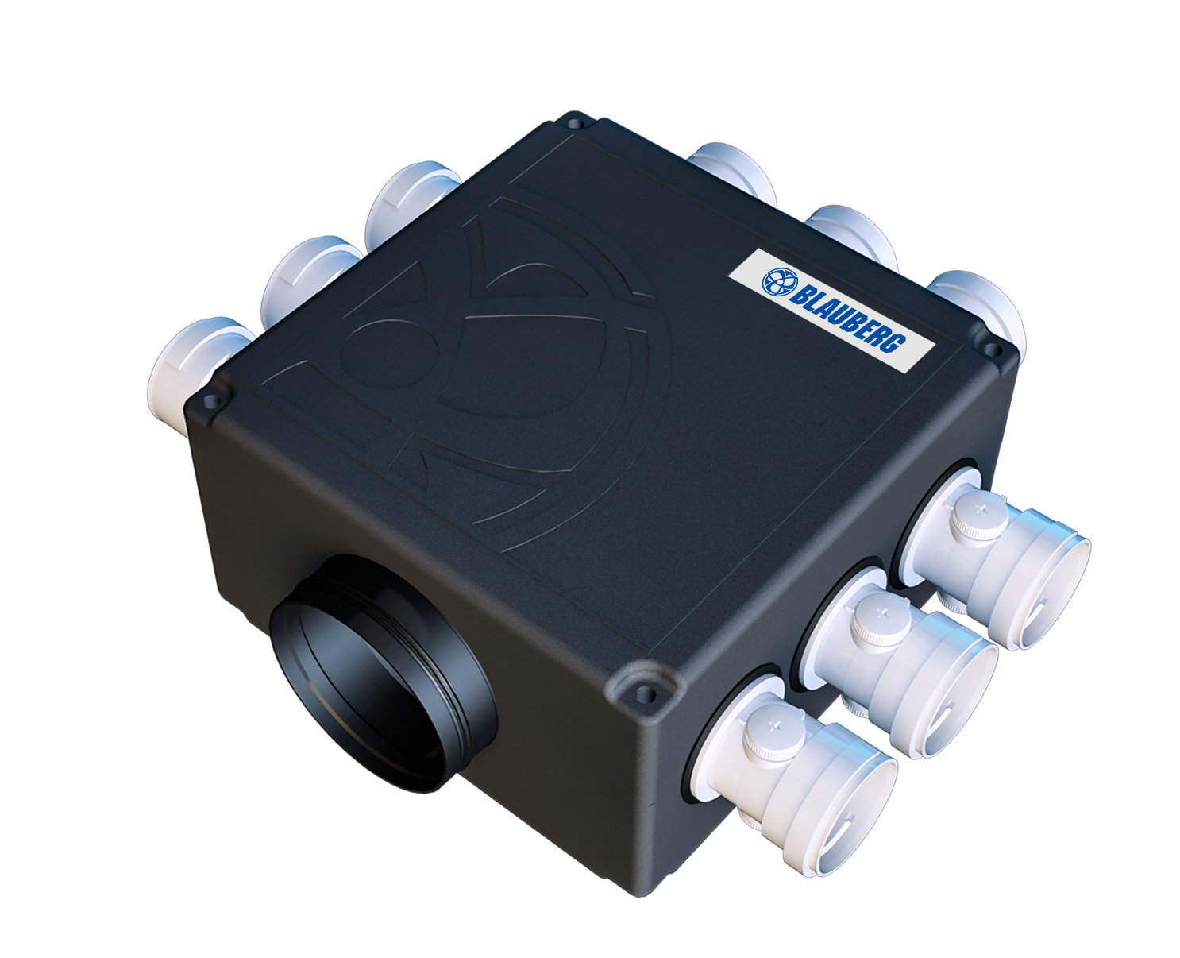
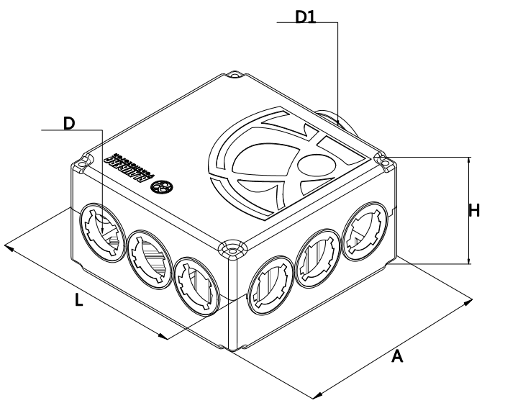
EPP draught distributing box
Product features:
The material is EPP, which has good sound insulation, sound absorption, thermal insulation, sealing and aging resistance;
The internal space of the box is designed with static pressure, and three air outlet interfaces can ensure the full conversion of static and dynamic pressure;
The diffuser is used to reflect sound waves at the bottom of the box, and the Helmholtz resonance silencing structure is used at the top to absorb mid-low frequency noise more effectively;
Two-blade butterfly valve regulation, the regulation of air volume is more delicate, the wind valve is stable and durable;
The box is divided into one nine form and can be connected with 75/63 connectors;
Blower size table
 | Fan model | D（mm） | D1（mm） | L（mm） | A（mm） | H（mm）
DN 63 | BlauFast SER 150/63× 9C | 54.5 | 149 | 380 | 385 | 210
DN 75 | BlauFast SER 150/75× 9C | 65 | 149 | 380 | 385 | 210
* The SER fan is under maintenance, and the maintenance port is 300*300

Slide 3
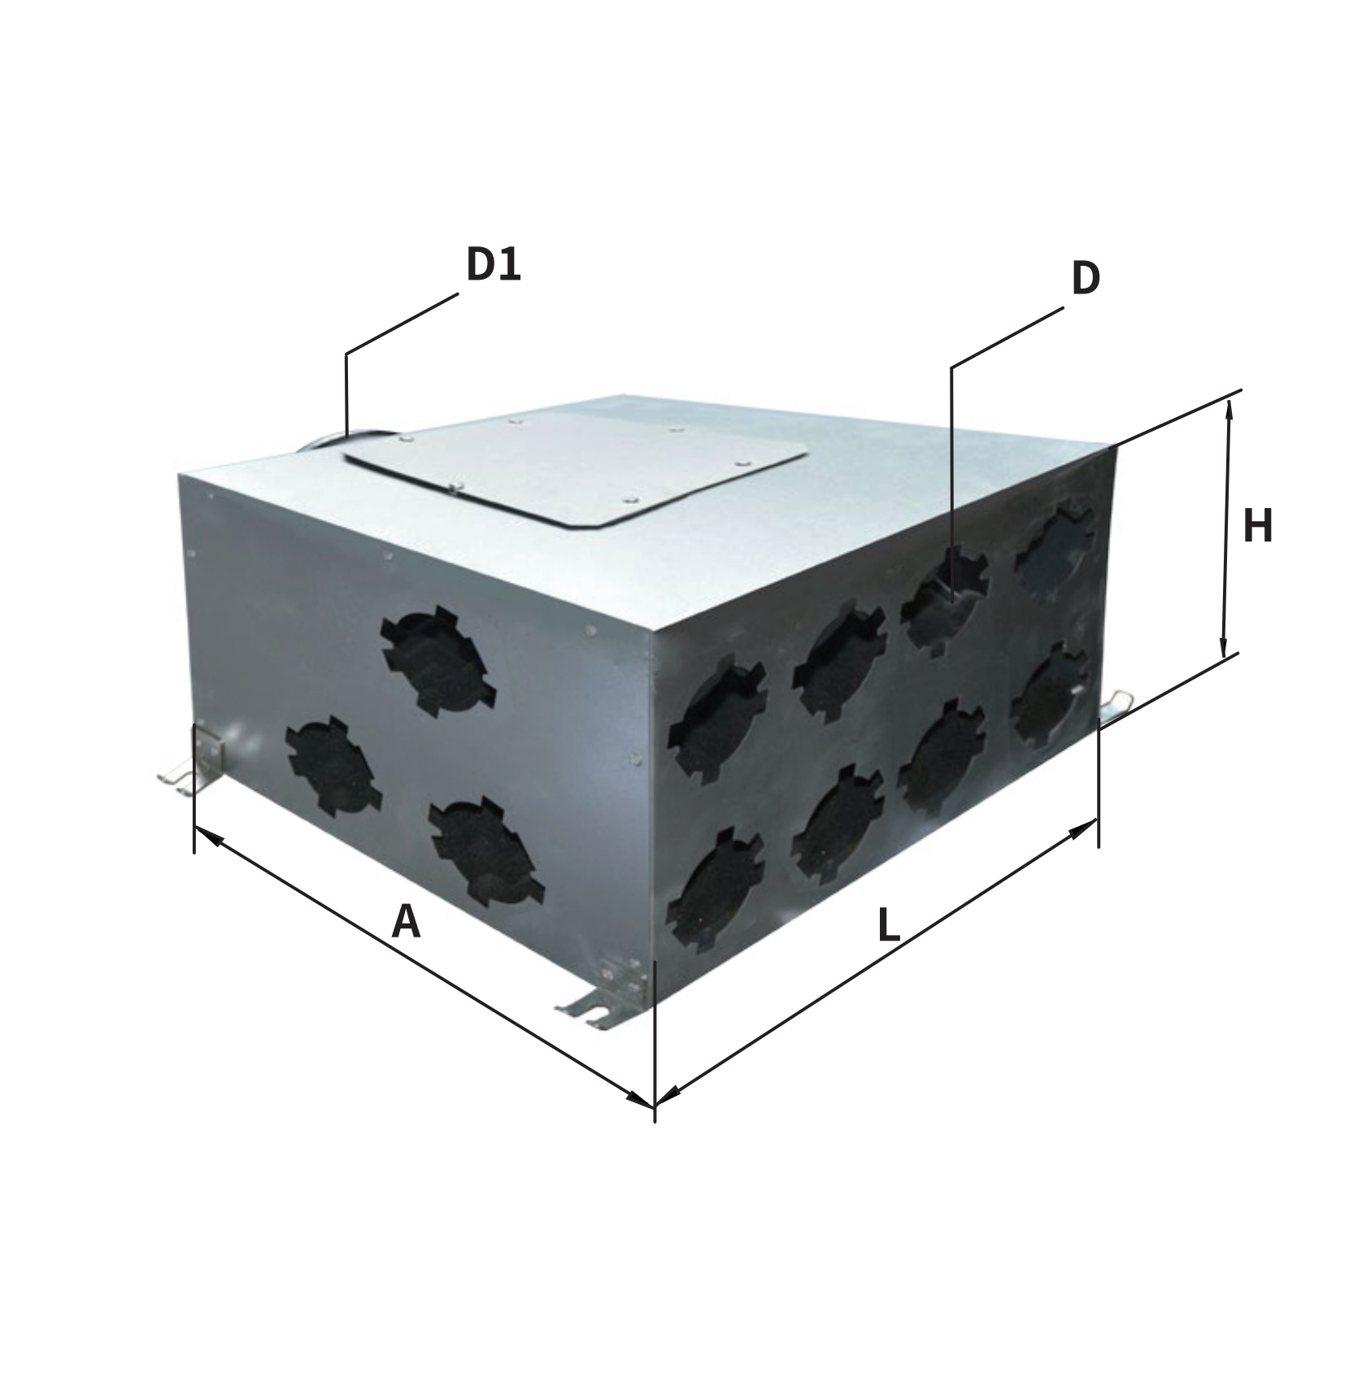
Metal air draught distributing box
Product features:
The metal air draught distributing box can be used for fresh air and dehumidifier equipment with 350m³/h~500m³/h
The sound box is coated with 20mm thick sound absorbing PE cotton, which has the advantages of sound insulation and high strength;
The upgrade is equipped with double-leaf butterfly valve regulation, which can adjust the air volume more finely and stabilize the wind valve;
The box is in the form of one part and fourteen, which can be connected to 75/63 connectors;
Blower size table
 | Fan model | D（mm） | D1（mm） | L（mm） | A（mm） | H（mm）
DN 63 | BlauFast SR 150/63× 14 C | 54.5 | 149 | 460 | 400 | 200
DN 75 | BlauFast SR 150/75× 14 C | 65 | 149 | 460 | 400 | 200
* The metal air distributor adopts the lower maintenance form, and the maintenance port is 300*300

Slide 4
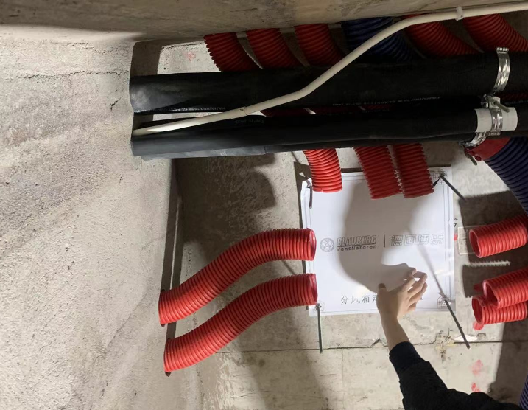
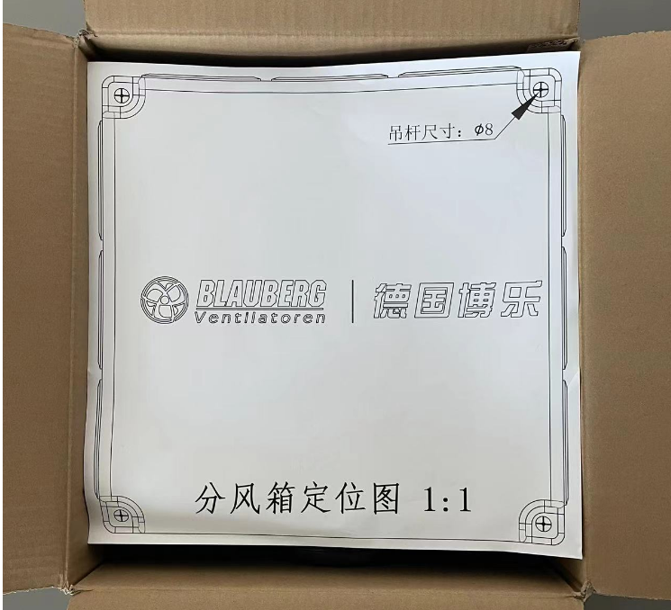
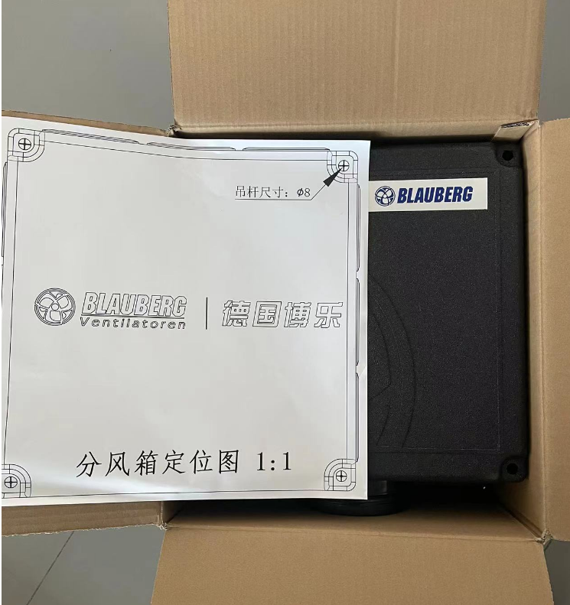
EPP box unpacking photos
The EPP box is equipped with an installation positioning plate for the installation personnel to locate and use on site

Slide 5
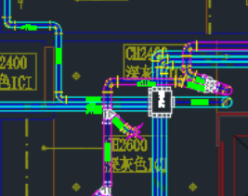
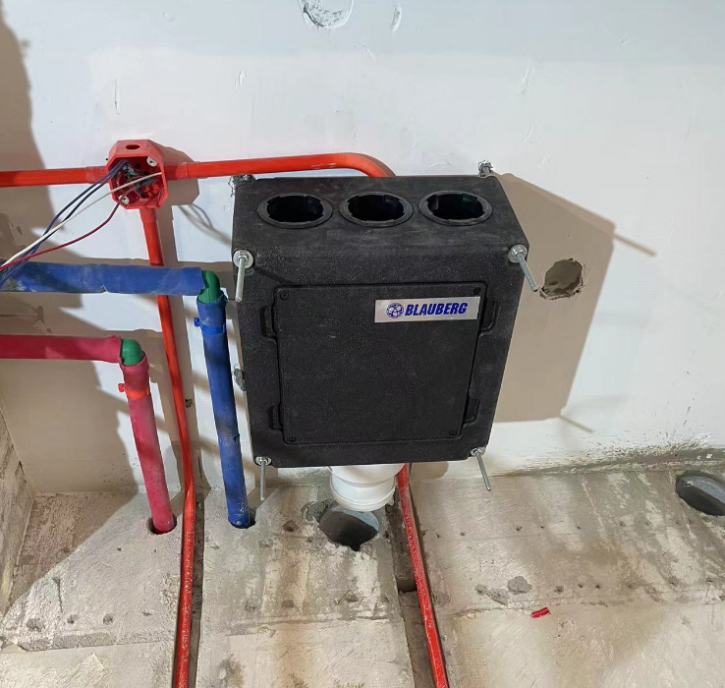
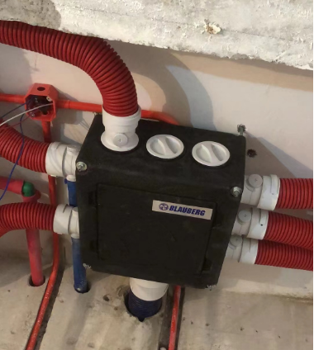
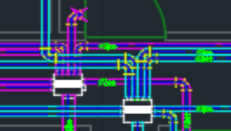
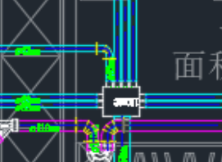
EPP box site installation diagram
The Blauberg SER EPP box uses a three-sided air outlet. As can be seen from many cases, this distribution method is more reasonable and conducive to reducing the bending of the pipeline and making the pipeline layout more reasonable

Slide 6
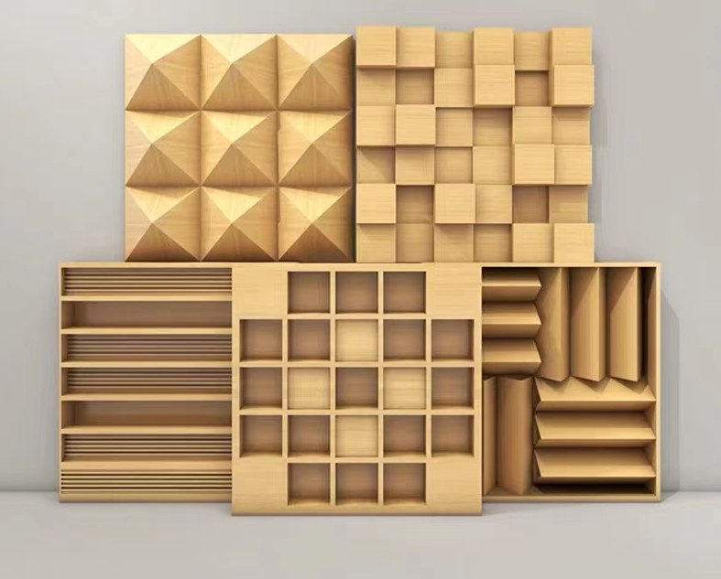
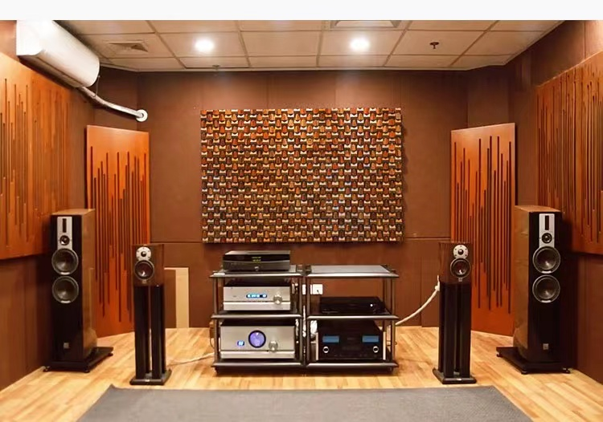
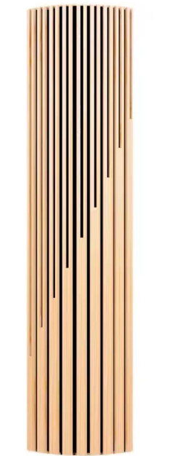
Divide the bellows silencing structure
Secondary remainder diffuser
Why is the professional video room arranged like this?
Sound trap

Slide 7
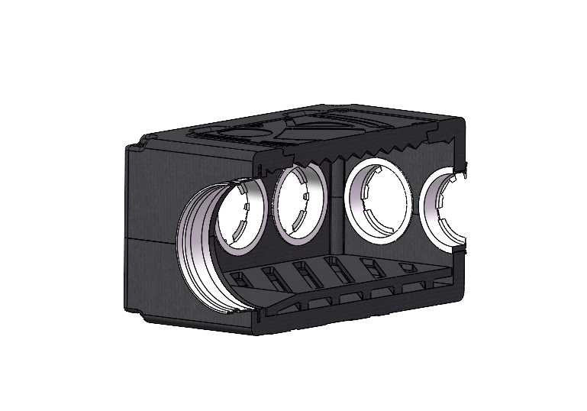
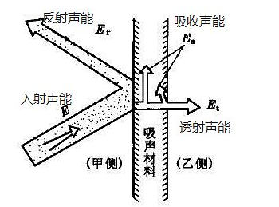
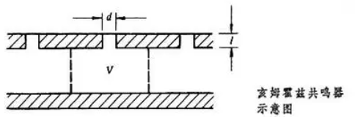
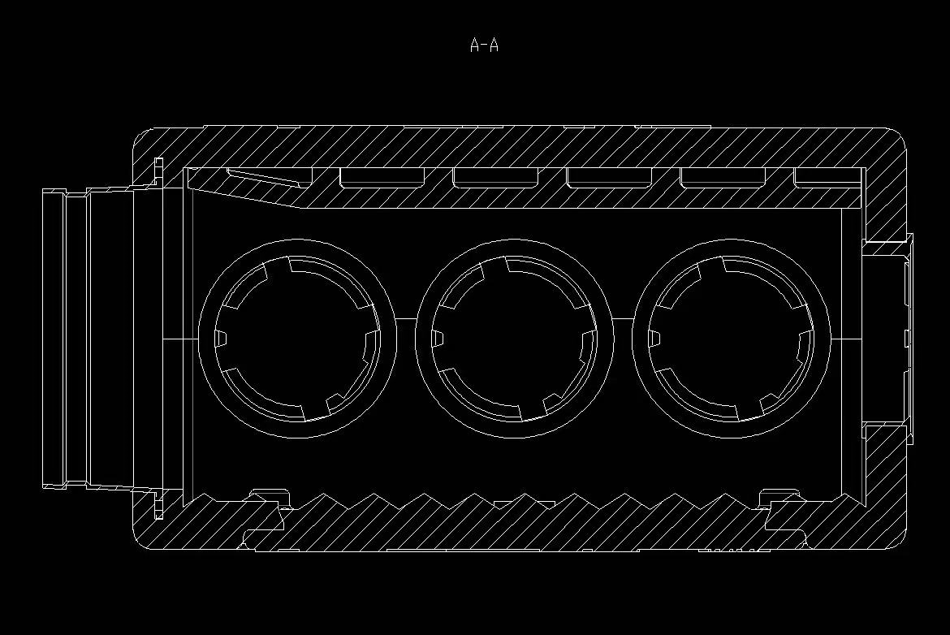
Divide the bellows silencing structure
Helmholtz resonant sound absorption structure
It can be seen that the professional audio and video room uses two kinds of equipment, diffusion body and sound trap to absorb the interference noise and noise. The diffusion body reflects the sound wave and the sound trap eliminates the excess noise.
The new Blauberg EPP box draws on the Helmholtz resonant sound absorption structure. When the frequency of the external sound wave is consistent with the inherent frequency, the system will resonate and the sound vibration in the system will be strongly amplified, consuming sound energy to achieve good sound absorption effect. This sound absorption structure has a better absorption effect for medium and low frequency sounds.
As shown in the figure, sound waves are longitudinal waves. When longitudinal waves enter the EPP box, they will encounter the diffuser and diffuse, which makes the sound waves reflect in more angles. The sound waves are reflected into the Helmholtz resonance silencing structure, and the sound energy will be consumed. Therefore, the combination of the two can achieve more silencing performance.
Sound wave diffuser
Helmholtz resonant sound absorption structure
Helmholtz resonant sound absorption structure
Sound wave diffuser

Slide 8
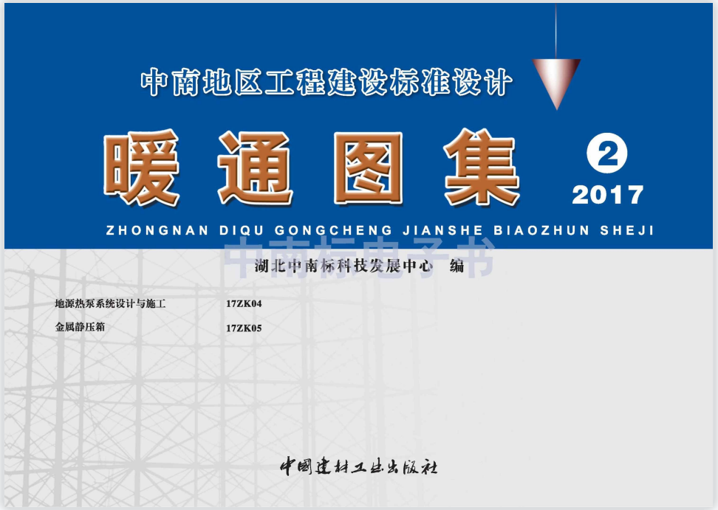
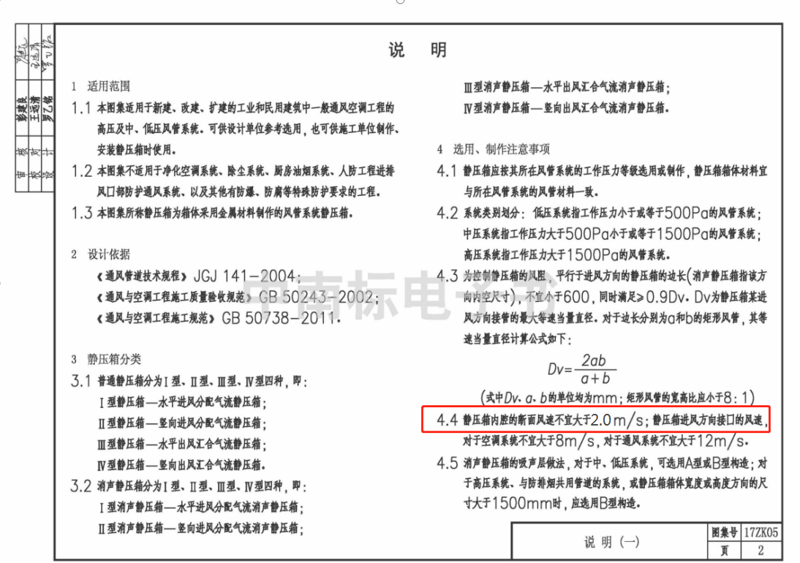
Determine the static pressure effect of the bellows
Air distribution and static pressure are the basic functions of air distributor, and the static pressure function needs to be realized according to the structure of the box.
According to the HVAC Atlas 17ZK05, the cross-sectional wind speed in the cavity of the static pressure chamber should not be greater than 2.0m/s, so that the dynamic pressure will be more converted into static pressure, and the static pressure effect will be achieved. The static pressure inside the air distributor should be equal everywhere, so that the wind inside the air distributor can minimize the occurrence of turbulence and reduce the pressure loss of the wind.

Slide 9
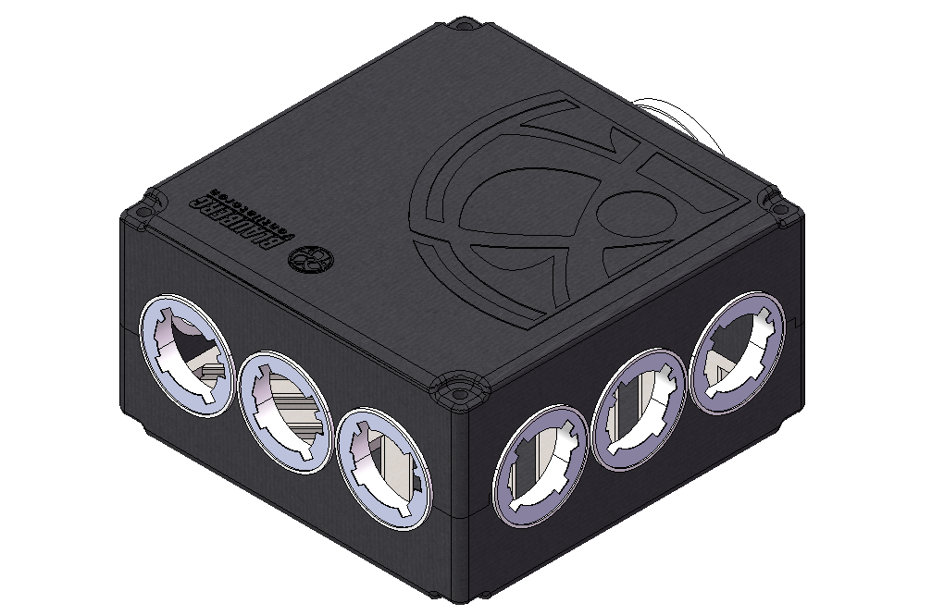
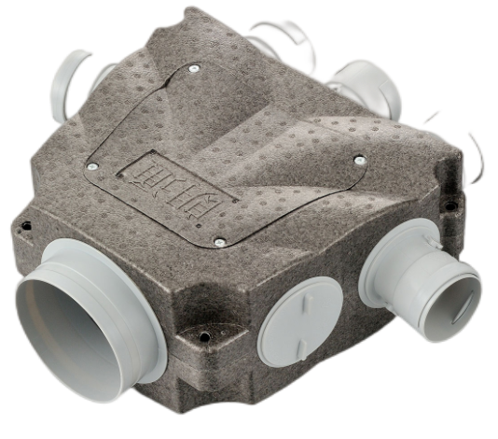
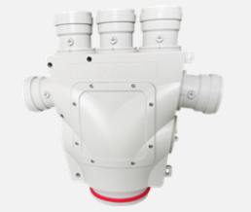
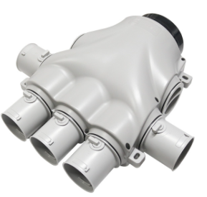
Determine the static pressure effect of the bellows
Total pressure = static pressure + dynamic pressure
Dynamic pressure =0.5 * air density * wind speed ^2
Static pressure = total pressure-dynamic pressure = total pressure-0.5* air density * wind speed ^2
Under 250m³/h conditions: the cross-sectional wind speed of Bole EPP air distributor is 1.1m/s;
The front wind speed of this trapezoid is 1.8m/s and the side wind speed is 2.2m/s
Under the condition of 350m³/h: the cross-sectional wind speed of Bole EPP air distributor is 1.5m/s;
The front wind speed of this trapezoid is 2.53m/s and the side wind speed is 3.11m/s
Under the condition of 500m³/h: the cross-sectional wind speed of Bole EPP air distributor is 2.2m/s;
The front wind speed of this trapezoid is 3.62m/s and the side wind speed is 4.45m/s
It can be seen that the cross-sectional wind speed of Bole EPP fan is lower than that of the market fan. Considering that the total pressure and air density in the system remain unchanged, the dynamic pressure decreases and the static pressure value is higher, so the efficiency of dynamic pressure conversion to static pressure is higher.
Excellent dynamic pressure and static pressure conversion ability, reduce the pressure loss of wind, increase the distance of air supply.

Slide 10
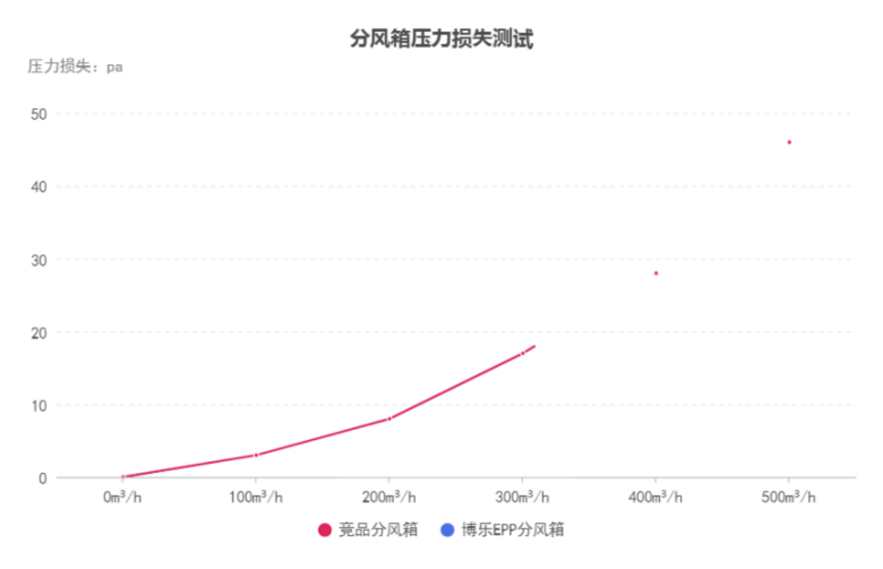
Comparison of resistance loss of air blower
After testing, the wind resistance of Blauberg EPP box is lower than that of competitive fans on the market under the same air volume. The advantages are mainly reflected in the following aspects:
By reducing the loss of static pressure box, the wind resistance of the whole transmission and distribution system can be reduced;
In the fresh air scheme with the same pipeline design and equipment selection, the system terminal air volume is larger by using Blauberg EPP air distributor;
Using the same host and equipped with Blauberg EPP fan, the distribution system has greater static pressure margin and longer air delivery distance.

Slide 11
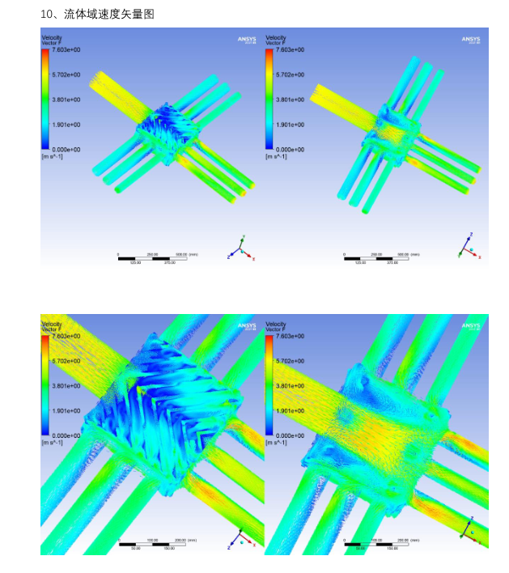
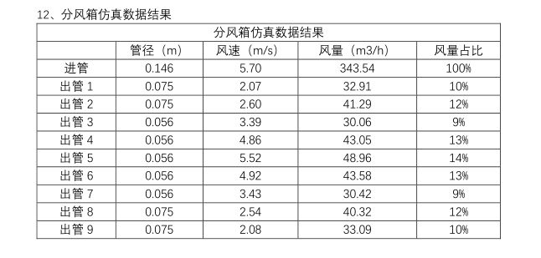
Control the air valve of the wind box
In the early stage of the development of the EPP draught distributing box, CFD fluid simulation was carried out. It can be found from the velocity vector diagram that the air volume of each branch is evenly balanced after being adjusted by the air valve. The air in the main pipe enters the box and greatly reduces the flow rate to ensure the conversion of static and dynamic pressure.

Slide 12
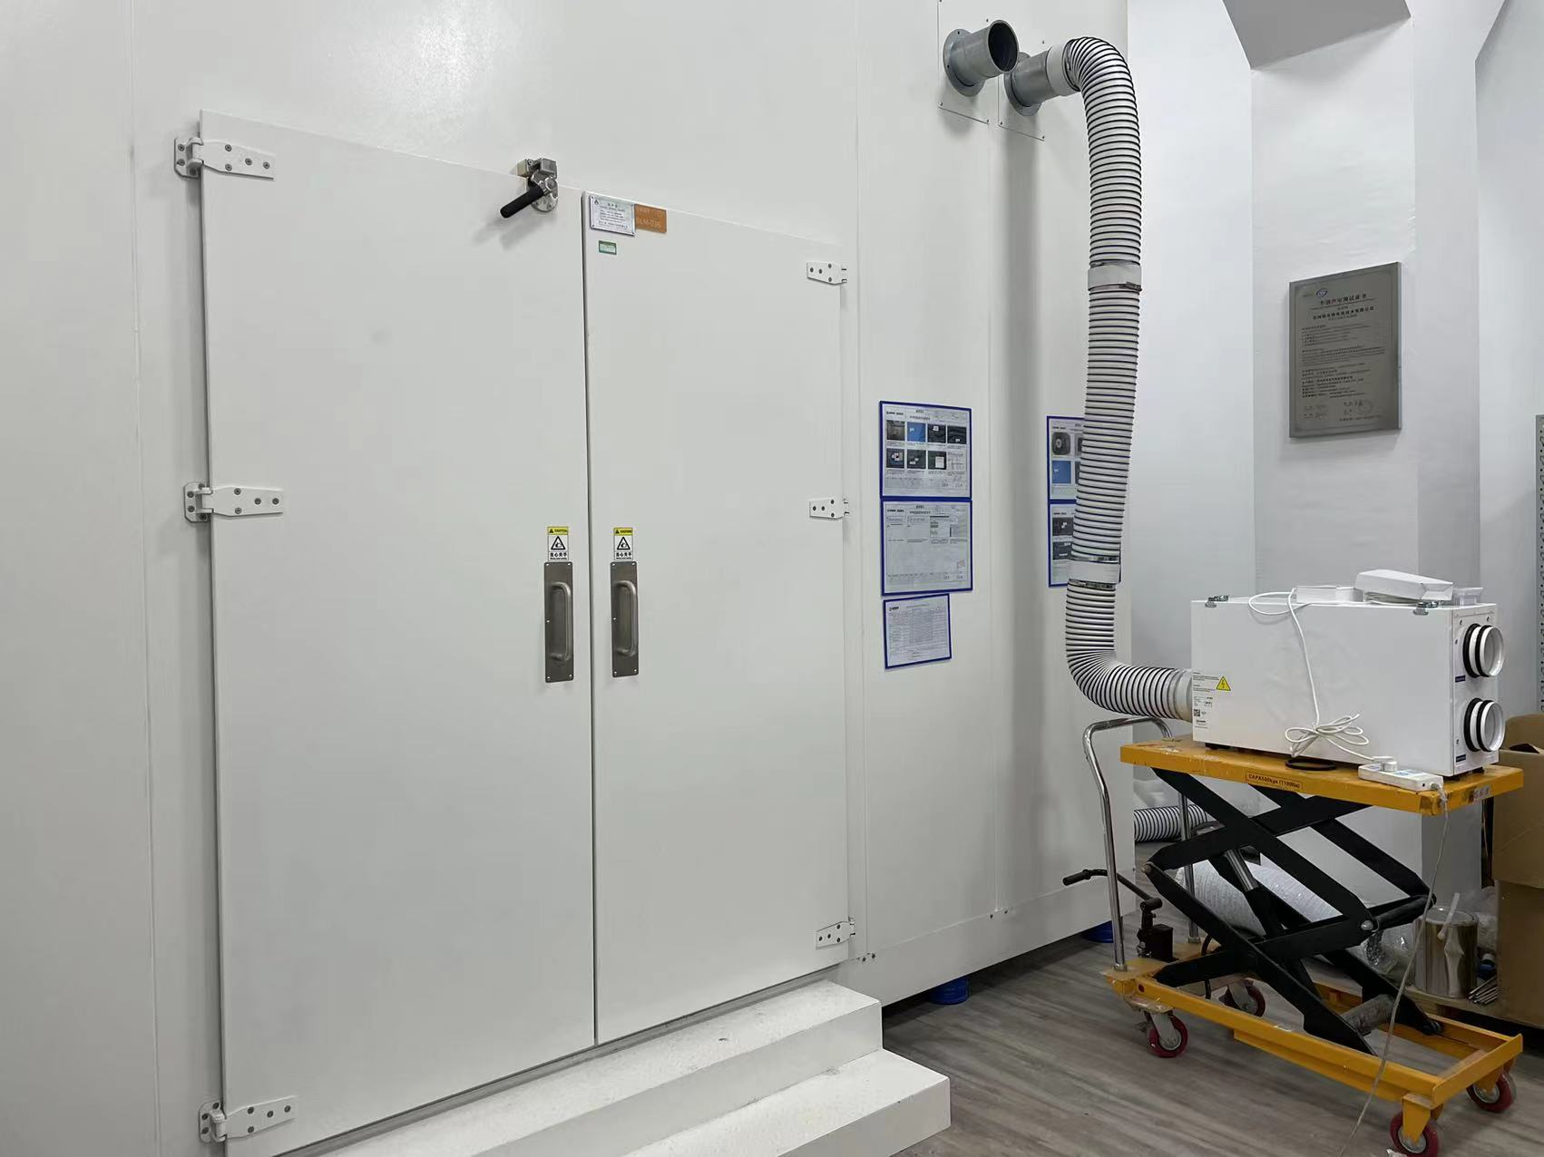
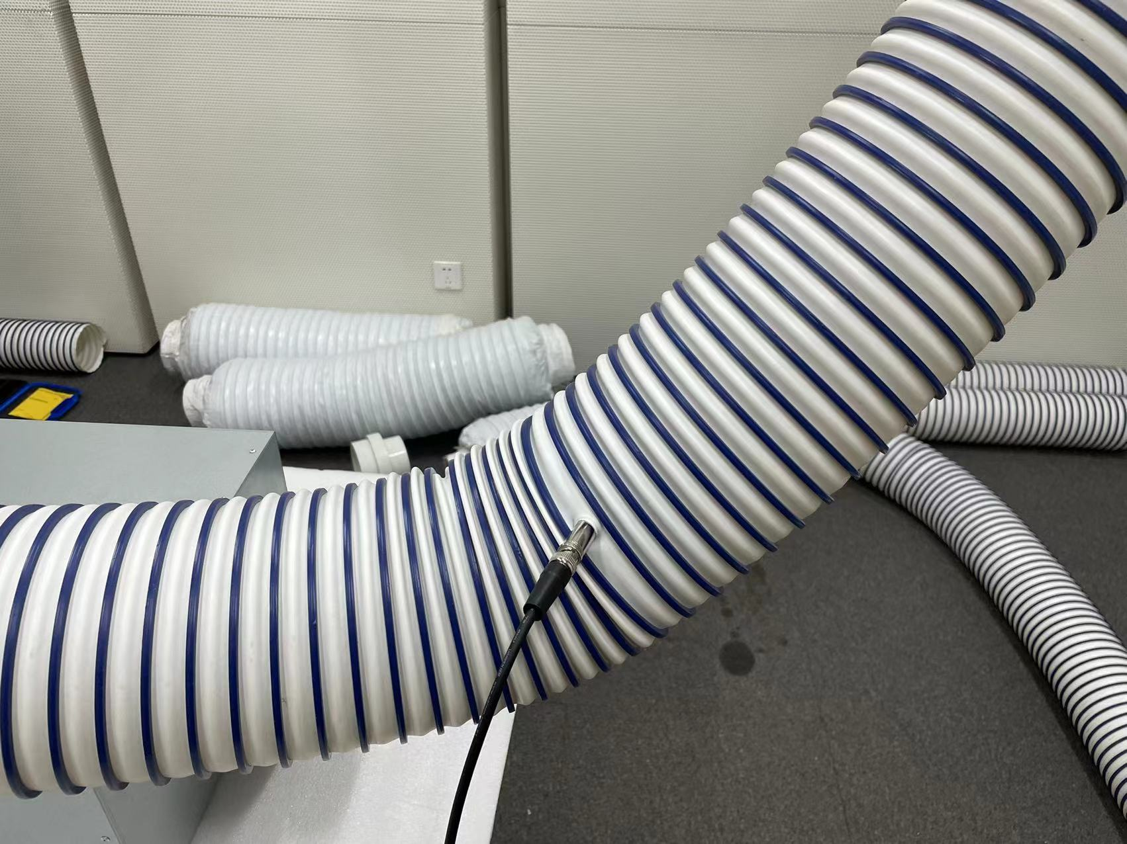
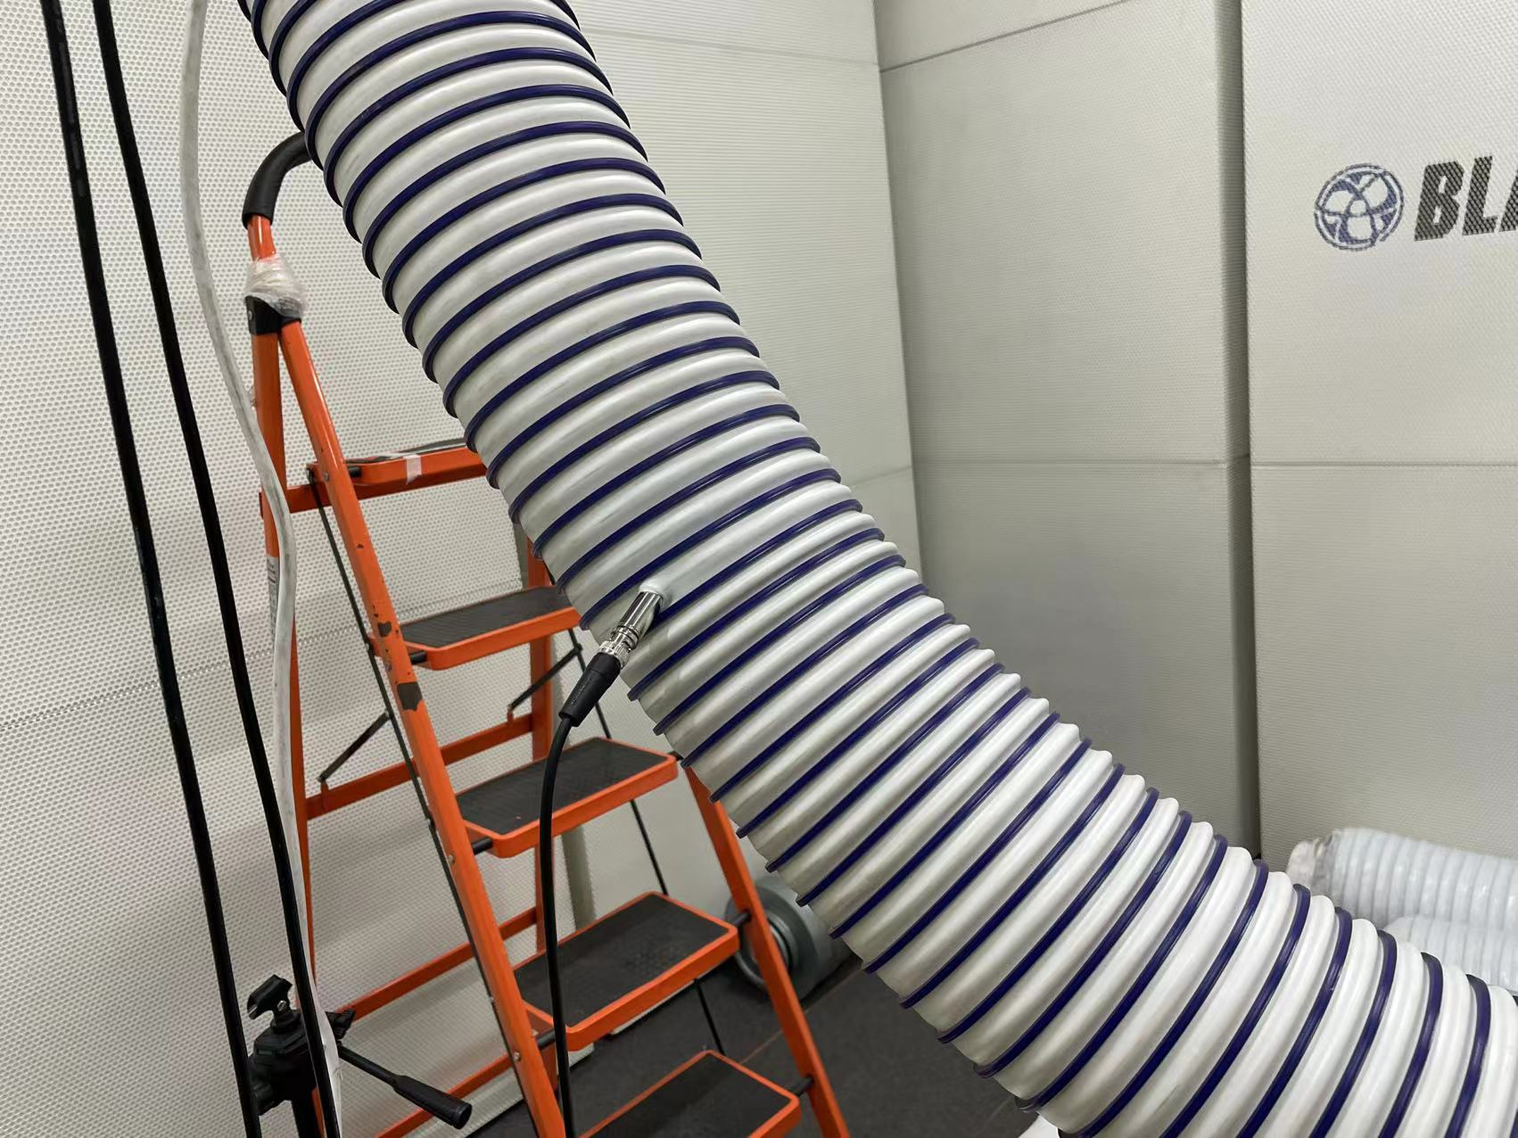
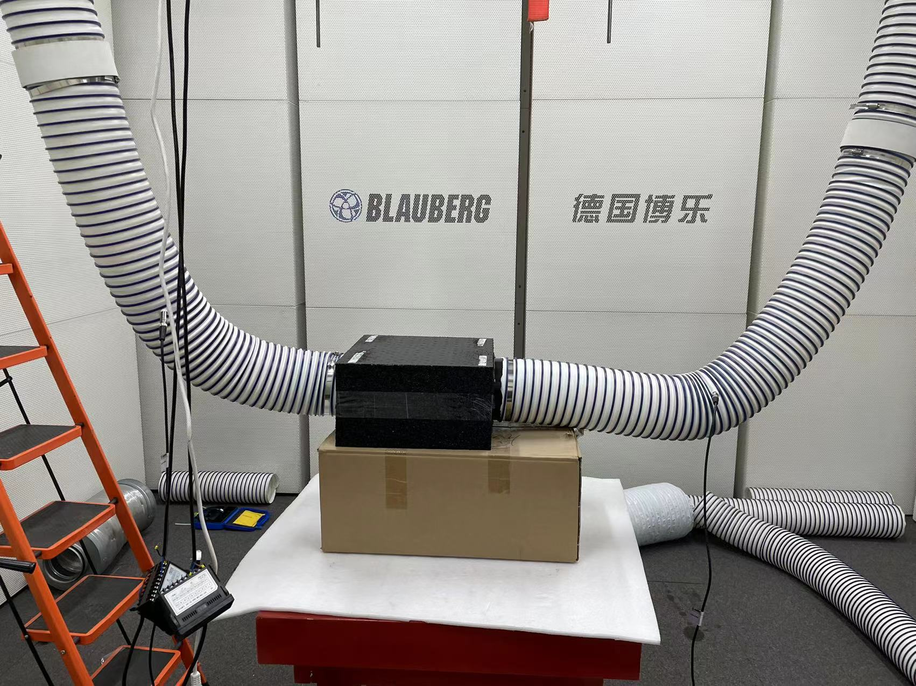
EPP box sound absorption test
Noise is received in the pipeline without passing through the air distributor
The noise in the pipeline is received after passing through the air distributor
Use different models of equipment as noise sources
Blauberg EPP fan box test

Slide 13
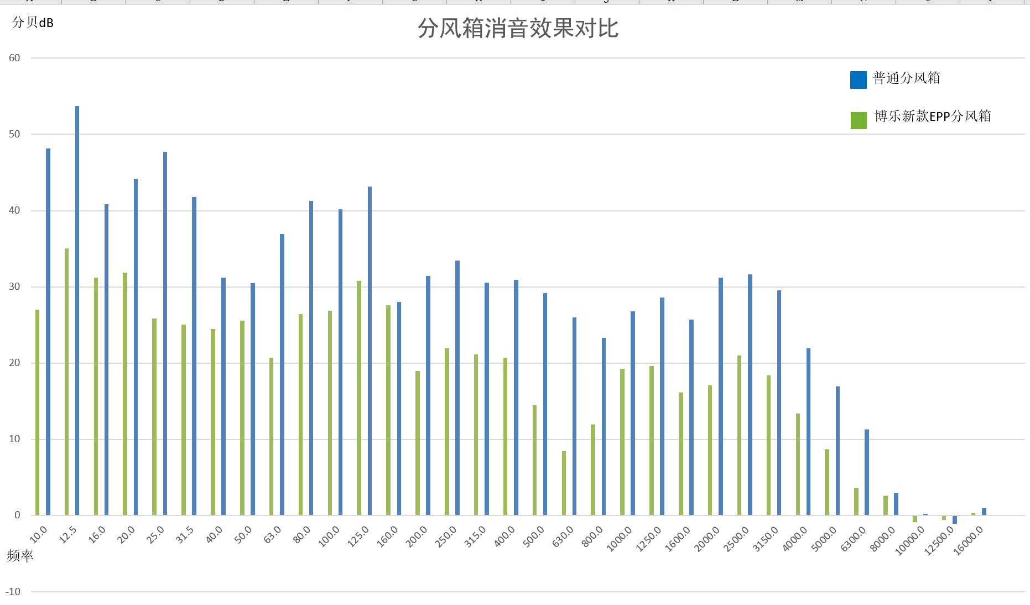
Comparison of sound absorption data of draught distributing box
Blauberg semi-echo chamber test data comparison
The vertical axis is the decibel value of the sound
The horizontal axis is the frequency value
It can be clearly analyzed from the noise spectrum that SER fan has an obvious silencing effect on medium and low frequency sound
From the above data, the test results of using specific host devices are different due to the difference of noise in the device body
Test standard: GB/T 4760-1995, acoustic muffler measurement method

Slide 14

01

