Slide 1

BlauWind
2024

Slide 2
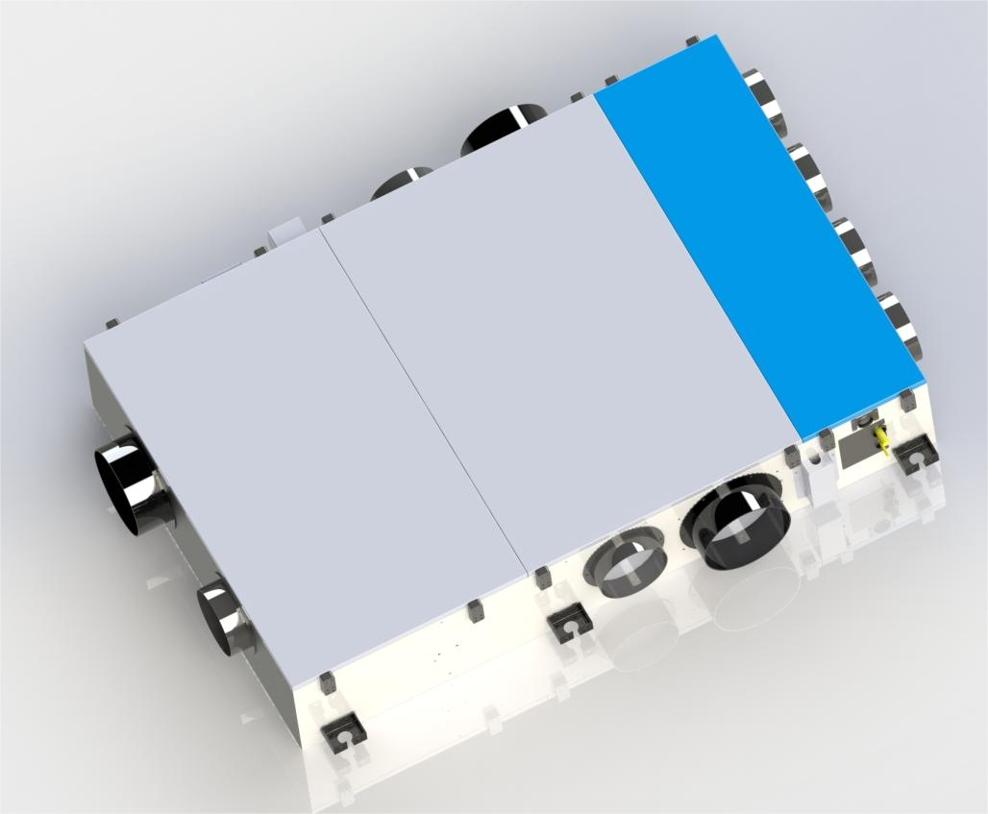
BlauWind
All in one solution.
Ventilation
Cooling
Heating
Air treatment
iAQ control

Slide 3
Ventilation with heat recovery, up to 300 m3/h
Overall airflow, up to 800 m3/h
Cooling capacity up to 7,2 kW
Heating capacity up to 7,2 kW
Exchange efficiency ~ 79 %

Slide 4
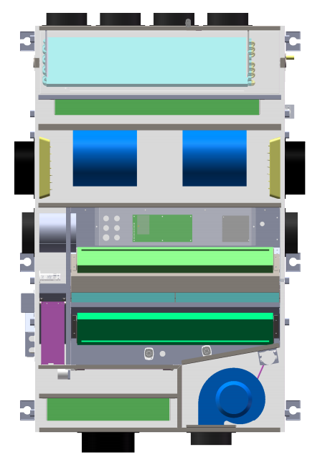
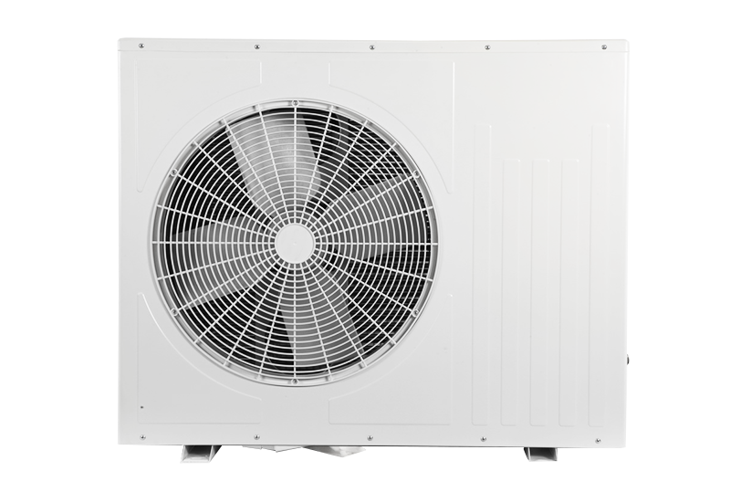
Heat pump coil
HEPA filter
Supply and recirculation fan section
Recirculation air inlet
Heat pump outer block
Extract air inlet
Extract filter
Bypass
Supply filter
Intake air inlet
Exhaust fan

Slide 5
Treated air, according to temperature settings
Mild season operation
Heating
Treated air, 19°C
Return air, 22°C
Supply air, 16°C
Extract air, 22°C
Intake air, 0°C

Slide 6
Treated air, according to temperature settings
Cold season operation
Heating
Treated air, 17°C
Return air, 20°C
Supply air, 12°C
Extract air, 20°C
Intake air, -10°C

Slide 7
Treated air, according to temperature settings
Hot season operation
Cooling
Treated air, 24°C
Return air, 22°C
Supply air, 24°C
Extract air, 22°C
Intake air, 35°C

Slide 8

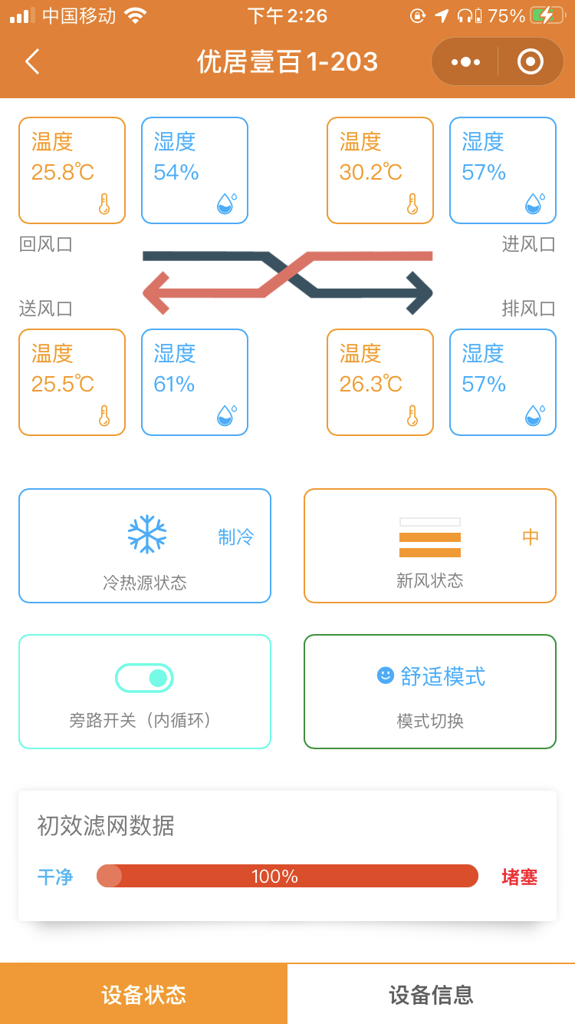
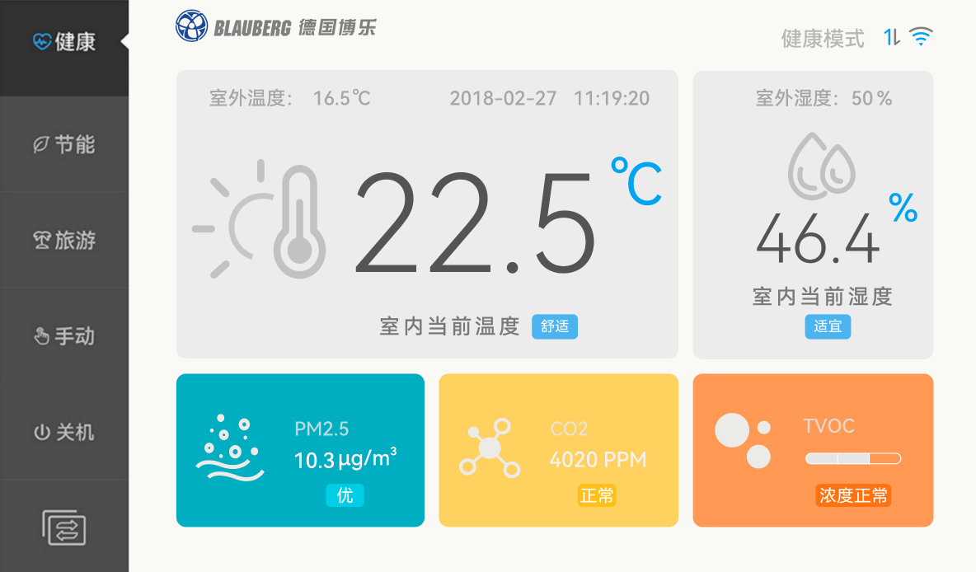
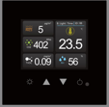
Controls & automation
Main advanced control panel
Mobile App
Cloud server
iAQ control
Zoning
Control Panel
iAQ Sensor
Mobile App

Slide 9
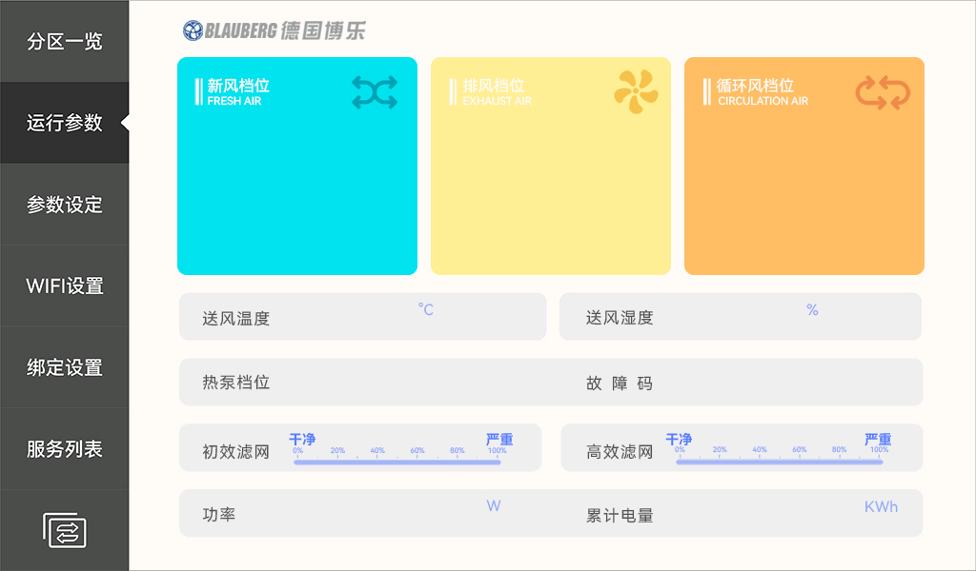
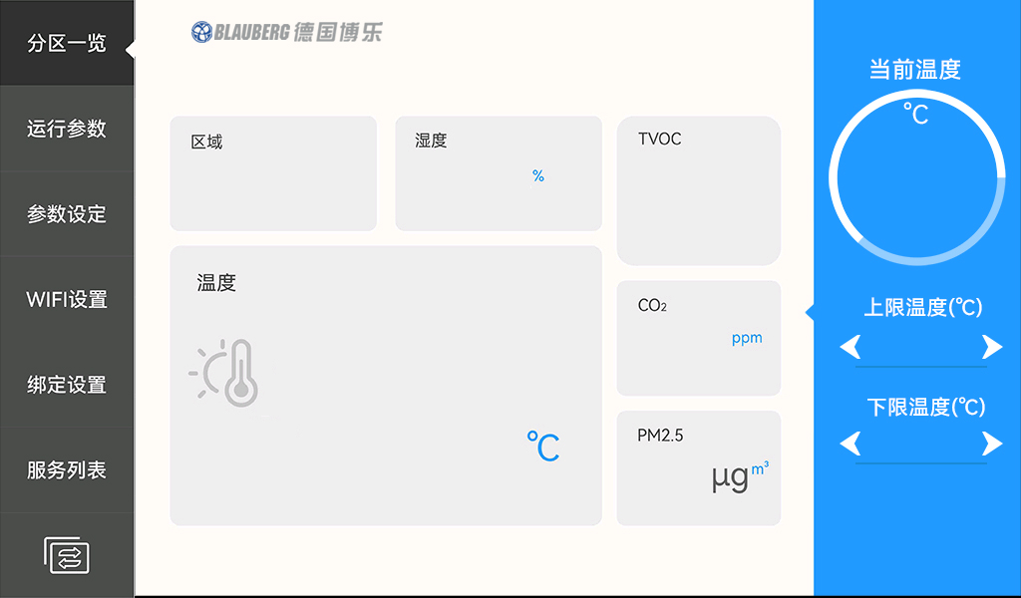
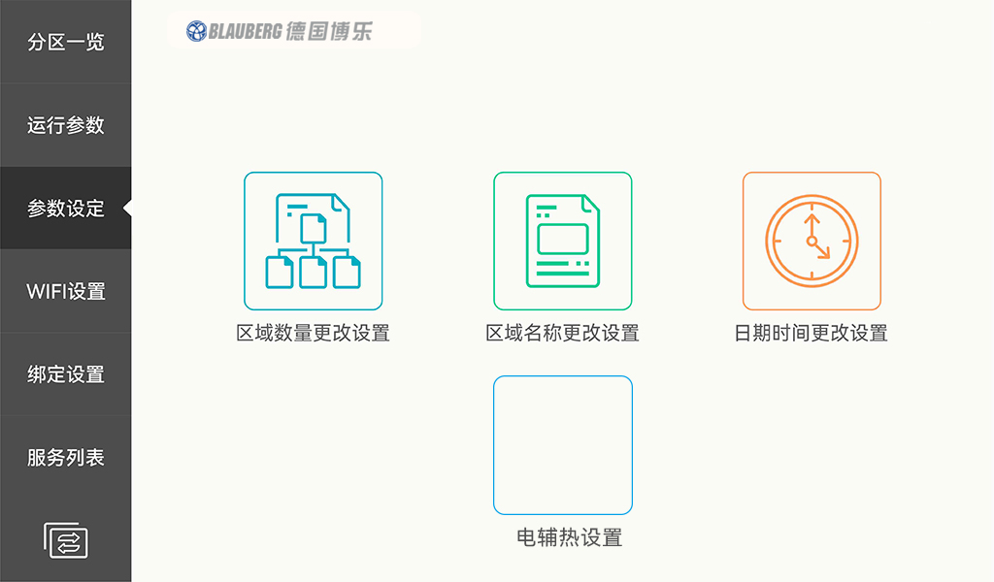
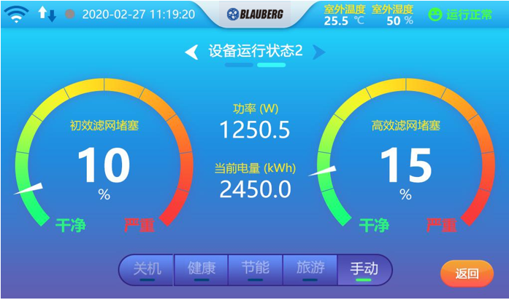
Control panel
Main screen, iAQ status
Airflow control
iAQ settings
Airflow control
Energy management

Slide 10
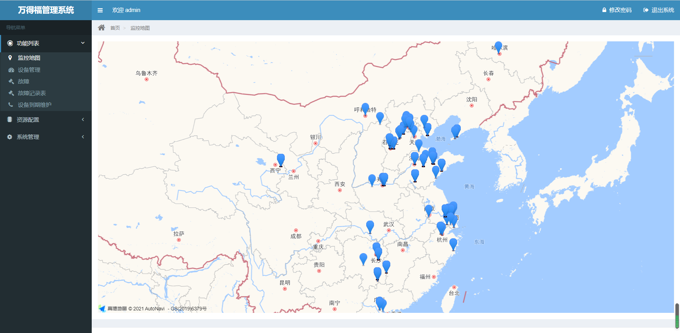
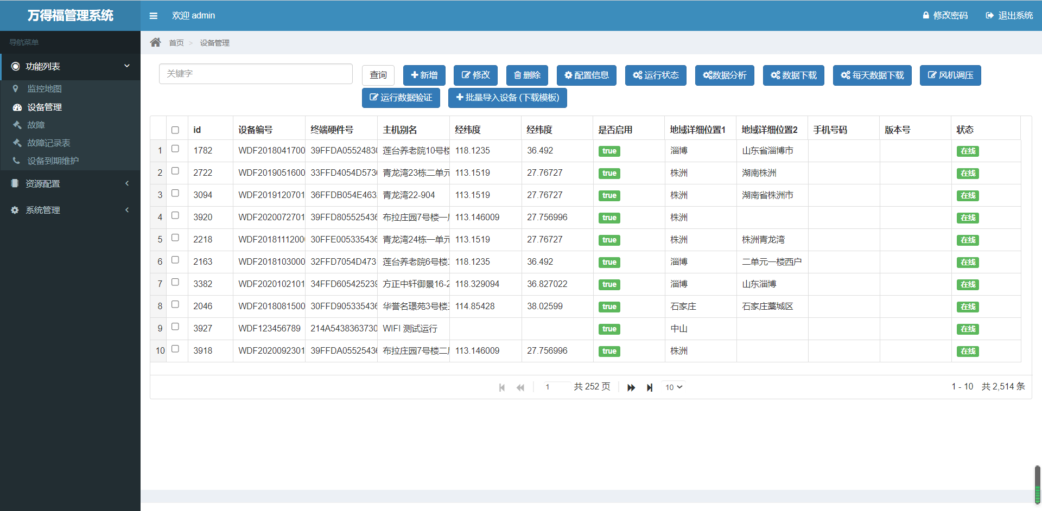
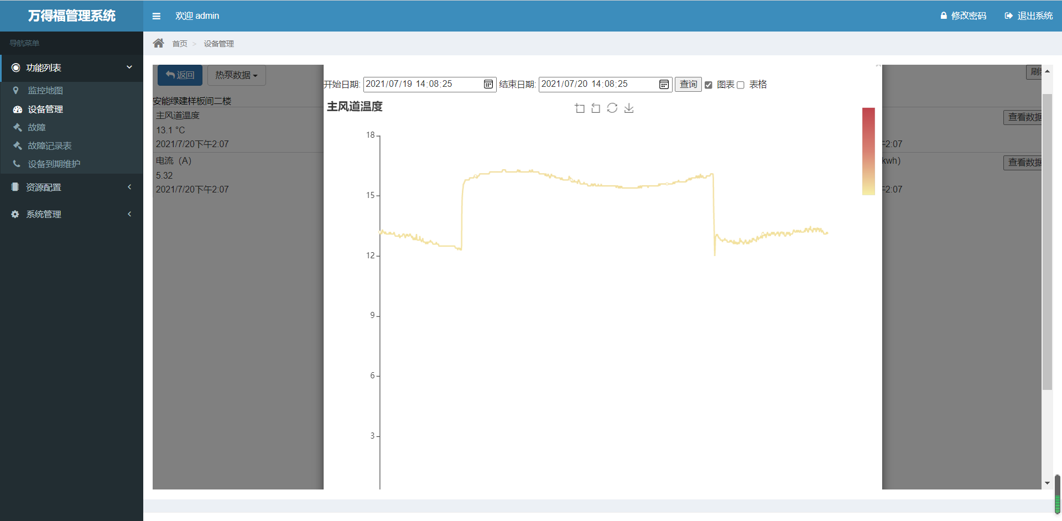
Mobile app & cloud server
Mobile application for the end-user
PC tool for unit troubleshooting
iAQ status archive
Unit location (if needed)

Slide 11

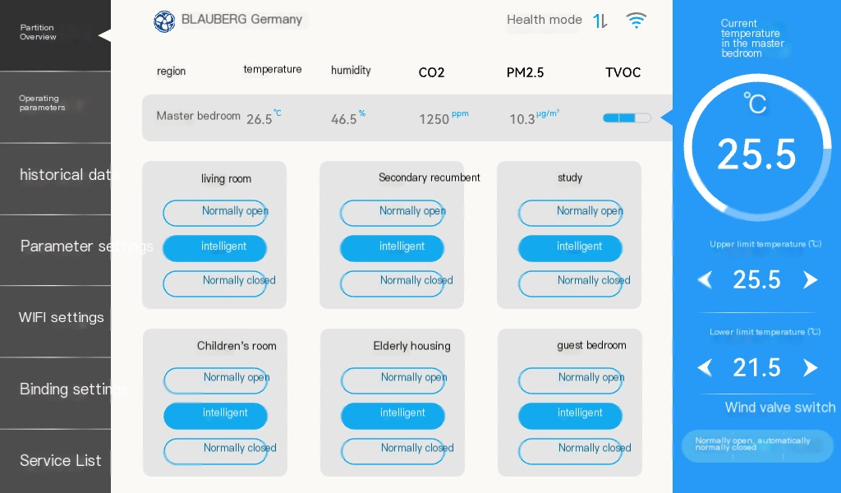
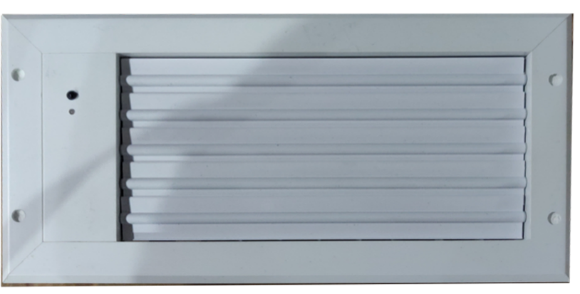
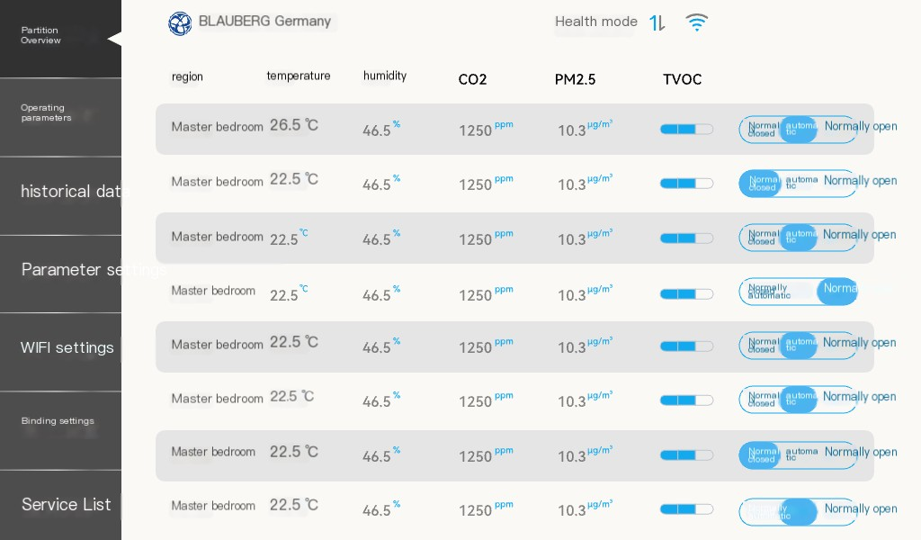
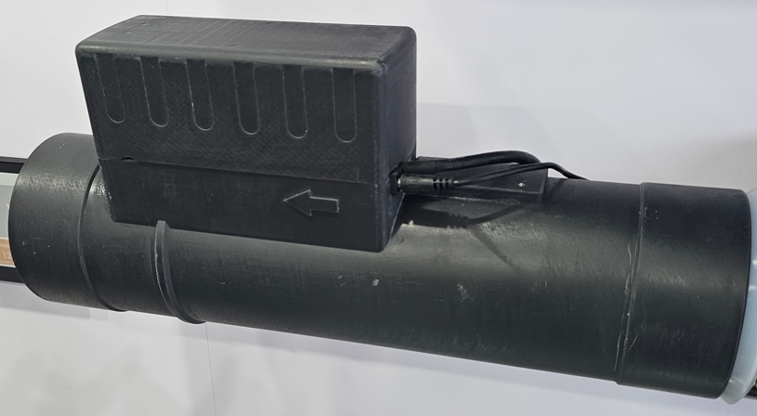
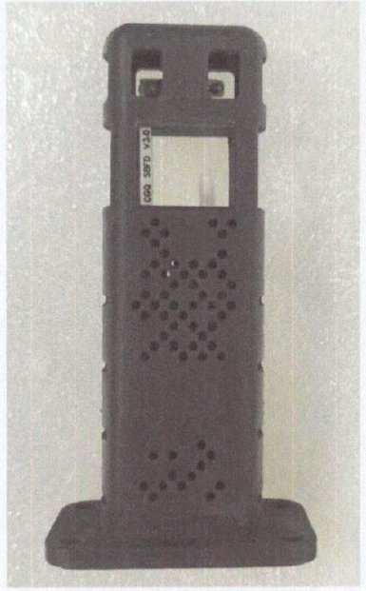
Zoning and iAQ control
Airflow control in the unit
iAQ all-in-one sensor
Zoning valve with airflow control and unit connection
Airflow and temperature sensor

Slide 12
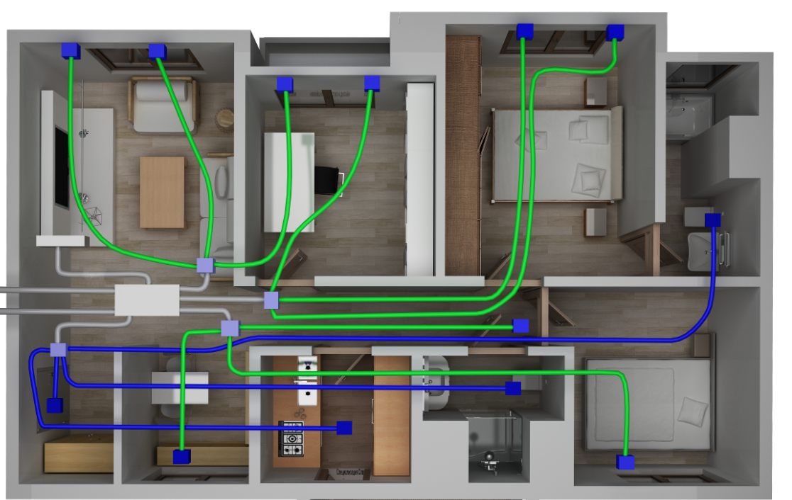
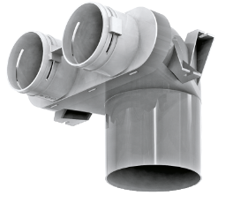
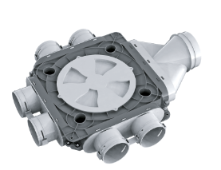
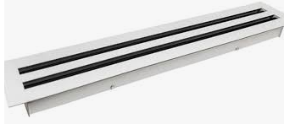
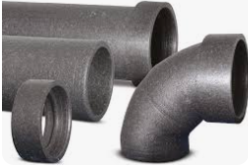
European suggested BlauWind solution
2
2
2
2
1
BlauWind unit
2
2
2
BlauFast valve connectors
5
5
5
5
5
2
3
BlauFast air distribution box
4
3
Slot diffuser for recirculation air
6
1
6
3
4
2
5
3
5
BlauFast air ducts
3
5
5
2
2
5
6
Insulated ducts, foil or EPP
2
2
2

Slide 13
European suggested BlauWind solution
2
2
2
2
Unit price ~ EUR 3400
Components price ~ EUR 1100
Mounting price ~ EUR 1500 – 2500
Overall project price ~ EUR 6500
2
2
5
5
5
5
5
2
6
1
6
3
3
5
3
5
3
5
2
2
5
2
2
2

Slide 14
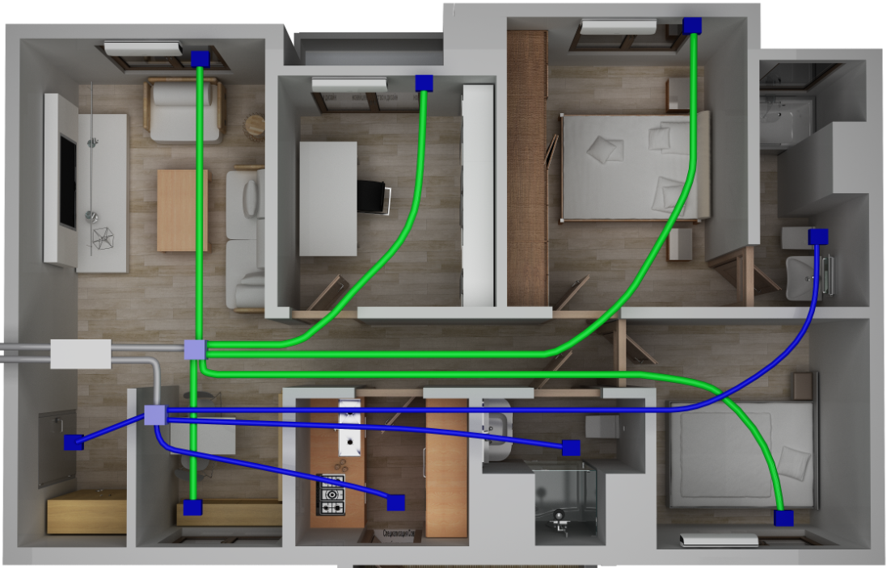
European basic solution with splits
4
2
4
2
4
2
1
AHU
2
BlauFast valve connectors
2
3
BlauFast air distribution box
3
Split system AC
6
1
6
5
4
3
5
5
BlauFast air ducts
2
2
6
Insulated ducts, foil or EPP
2
2
2
4

Slide 15
European basic solution with splits
Unit price ~ EUR 2000
Components price ~ EUR 500
Mounting price ~ EUR 1500
AC price ~ EUR 1750
AC mounting ~ EUR 1800
Overall project price ~ EUR 7250

Slide 16
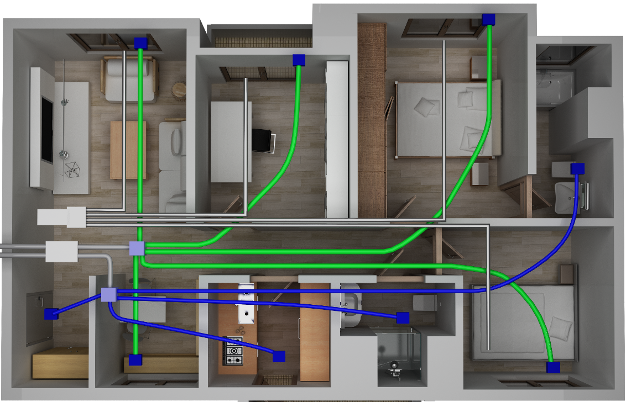
European basic solution with ducted AC
2
2
2
1
AHU
2
BlauFast valve connectors
2
3
BlauFast air distribution box
4
3
Ducted AC
6
1
6
5
4
3
5
5
BlauFast air ducts
2
2
6
Insulated ducts, foil or EPP
2
2
2

Slide 17
European basic solution with ducted AC
Unit price ~ EUR 2000
Components price ~ EUR 500
Mounting price ~ EUR 1500
AC price ~ EUR 2275
AC mounting ~ EUR 1700
Overall project price ~ EUR 8000

Slide 18
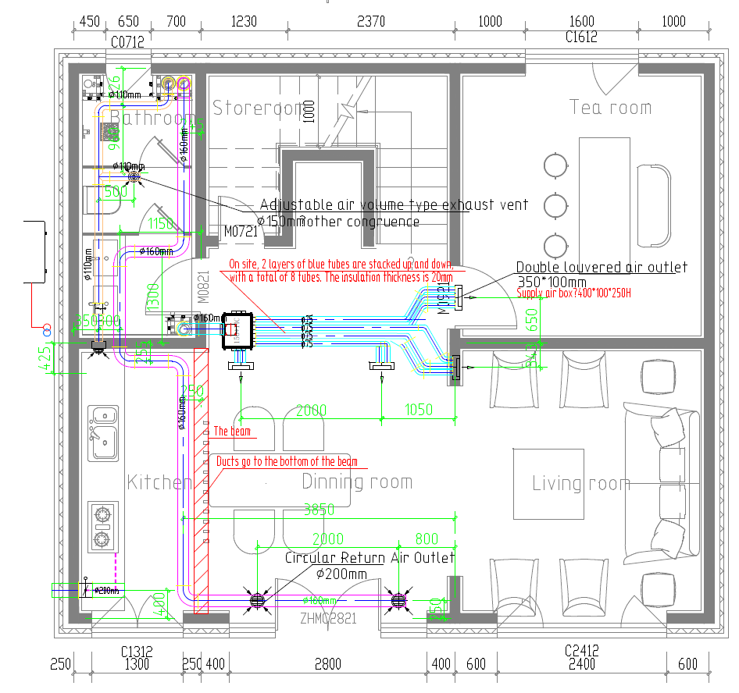
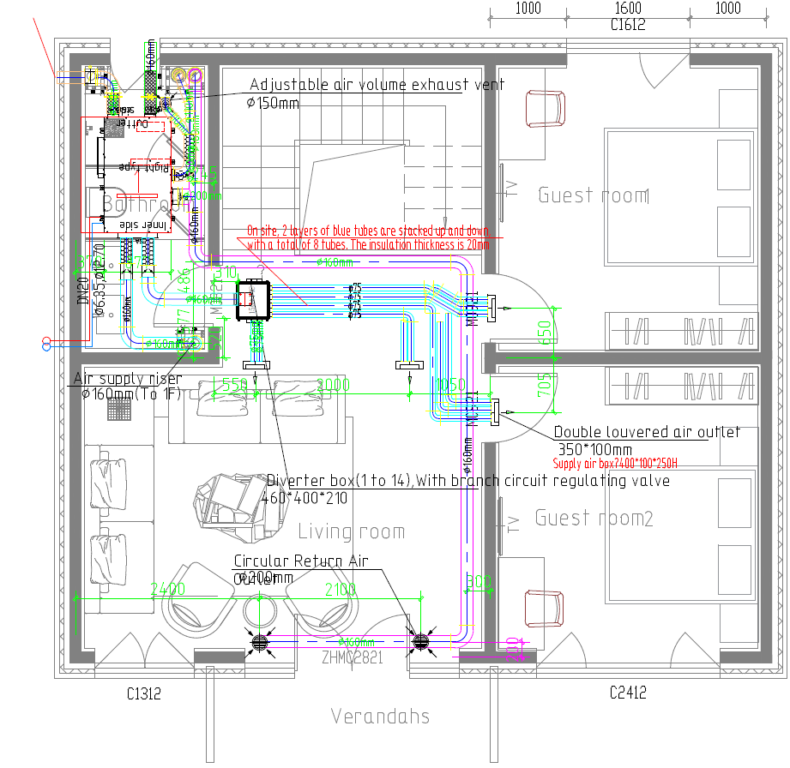
Real case
1st floor
2nd floor

Slide 19



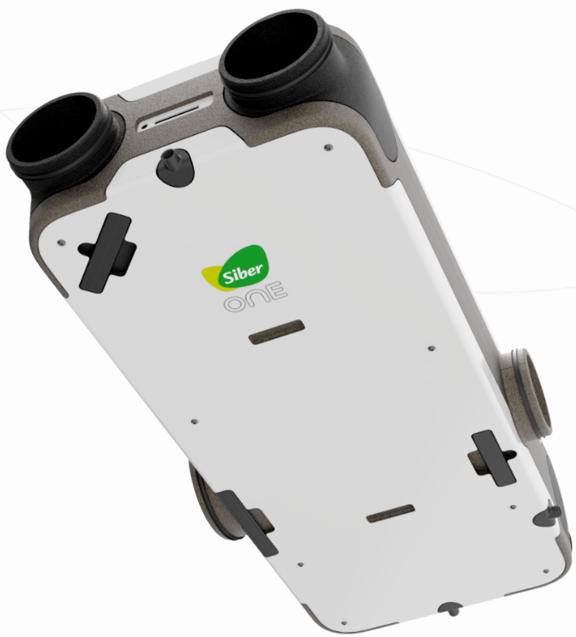
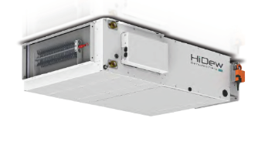
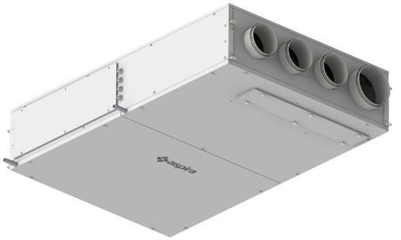
Competitors

Slide 20
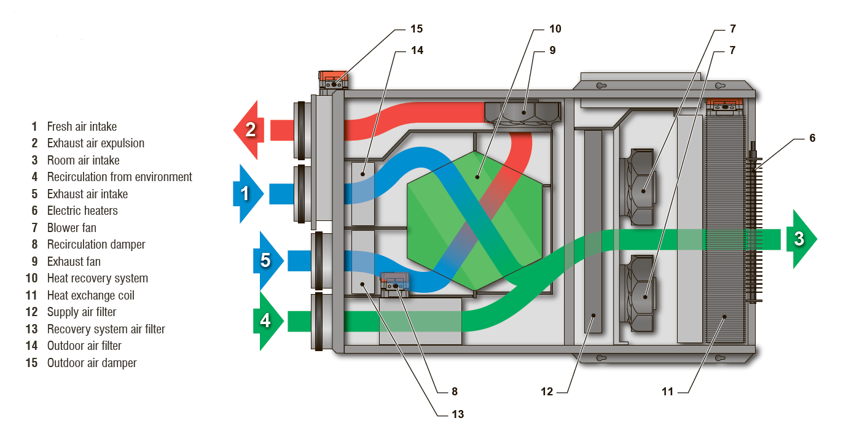
Competitors

Slide 21
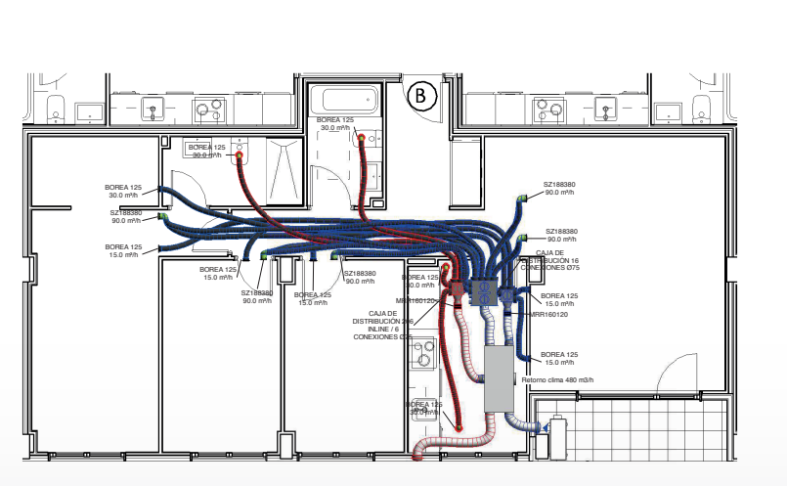
Competitors Solution

Slide 22
Competitors Solution
 | EU Solution | BlauWind
EU Ventilation norms compliance | Yes | Yes
Fully-autonomous solution | No | Yes
Zoning solution | No | Yes
Advanced controls | No | Yes
Energy management | No | Yes

Slide 23

Thank You!
blauberg-group.com
2023

