Slide 1


Heat recovery units. Reneo range.
2023

Slide 2

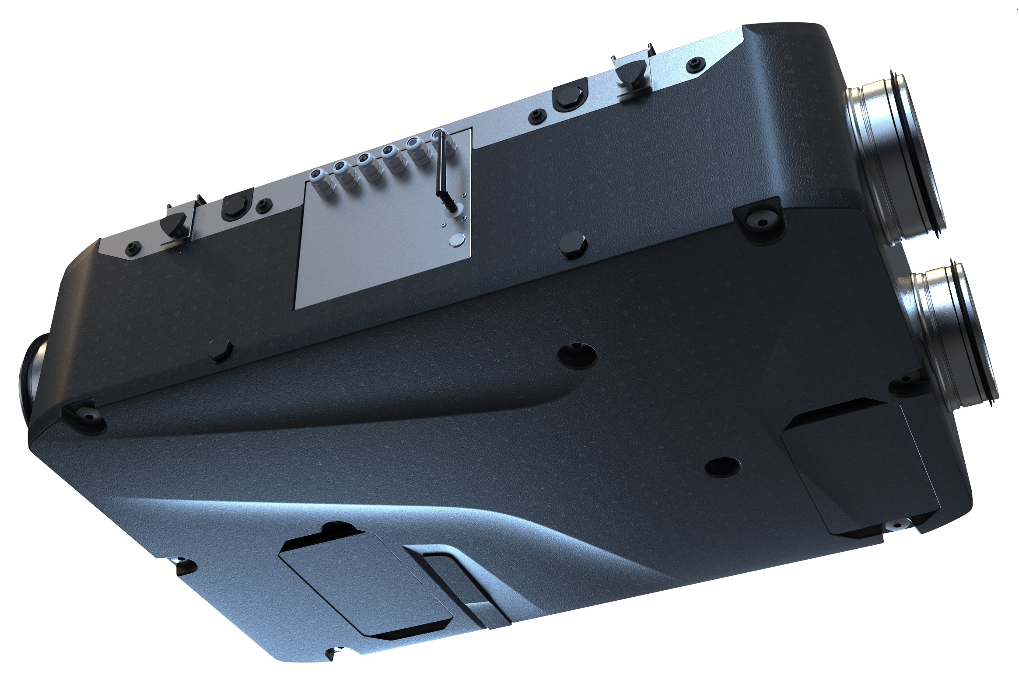
Reneo D 180
Max Air Flow – 181 m3/h
Sound pressure level, 3m (ref. point) – 29 dB(A)
Max. power – 53 W
Recovery efficiency up to 91 %
Enthalpy modification available (D 180-E units)
S14 / S21 Control system
blauberg-group.com

Slide 3
Reneo D 240
Max Air Flow – 310 m3/h
Sound pressure level, 3m (ref. point) – 33 dB(A)
Max. power – 171 W
Recovery efficiency up to 91 %
Enthalpy modification available (D 180-E units)
S14/S21 Control system
blauberg-group.com

Slide 4
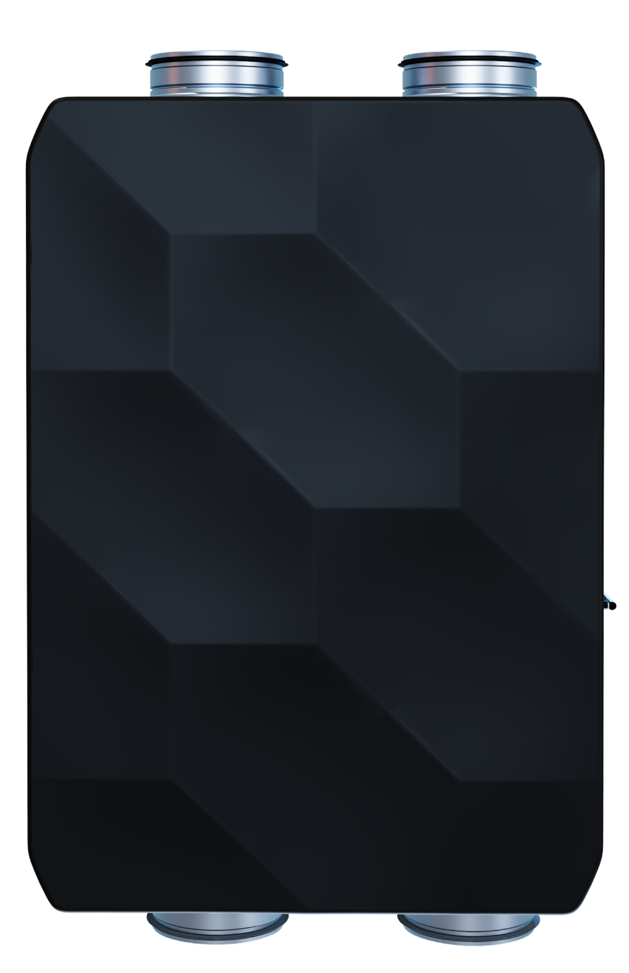
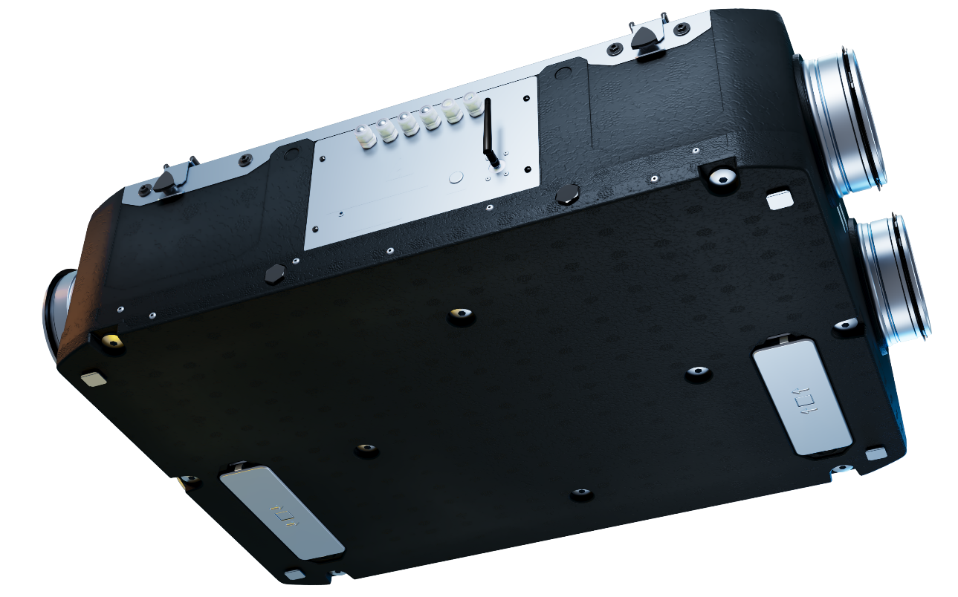
Reneo D 181 / 241
Units with flat front panel, suitable for mounting of decorative panel.
blauberg-group.com

Slide 5


EP-Reneo D 181
Decorative panels for Reneo D 181 and 241, different colors could be available.
blauberg-group.com

Slide 6
Technical parameters. Airflow.
blauberg-group.com

Slide 7
Technical parameters. Noise level.
Reneo D 180
Reference point, 70 % 50 Pa
Sound Power level, A-weighted dB(A) |  | 49
Sound pressure level, 1m, dB(A) |  | 38
Sound pressure level, 3m, dB(A) |  | 29
Max Speed, 100 % 0 Pa
Sound Power level, A-weighted dB(A) |  | 58
Sound pressure level, 1m, dB(A) |  | 47
Sound pressure level, 3m, dB(A) |  | 37
blauberg-group.com

Slide 8
Technical parameters. Noise level.
Reneo D 240
Reference point, 70 % 50 Pa
Sound Power level, A-weighted dB(A) |  | 53
Sound pressure level, 1m, dB(A) |  | 42
Sound pressure level, 3m, dB(A) |  | 33
Max Speed, 100 % 0 Pa
Sound Power level, A-weighted dB(A) |  | 61
Sound pressure level, 1m, dB(A) |  | 50
Sound pressure level, 3m, dB(A) |  | 40
blauberg-group.com

Slide 9
Thermal efficiency.
Reneo D 180
Reneo D 180-E
 |  |  | MIN Speed | MED Speed | MAX Speed
Thermal efficiency, according to EN 13141-7 |  |  | 91% | 87% | 85%
 |  |  | MIN Speed | MED Speed | MAX Speed
Thermal efficiency, according to EN 13141-7 |  |  | 84% | 77% | 72%
Humidity recovery efficiency |  |  | 59% | 53% | 48%
blauberg-group.com

Slide 10
Thermal efficiency.
Molded casing tested. Final parameters
Reneo D 240
Reneo D 240-E
 |  |  | MIN Speed | MED Speed | MAX Speed
Thermal efficiency, according to EN 13141-7 |  |  | 91% | 84% | 82%
 |  |  | MIN Speed | MED Speed | MAX Speed
Thermal efficiency, according to EN 13141-7 |  |  | 80% | 69% | 60%
Humidity recovery efficiency |  |  | 57% | 45% | 37%
blauberg-group.com

Slide 11
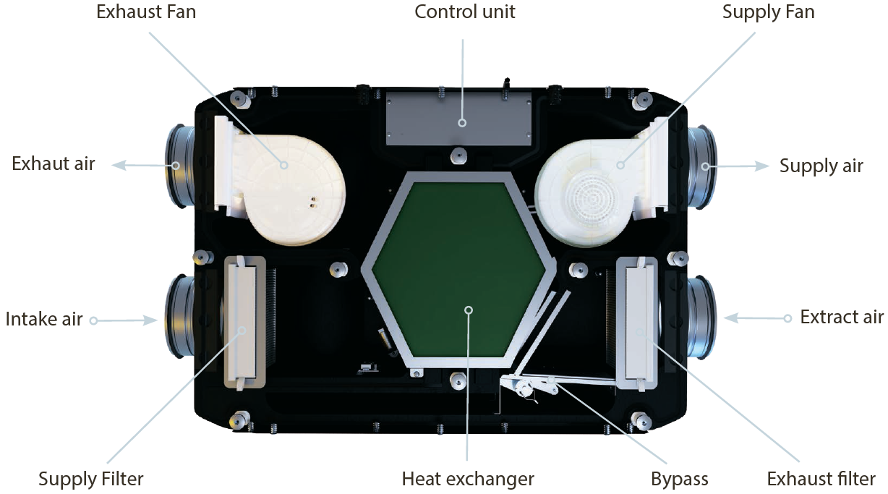
Construction
blauberg-group.com

Slide 12
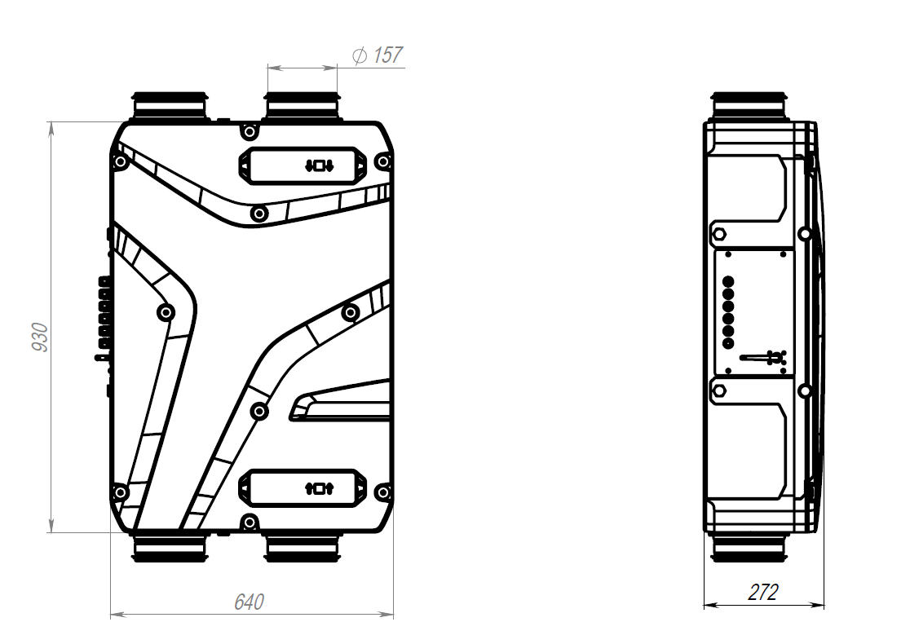
Dimensions.
blauberg-group.com

Slide 13
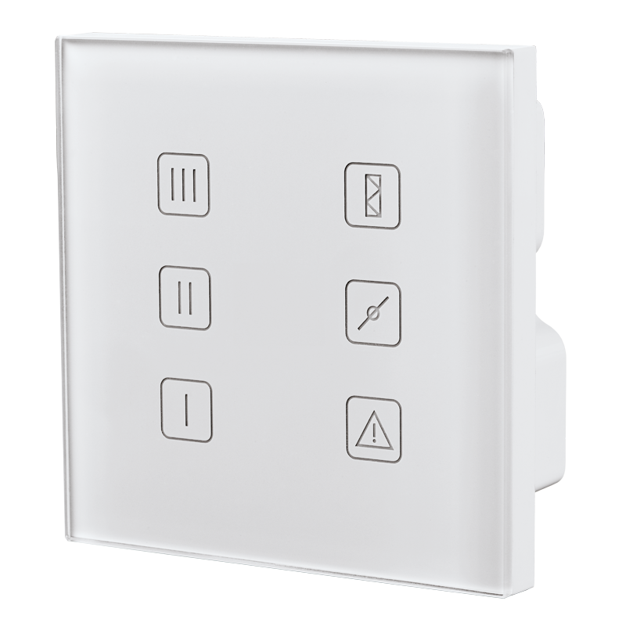
S14 control system
Speed selection
Filter replacement indication
Manual by-pass
Optional humidity control (via additional sensor)
Optional CO2 control (via additional sensor)
Fire alarm sensor connection
Glass Control Panel
blauberg-group.com

Slide 14
S21. Advanced Control System.

Slide 15
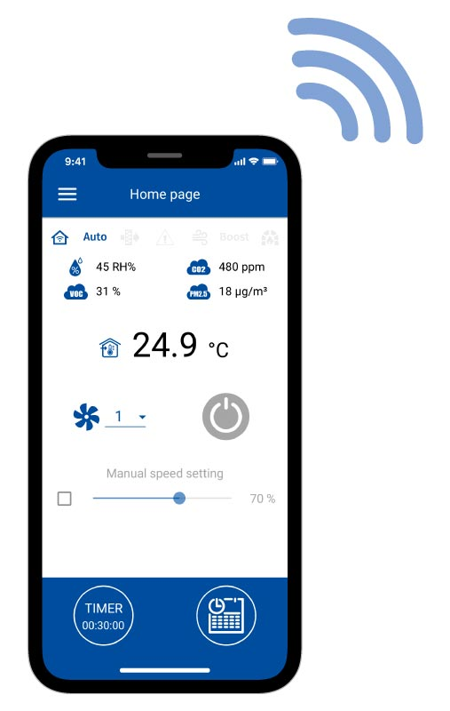
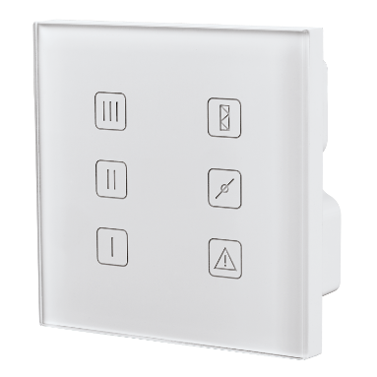
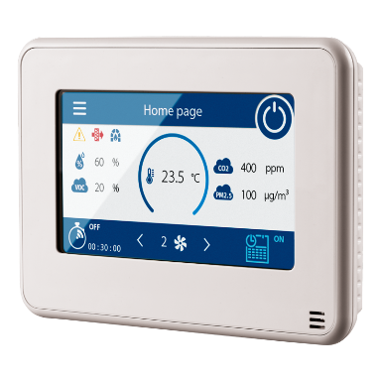
S21. Control Interfaces.
Smartphone application
Glass panels S22 / S22 Wifi
Sensor display S25

Slide 16
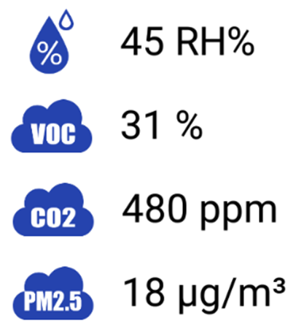
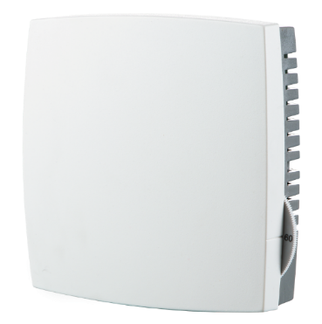
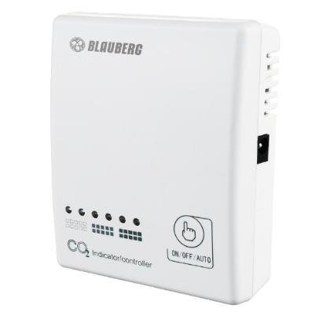
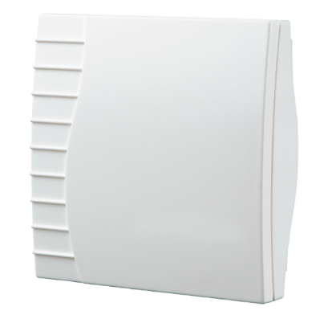
S21. Air quality control.
Temperature sensor in S25 panel
Humidistat HR-S
CO₂ sensor CD-1
VOC sensor

Slide 17
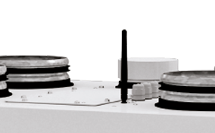
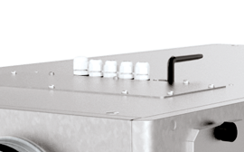
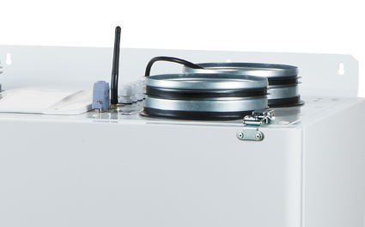
S21. Connections and utility.
Internet connection via LAN or Wi-Fi
BMS connection via RS-485, Wi-Fi or LAN
Communication protocol – ModBus
Reheater, pre-heater and cooler connection
Condensing unit connection
Connection to Blauberg Cloud Server
All connections are pre-installed, no additional connectors are needed.

Slide 18
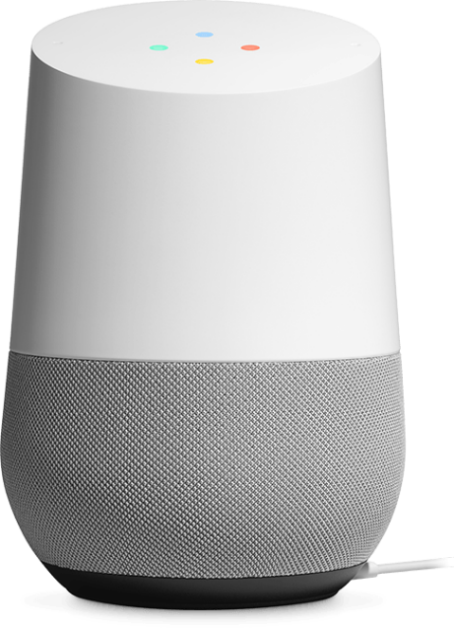


Slide 19
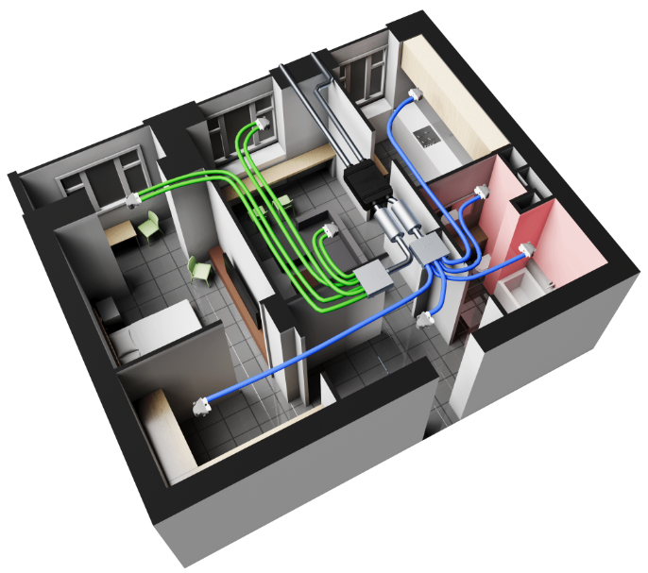
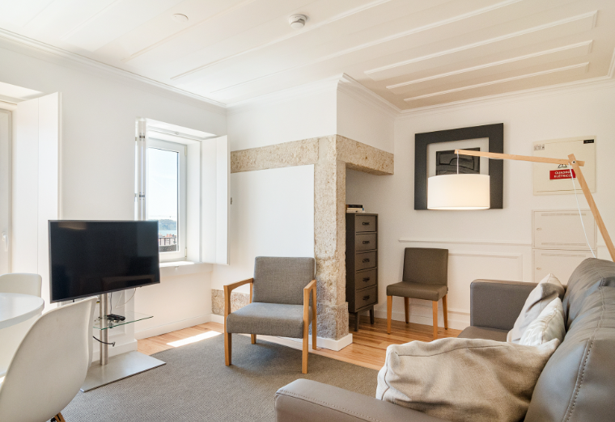
Range of application
Apartments
blauberg-group.com

Slide 20
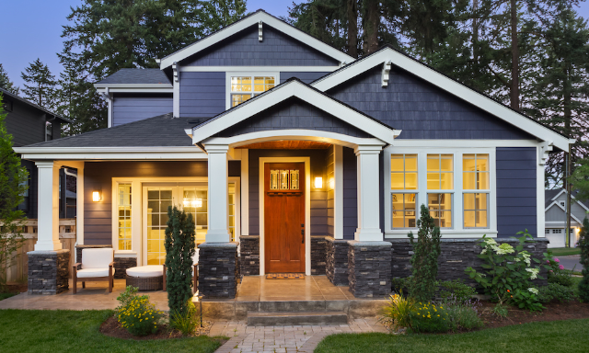

Range of application
Single-family houses
Apartments
Cottages
blauberg-group.com

Slide 21

blauberg-group.com
2022
Notes:
Dear colleagues, thank you very much for your attention, please send your enquires to our sales department, visit our stand on ISH, for more information about our assortment, solutions and selection software, please, visit our web-site. Good bye and see you soon.

