Slide 1


HRV & ERV units. Reneo range.
2023

Slide 2

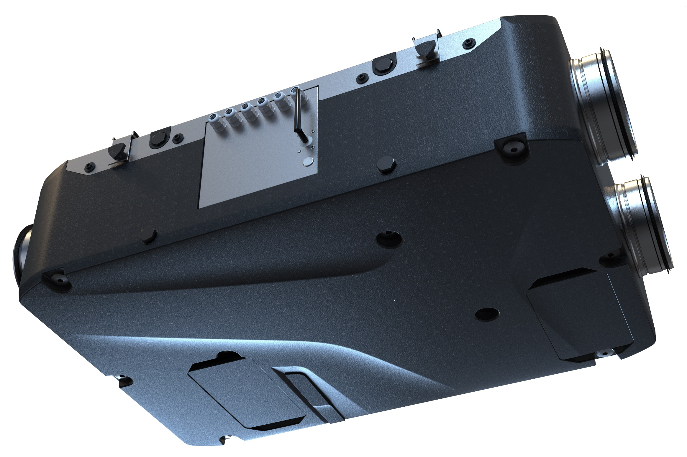
Reneo D 180-E
EC-motors
Counterflow heat exchanger
Airflow – 93 CFM / 0,4 i.w.g.
SRE (32 F) – 78 %
SRE (-13 F) – 66 %
Fan defrost
HRV modification available
Control system
blauberg-group.com

Slide 3
Reneo D 240-E
EC-motors
Counterflow heat exchanger
Airflow – 170 CFM / 0,4 i.w.g.
SRE (32 F) – 77 %
SRE (-13 F) – 65 %
Fan defrost
HRV modification available
Control system
blauberg-group.com

Slide 4
Technical parameters. Airflow.
Reneo D 180-E
Reneo D 240-E
blauberg-group.com

Slide 5
Thermal efficiency.
Reneo D 180-E
 |  | Supply |  | Net |  | Average |  | Sensible |  | Apparent |  | Net
 |  | Temperature |  | Airflow |  | Power |  | Recovery |  | Sensible |  | Moisture
 |  | °C | °F | L/s | cfm | (Watts) |  | Efficiency |  | Effectiveness |  | Transfer
HEATING | I | 0 | 32 | 33 | 70 | 53 |  | 78 |  | 84 |  | 0,56
 | II | 0 | 32 | 40 | 85 | 54 |  | 76 |  | 81 |  | 0,54
 | III | 0 | 32 | 44 | 93 | 54 |  | 75 |  | 80 |  | 0,52
 | IV | -25 | -13 | 33 | 70 | 53 |  | 66 |  | 71 |  | 0,57
COOLING | V | 35 | 95 | 33 | 70 | 53 |  | 65** |  | 70 |  | 0,56
Reneo 180 D
 |  | Supply |  | Net |  | Average |  | Sensible |  | Apparent |  | Net
 |  | Temperature |  | Airflow |  | Power |  | Recovery |  | Sensible |  | Moisture
 |  | °C | °F | L/s | cfm | (Watts) |  | Efficiency |  | Effectiveness |  | Transfer
HEATING | I | 0 | 32 | 33 | 70 | 53 |  | 90 |  | 96 |  | 0,00
 | II | 0 | 32 | 40 | 85 | 54 |  | 89 |  | 95 |  | 0,00
 | III | 0 | 32 | 44 | 93 | 54 |  | 88 |  | 94 |  | 0,00
 | V | -25 | -13 | 33 | 70 | 53 |  | 78 |  | 83 |  | 0,00
COOLING | V | 35 | 95 | 33 | 70 | 53 |  | 89** |  | 95 |  | 0,00
blauberg-group.com

Slide 6
Thermal efficiency.
Molded casing tested. Final parameters
Reneo D 240-E
 |  | Supply |  | Net |  | Average |  | Sensible |  | Apparent |  | Net
 |  | Temperature |  | Airflow |  | Power |  | Recovery |  | Sensible |  | Moisture
 |  | °C | °F | L/s | cfm | (Watts) |  | Efficiency |  | Effectiveness |  | Transfer
HEATING | I | 0 | 32 | 36 | 76 | 168 |  | 77 |  | 82 |  | 0,54
 | II | 0 | 32 | 46 | 97 | 168 |  | 74 |  | 79 |  | 0,51
 | III | 0 | 32 | 54 | 116 | 168 |  | 71 |  | 76 |  | 0,48
 | IV | -25 | -13 | 36 | 76 | 168 |  | 65 |  | 70 |  | 0,55
COOLING | V | 35 | 95 | 36 | 76 | 168 |  | 64** |  | 68 |  | 0,53
Reneo D 240
 |  | Supply |  | Net |  | Average |  | Sensible |  | Apparent |  | Net
 |  | Temperature |  | Airflow |  | Power |  | Recovery |  | Sensible |  | Moisture
 |  | °C | °F | L/s | cfm | (Watts) |  | Efficiency |  | Effectiveness |  | Transfer
HEATING | I | 0 | 32 | 36 | 76 | 168 |  | 90 |  | 96 |  | 0,00
 | II | 0 | 32 | 46 | 97 | 168 |  | 88 |  | 95 |  | 0,00
 | III | 0 | 32 | 54 | 116 | 168 |  | 88 |  | 94 |  | 0,00
 | V | -25 | -13 | 36 | 76 | 168 |  | 77 |  | 84 |  | 0,00
COOLING | V | 35 | 95 | 36 | 76 | 168 |  | 89** |  | 95 |  | 0,00
blauberg-group.com

Slide 7
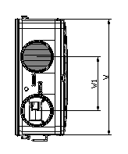
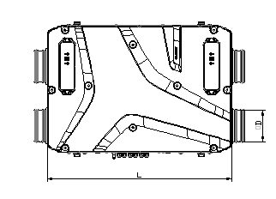
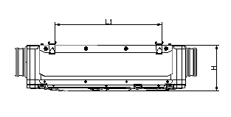
Dimensions.
Model | W |  | W1 |  | L |  | L1 |  | H |  | ØD
 | in | mm | in | mm | in | mm | in | mm | in | mm | in | mm
Reneo D180(-E) | 25 1/5 | 640 | 11 8/9 | 300 | 36 2/3 | 930 | 24 3/5 | 627 | 10 7/9 | 272 | 6 | 160
Reneo D240(-E) | 25 1/5 | 640 | 11 8/9 | 300 | 36 2/3 | 930 | 24 3/5 | 627 | 10 7/9 | 272 | 6 | 160
blauberg-group.com

Slide 8
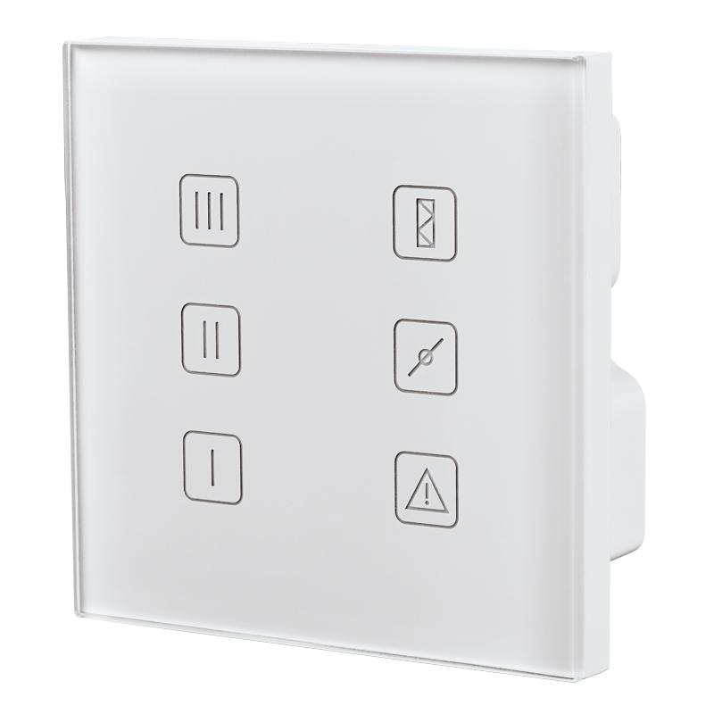
Control system
Speed selection
Filter replacement indication
Manual by-pass
Optional humidity control (via additional sensor)
Optional CO2 control (via additional sensor)
Fire alarm sensor connection
Glass Control Panel
blauberg-group.com

Slide 9
Advanced Control System.

Slide 10
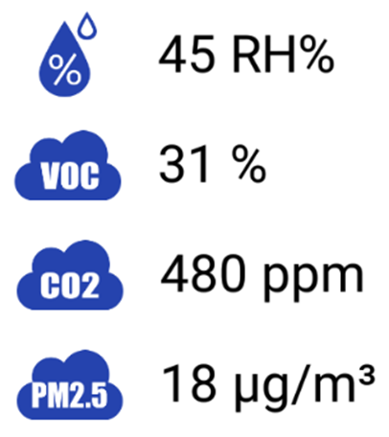
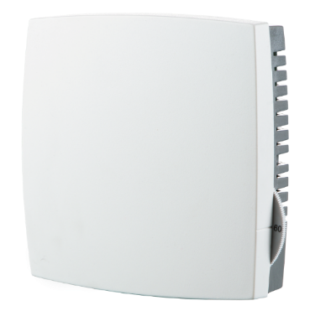
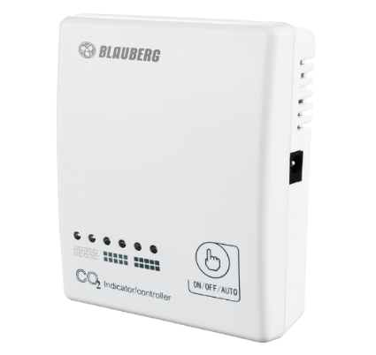
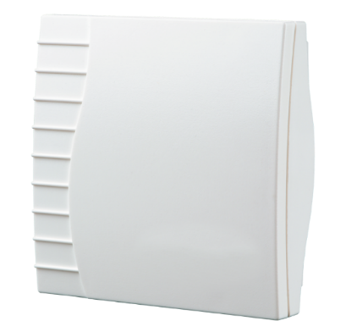
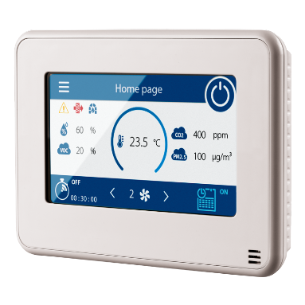
Air quality control.
Temperature sensor in S25 panel
Humidistat HR-S
CO₂ sensor CD-1
VOC sensor

Slide 11
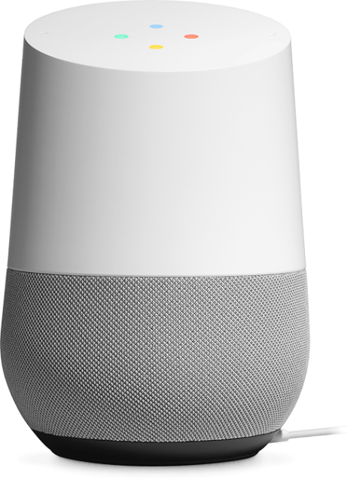


Slide 12
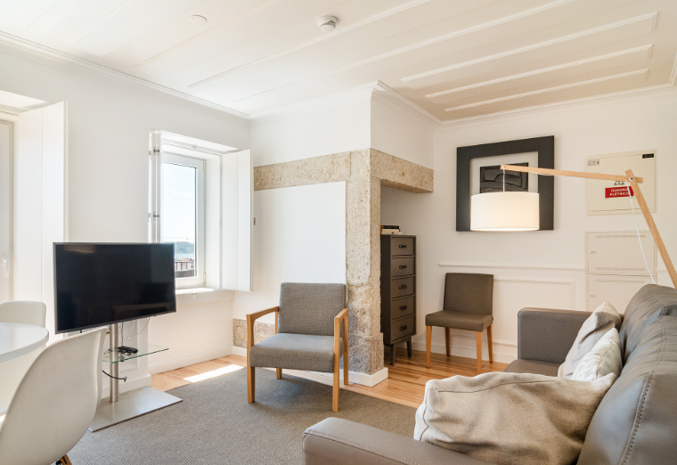


Range of application
Single-family houses
Apartments
Cottages
blauberg-group.com

Slide 13

blauberg-group.com
2023
Notes:
Dear colleagues, thank you very much for your attention, please send your enquires to our sales department, visit our stand on ISH, for more information about our assortment, solutions and selection software, please, visit our web-site. Good bye and see you soon.

