Slide 1


Heat recovery units. Reneo range.
2023

Slide 2

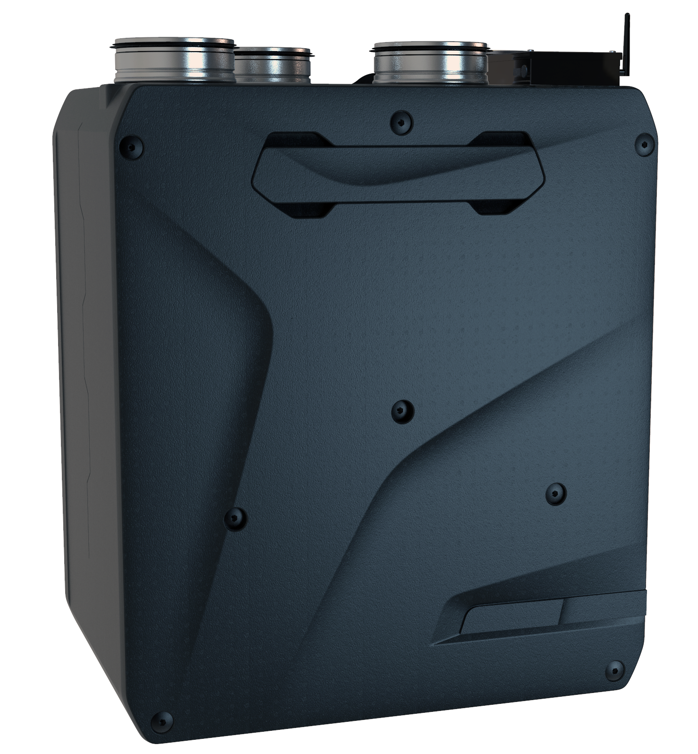
Reneo S 350
Max Air Flow – 410 m3/h
Sound pressure level, 3m (ref. point) – 26 dB(A)
Max. power – 213 W
SPI (ref. point) – 0,26 W/(m3/h)
Version with in-built electric pre-heater available
Recovery efficiency up to 92 %
Enthalpy modification available (S 350-E units)
S14 / S21 Control system
blauberg-group.com

Slide 3
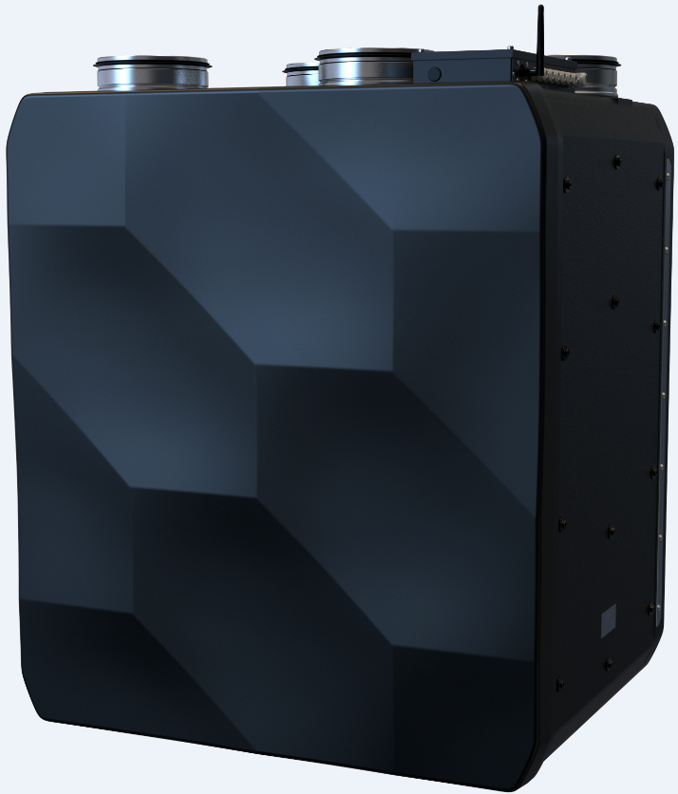
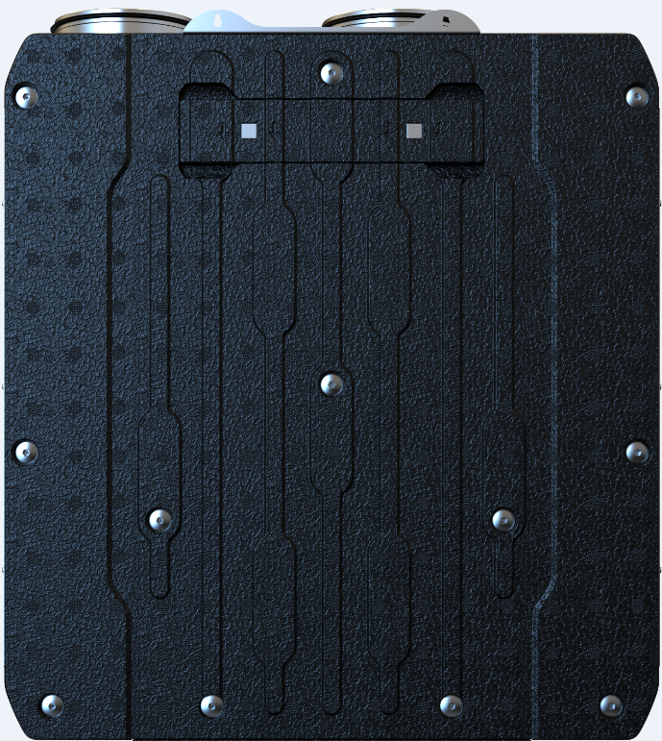
Reneo S 351
Units with flat front panel, suitable for mounting of decorative panel.
blauberg-group.com

Slide 4


EP-Reneo S 351
Units with flat front panel, suitable for mounting of decorative panel.
blauberg-group.com

Slide 5
Technical parameters. Airflow.
blauberg-group.com

Slide 6
Technical parameters. Noise level.
Reneo S 350
Reference point, 70 % 50 Pa
Sound Power level, A-weighted dB(A) |  | 46
Sound pressure level, 1m, dB(A) |  | 35
Sound pressure level, 3m, dB(A) |  | 26
Max Speed, 100 % 0 Pa
Sound Power level, A-weighted dB(A) |  | 55
Sound pressure level, 1m, dB(A) |  | 45
Sound pressure level, 3m, dB(A) |  | 36
blauberg-group.com

Slide 7
Thermal efficiency.
Reneo S 350
Reneo S 350-E
 |  |  | MIN Speed | MED Speed | MAX Speed
Thermal efficiency, according to EN 13141-7 |  |  | 93% | 90% | 86%
 |  |  | MIN Speed | MED Speed | MAX Speed
Thermal efficiency, according to EN 13141-7 |  |  | 83% | 81% | 79%
Humidity recovery efficiency |  |  | 78% | 67% | 61%
blauberg-group.com

Slide 8
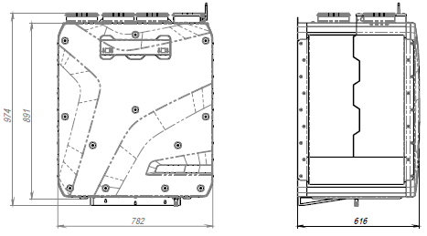
Dimensions.
blauberg-group.com

Slide 9
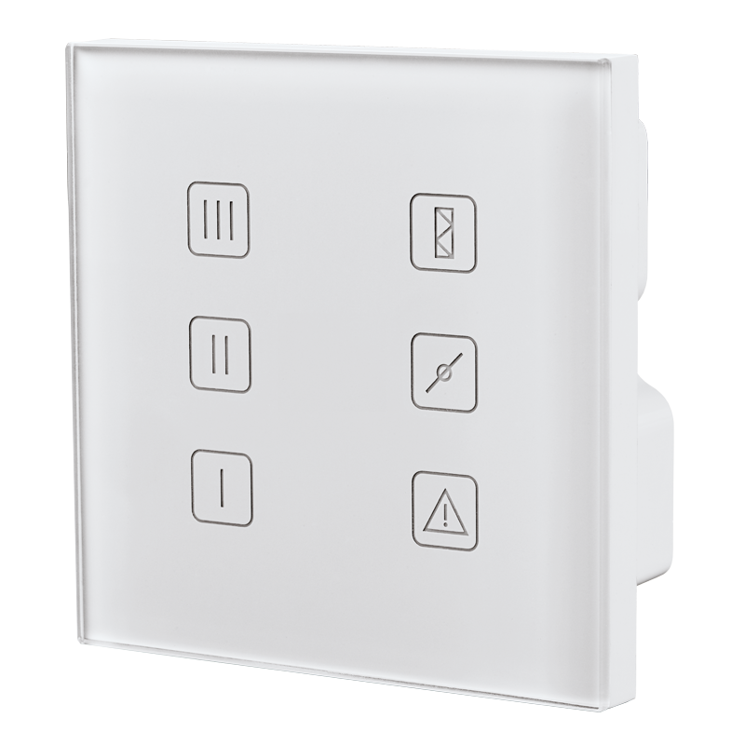
S14 control system
Speed selection
Filter replacement indication
Manual by-pass
Optional humidity control (via additional sensor)
Optional CO2 control (via additional sensor)
Fire alarm sensor connection
Glass Control Panel
blauberg-group.com

Slide 10
S21. Advanced Control System.

Slide 11
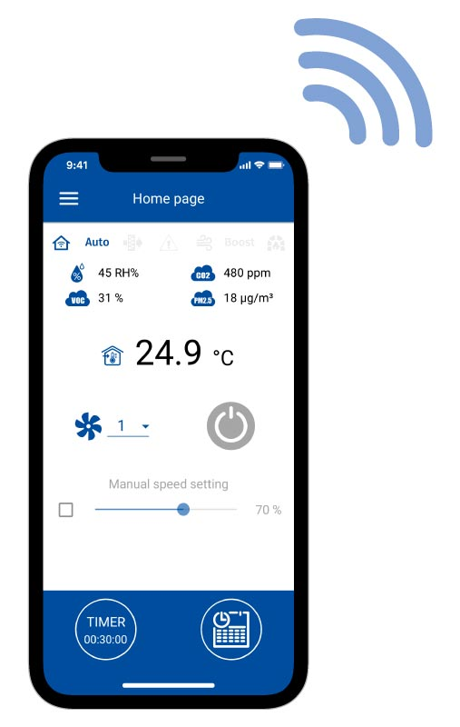
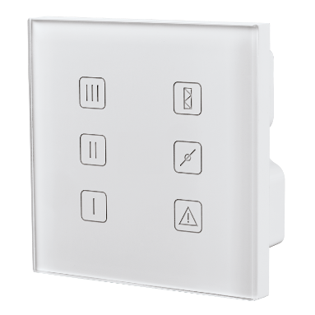
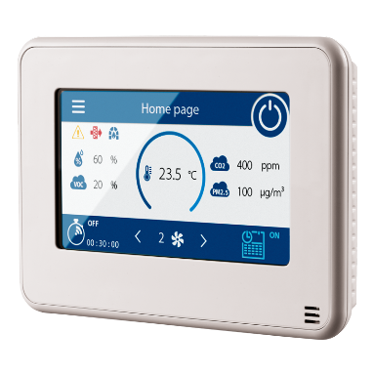
S21. Control Interfaces.
Smartphone application
Glass panels S22 / S22 Wifi
Sensor display S25

Slide 12
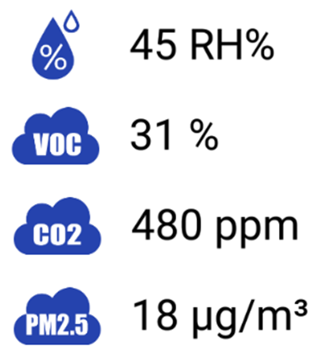
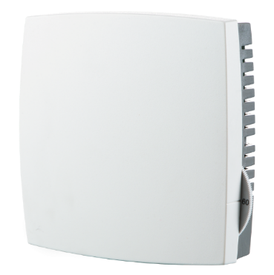
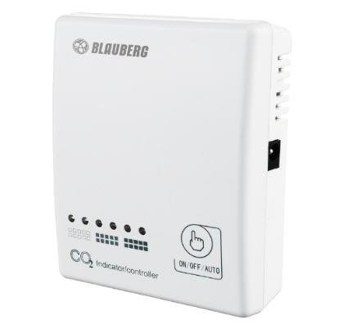
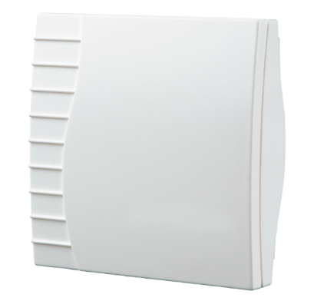
S21. Air quality control.
Temperature sensor in S25 panel
Humidistat HR-S
CO₂ sensor CD-1
VOC sensor

Slide 13
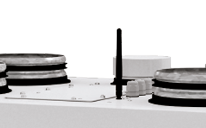
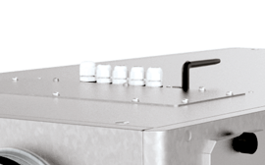
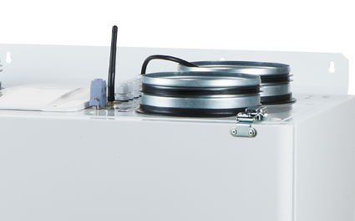
S21. Connections and utility.
Internet connection via LAN or Wi-Fi
BMS connection via RS-485, Wi-Fi or LAN
Communication protocol – ModBus
Reheater, pre-heater and cooler connection
Condensing unit connection
Connection to Blauberg Cloud Server
All connections are pre-installed, no additional connectors are needed.

Slide 14
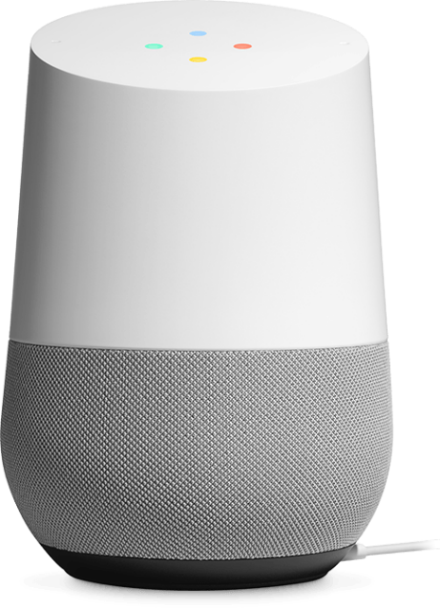


Slide 15
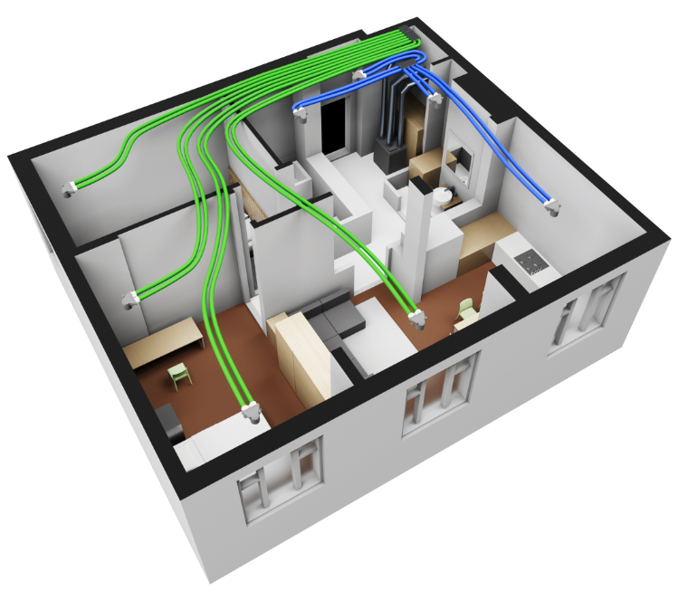
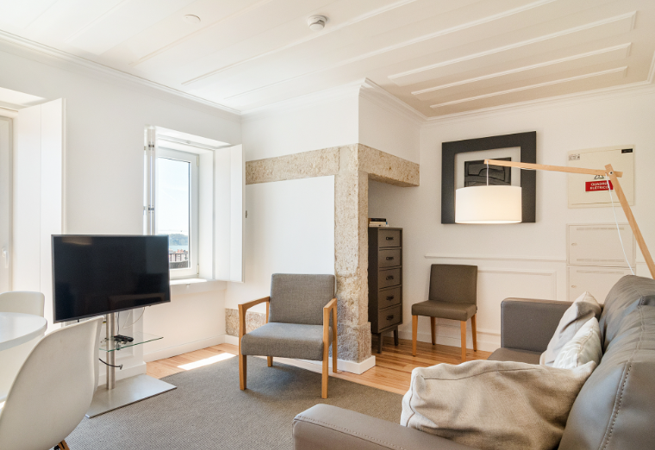
Range of application
Apartments
blauberg-group.com

Slide 16


Range of application
Single-family houses
Apartments
Cottages
blauberg-group.com

Slide 17

blauberg-group.com
2022
Notes:
Dear colleagues, thank you very much for your attention, please send your enquires to our sales department, visit our stand on ISH, for more information about our assortment, solutions and selection software, please, visit our web-site. Good bye and see you soon.

